Slide 1
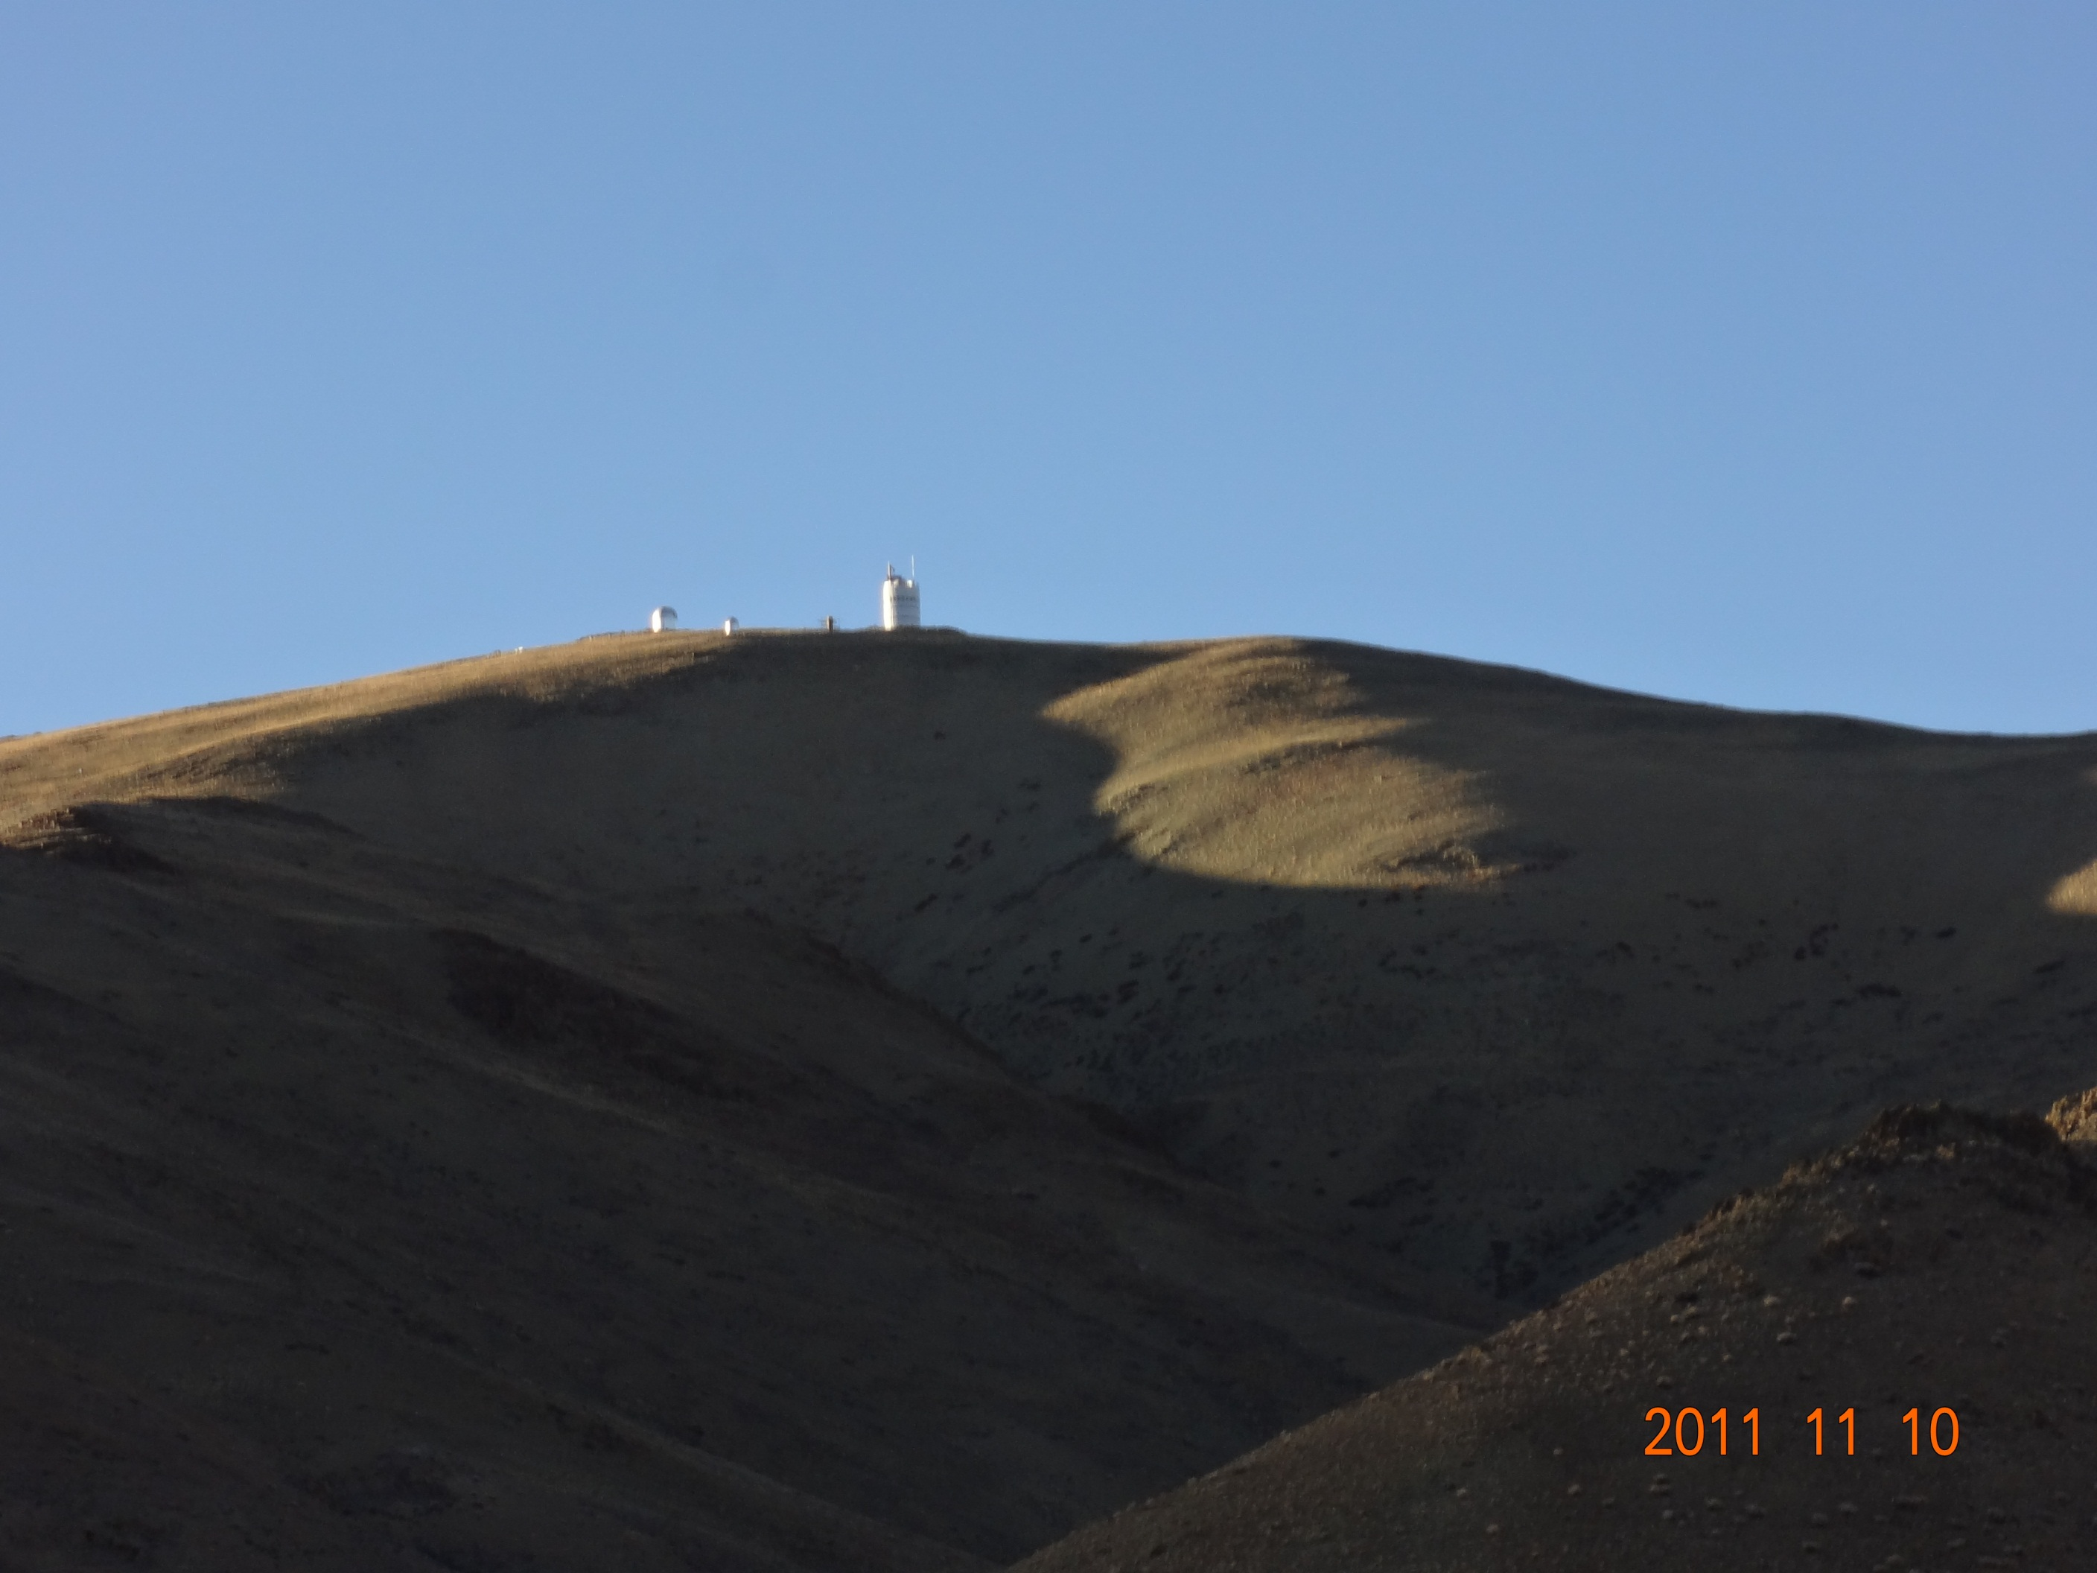
SasakiSiteSurvey_EAMA9_20131014Taiwan.pptx
A China-Japan Collaborative Site Survey in west Tibet
- Sky clearness at Gar/Ali, Tibet -
Toshiyuki Sasaki (NAOJ)
on behalf of Site Survey Team
Yongqiang Yao(NAOC), Norio Ohshima(NAOJ), Yoshitaka Mikami(NAOJ),
Michitoshi Yoshida(Hiroshima Univ.), Norio Okada(NAOJ), Hisashi Koyano(NAOJ),
Kazuhiro Sekiguchi(NAOJ), Liyong Liu(NAOC) and Chinese collaborators
Contents
Background , history and monitoring instruments
Site characteristics at Gar/Ali in far west Tibet
- Clear Sky ratio, nearly comparable to Hawaii
- Strong wind in winter at current monitoring site at Gar
20131017_SasakiSiteSurvey_EAMA9_Taiwan.pptx

Slide 2
SasakiSiteSurvey_EAMA9_20131014Taiwan.pptx
China-Japan Collaborative Site Testing in West China
Collaborative Site Testing in West China
Short Summary
1) Site Survey and testing has been conducted since 2003, led by Prof. Y. Yao (NAOC), and three weather-monitoring stations have been settled at Karasu (Xinjiang), at Oma (Tibet), and currently at Gar (Tibet).
2) Japanese team has joined the site survey project after the workshop at Lhasa, 2004. We introduced MIR cloud monitor cameras , atmospheric micro-turbulent C_{T}² sensors, and weather stations at the sites.
At Oma and Gar site, cloud monitor camera has revealed excellent sky conditions, especially in winter. Gar has shown better weather conditions than Oma.
Strong winds have been observed at current site, Gar, in winter season, which may affects observable nights seriously.
We are now searching for another better site(s) near Ali with more calm wind condition.

Slide 3
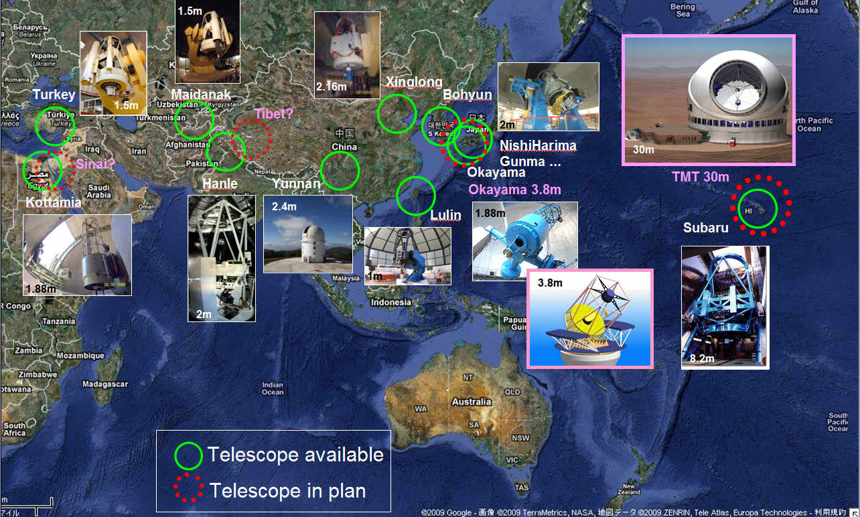
SasakiSiteSurvey_EAMA9_20131014Taiwan.pptx
China-Japan Collaborative Site Testing in West China
Why do we need a new observing site in west Tibet?

Slide 4
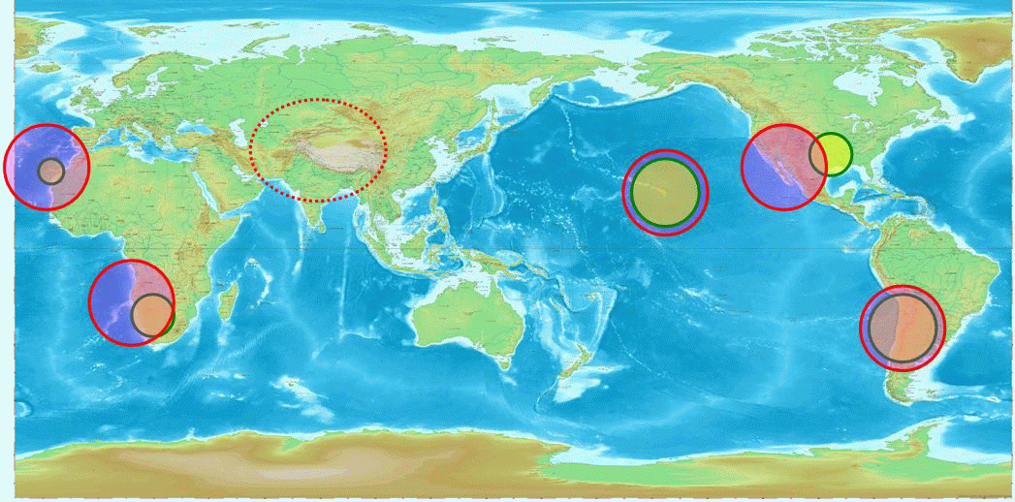
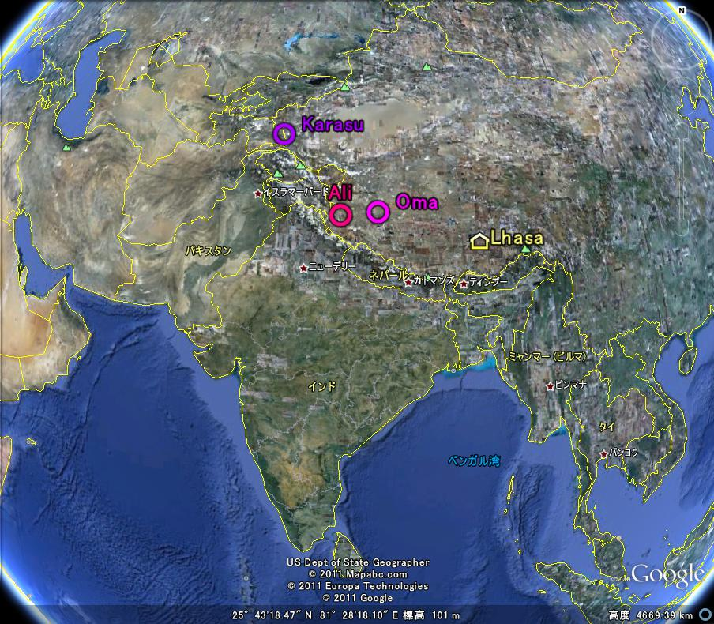
SasakiSiteSurvey_EAMA9_20131014Taiwan.pptx
China-Japan Collaborative Site Testing in West China
West Tibet is at an important longitudinal location for global astronomical observation network
sites in west China; Karasu, Oma, and Gar/Ali

Slide 5
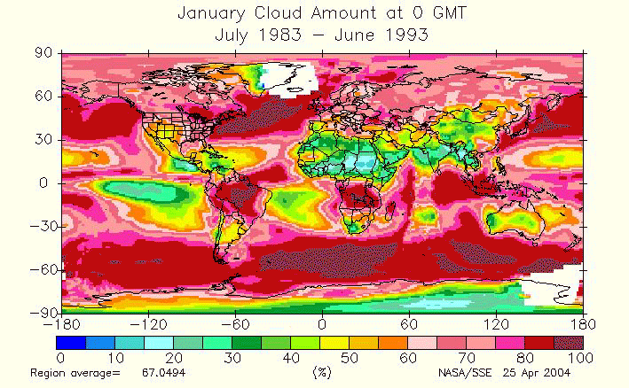
SasakiSiteSurvey_EAMA9_20131014Taiwan.pptx
China-Japan Collaborative Site Testing in West China
In Planning phase of ELT, west China is one of candidate sites
Dr. Sarazin (ESO) showed a global weather map at SPIE at Kona, 2002 .
Refer to http://eosweb.larc.nasa.gov/sse/
Meteorology and Solar Energy
Global/Regional Plots
Ｇｌｏｂａｌ Ｃｌｏｕｄ Ｄｉｓｔｒｉｂｕｔｉｏｎ

Slide 6
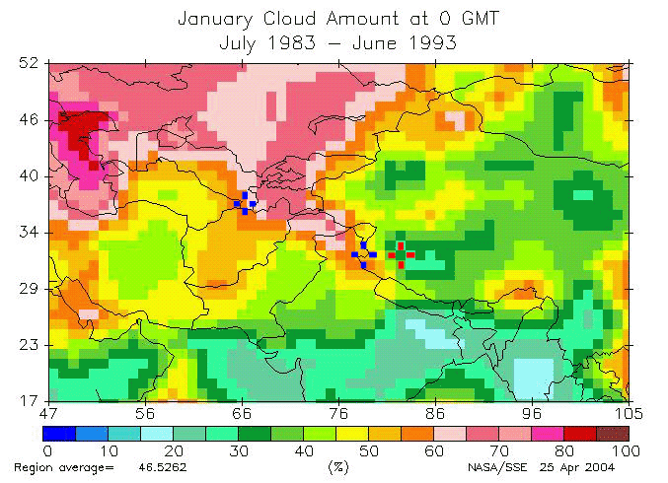
SasakiSiteSurvey_EAMA9_20131014Taiwan.pptx
China-Japan Collaborative Site Testing in West China
Arranged only for night data.
Two blue crosses show Hanle (India)
and Maidanak (Uzbekistan). Red cross
shows candidate site in Tibet.
Cloud map around west China

Slide 7

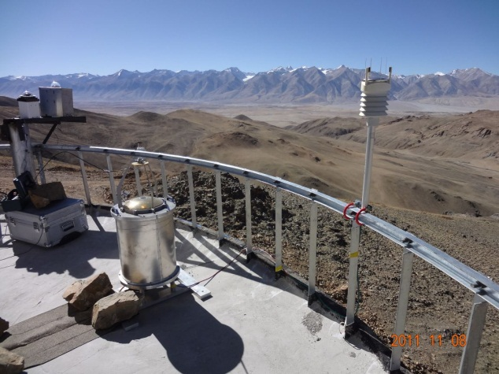
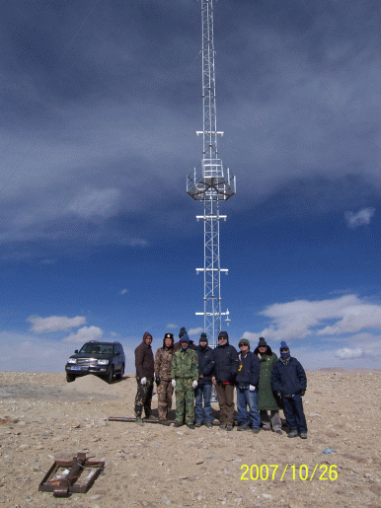
SasakiSiteSurvey_EAMA9_20131014Taiwan.pptx
China-Japan Collaborative Site Testing in West China
Site monitoring instruments available and/or planned
Instrument Method Measured value Height range
Weather Station Temperature, Humidity, Wind, Pressure Meteorological data at several m
Rain, (Sunshine, IR radiation )
Dust counter Particle counter Dust particle at several m
Visible whole-sky camera visible CCD camera Night sky through atmosphere
IR Cloud monitor 10μm-band MIR camera Cloudiness through atmosphere
DIMM Differential Image Motion Monitor Seeing through atmosphere
MASS Multi-Aperture Scintillation Sensor Scintillation 1km to several 10km
SCIDAR Scintillation Detection and Ranging Scintillation 1km to several 10km
CT2 sensor Micro-thermal Turbulence in Surface Layer Turbulence 0 m to several 10 m
CT2 sensors on 40m tower
(at Gar )
(at Karasu )
Cloud Monitor
Weather Station

Slide 8
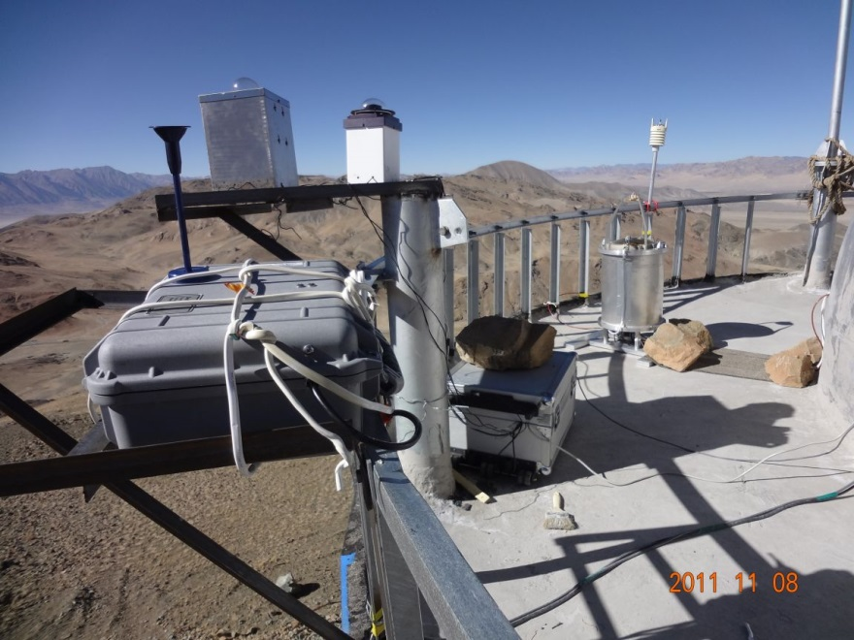

Site Monitoring Instruments at Gar (Japan group)
SasakiSiteSurvey_EAMA9_20131014Taiwan.pptx
China-Japan Collaborative Site Testing in West China
Weather Station
↓ Vaisala WXT510
CT2 sensor on 40m tower
↓ Himalaya is over these mountains
Cloud Monitor camera
Weather station
and
Barometer
↑ Dust Counter
DustTrak 8520
CloudMonitor →
w/ FLIR A40M MIR camera

Slide 9
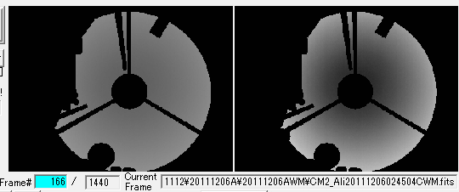
SasakiSiteSurvey_EAMA9_20131014Taiwan.pptx
China-Japan Collaborative Site Testing in West China
Sample Images of CloudMon at Gar on 2011/12/06
All-sky images, taken w/Cloud Monitor at Gar on 2011-12-06
- Shown every 6min ( original Images were taken every 1 min )
- Ground-based MIR images ( FLIR A40M MIR camera, 7-14 μm (320x240 pixel array), 1 frame/ 1 min)
( ↑ Red circles are marked to show Solar/Lunar images occasionally.)

Slide 10
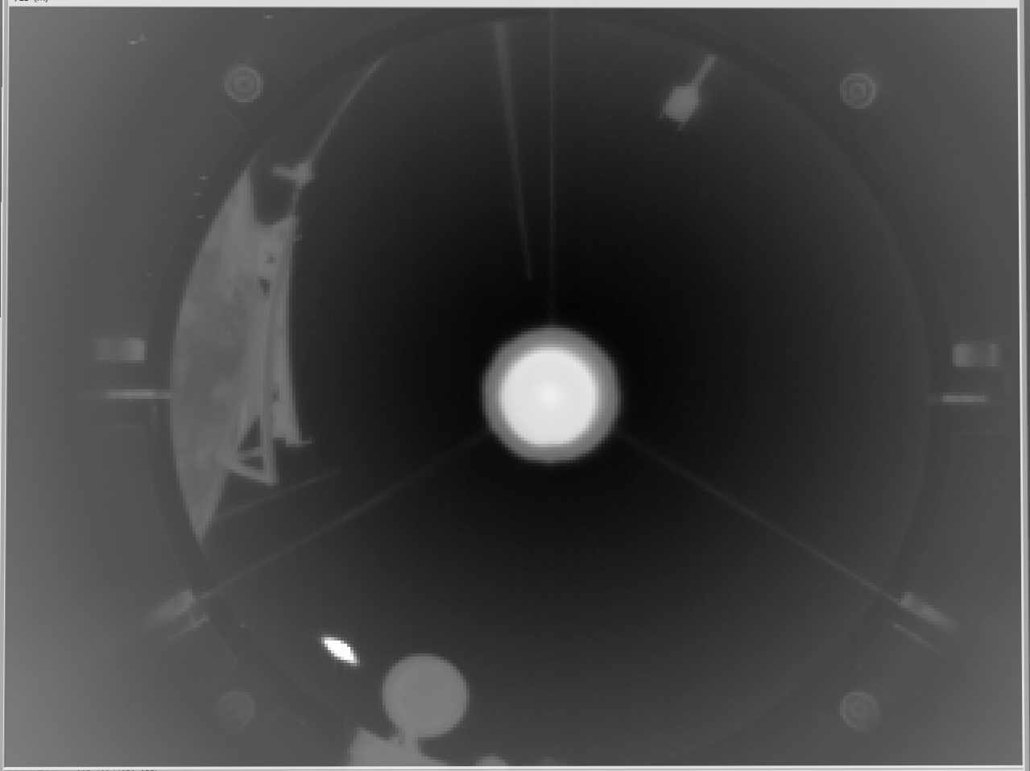
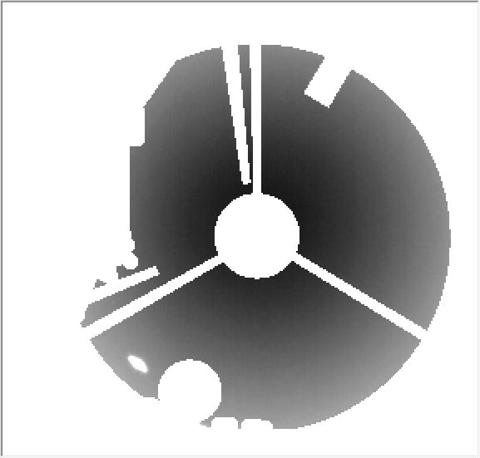
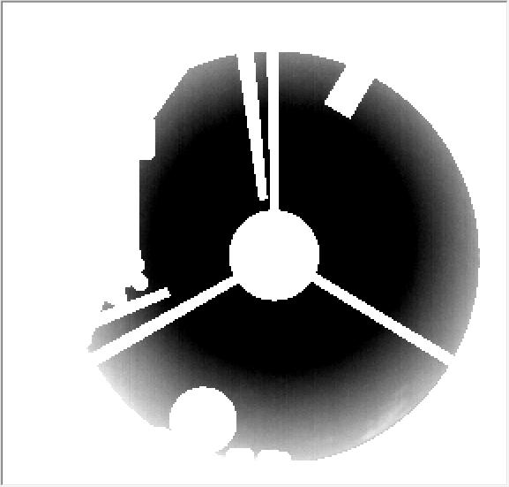
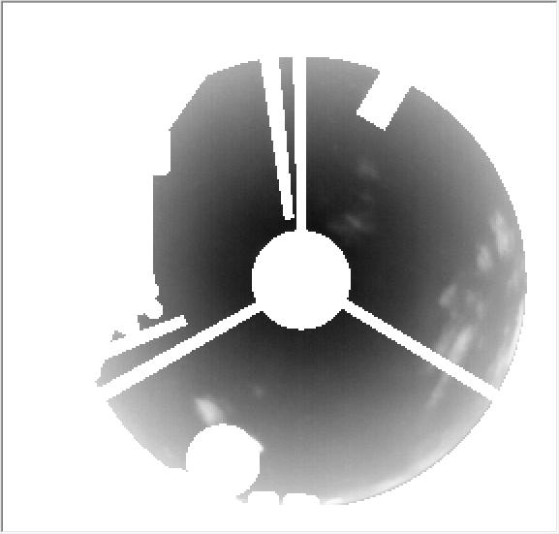
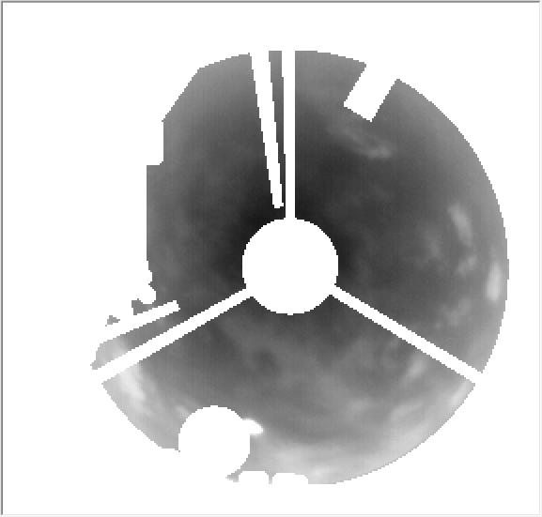
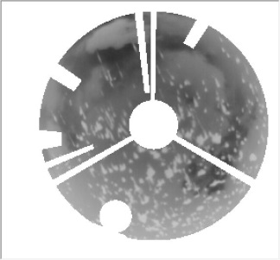
SasakiSiteSurvey_EAMA9_20131014Taiwan.pptx
China-Japan Collaborative Site Testing in West China
Sky Clearness is judged by eye inspection on MIR whole-sky images
Weather
Station
Dome
building
100%
75%
50%
0%
0%
Sun
Rainy
Clear Sky
Fine SKy
Cloud
Fair Sky
Cloudy SKy

Slide 11
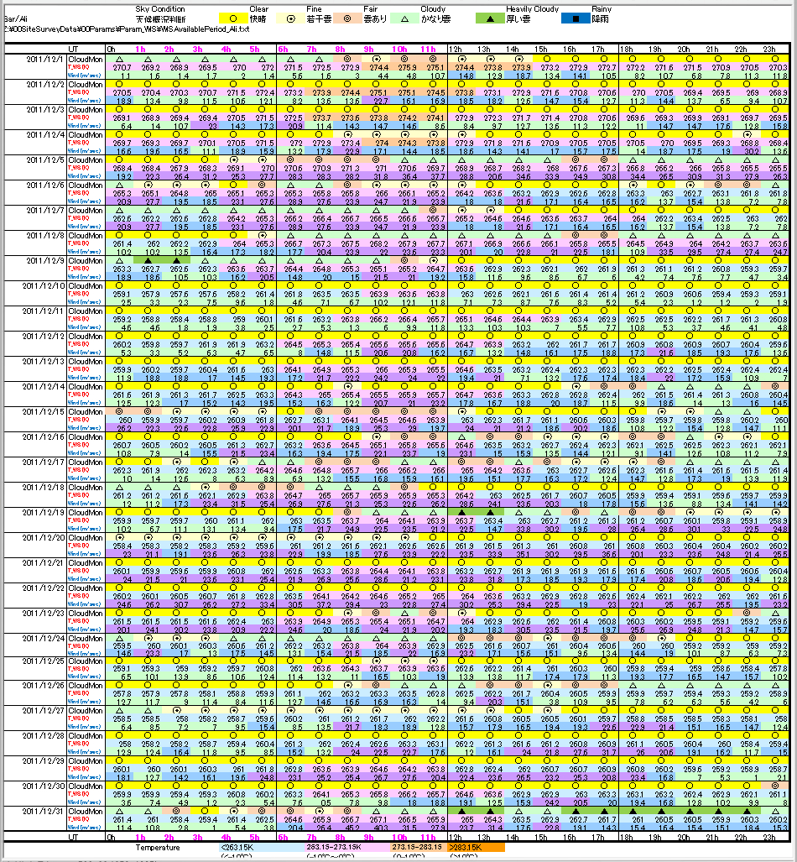
SasakiSiteSurvey_EAMA9_20131014Taiwan.pptx
China-Japan Collaborative Site Testing in West China
Monthly lists of Weather Conditions at Gar, Oma and Karasu,
which are now open to public
http://sasakihome.info/~sasaki/TibetSiteSurvey/index.html

Slide 12
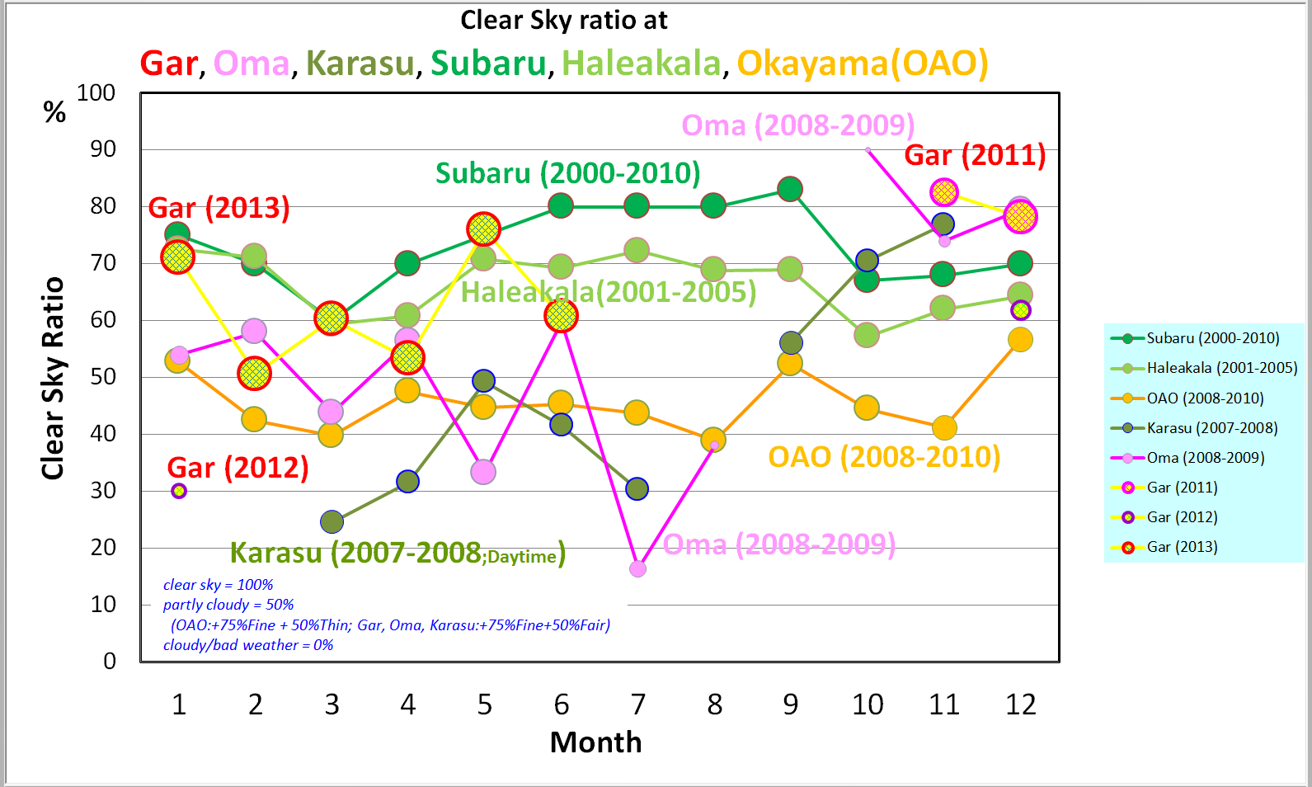
SasakiSiteSurvey_EAMA9_20131014Taiwan.pptx
China-Japan Collaborative Site Testing in West China
Clear sky ratios at Gar, except unknown summer season, are around 65%, which are nearly comparable to at Mauna Kea and Haleakala, Hawaii.
Subaru : statistics during 2000-2010
Haleakala: after Suganuma et al. 2007, PASP, 119, 567.
OAO: summary report during 2008-2010

Slide 13
Wind Speed at Tibet and Mauna Kea at 200mb
SasakiSiteSurvey_EAMA9_20131014Taiwan.pptx
China-Japan Collaborative Site Testing in West China
Stronger wind in winter in Tibet than over Mauna Kea
Winter season
Tibet
30m/s
Mauna Kea
[ 200mb around altitude～12,000 m ]
30m/s
From \01SatelliteData\NOAAData\AstronomicalSites\AllSites200mb.xls

Slide 14
SasakiSiteSurvey_EAMA9_20131014Taiwan.pptx
China-Japan Collaborative Site Testing in West China
Gar/Ali Evaluation matters
(2) Strongly Windy condition in winter season,
- Wind Speed in Dec, 2011 at Gar and 2008 at Oma
14 m/sec
7 m/sec
DayTime
NightTime
UT

Slide 15
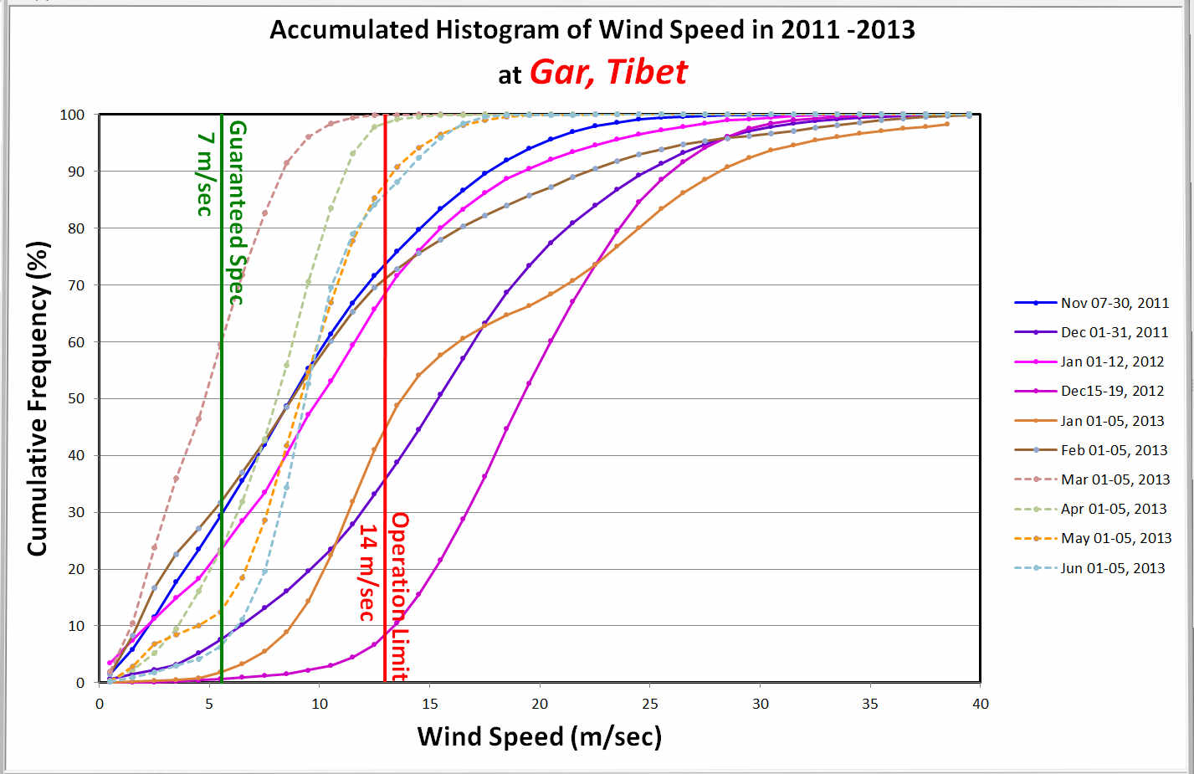
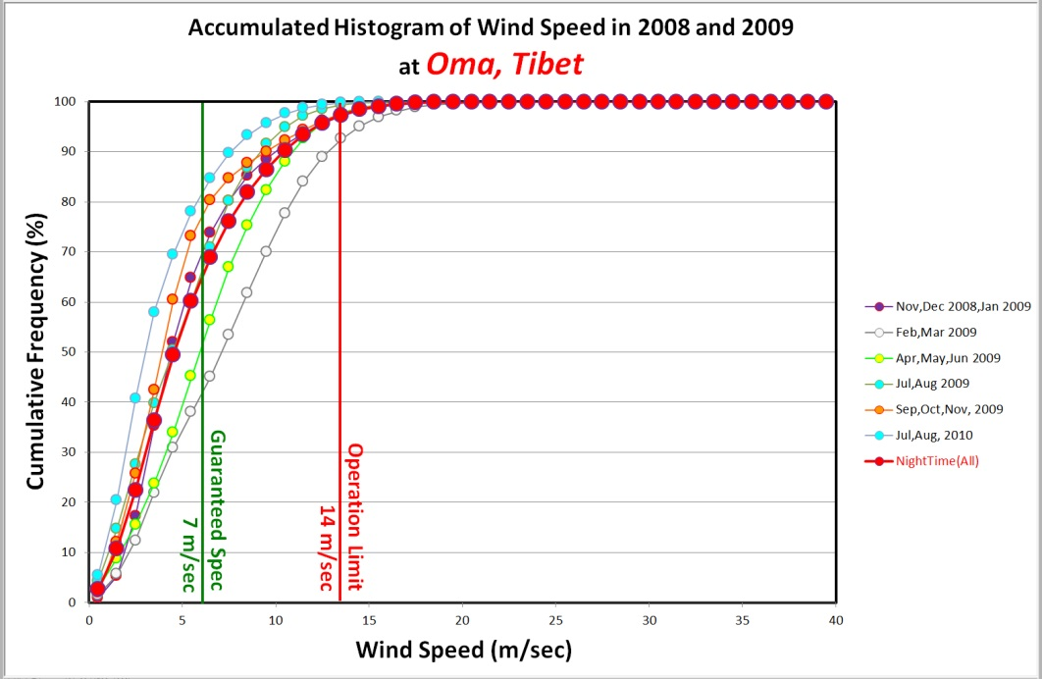
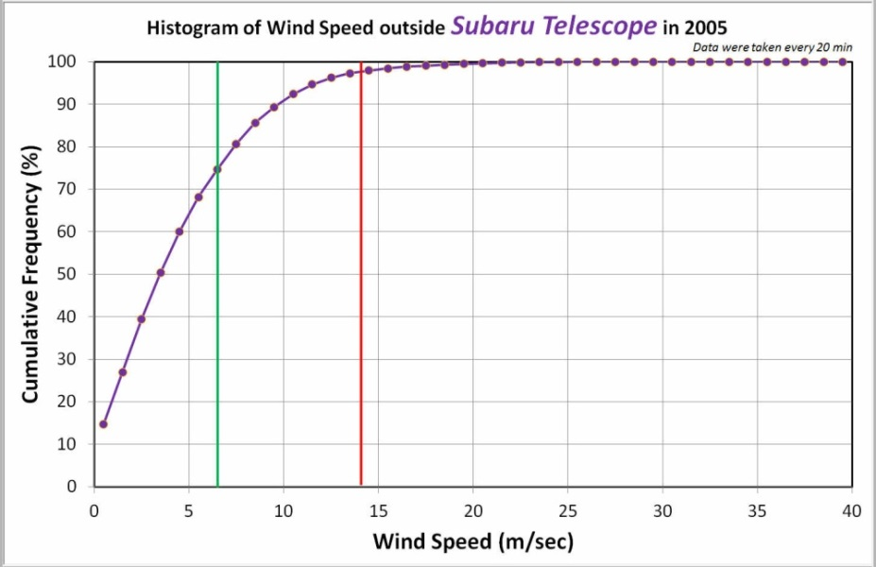
SasakiSiteSurvey_EAMA9_20131014Taiwan.pptx
China-Japan Collaborative Site Testing in West China
Gar/Ali Evaluation matters
(2) Strongly Windy condition in winter season,
- detected in Nov-Jan, 2012 and Dec-Jan, 2013

Slide 16
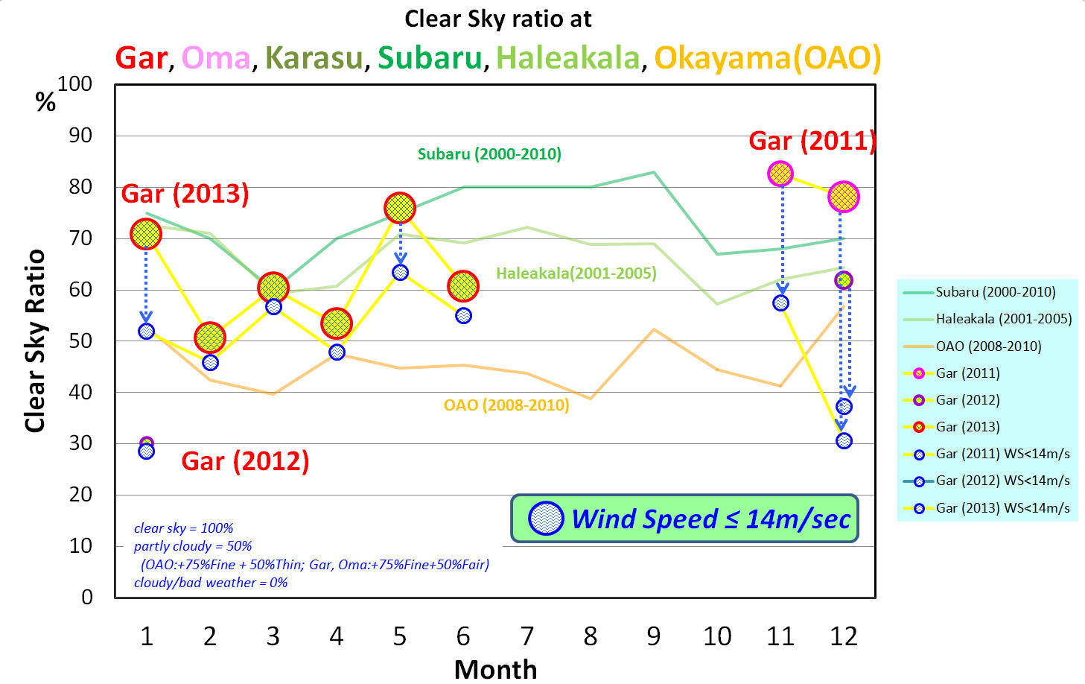
SasakiSiteSurvey_EAMA9_20131014Taiwan.pptx
China-Japan Collaborative Site Testing in West China
Gar/Ali Evaluation matters
(2) Strongly Windy condition in winter season,
- detected in Nov-Jan, 2012 and Dec-Jan, 2013

Slide 17
EACOA Medium-size Telescope Science Workshop, Kunming, China, June 21-25, 2013
T. Sasaki: “Ali Evaluation matters and Other Candidate Sites in Ali area?”
Other Candidate Sites in Ali area?
Weather Research and Forecasting (WRF) Model
NCAR(National Center for Atmosphere Research) and NCEP(National Centers for Environmental Prediction ).
Dr. Hongshuai Wang (王紅師) and Prof. Yao has simulated weather conditions
for 72 days over 2010 around Ali area(200km×200km) with 1km horizontal resolution
and vertical resolution is 65 levels from ground to 30km(1000Pa).
- Cloud Cover at Ali area
- Wind Speed and Direction
- PWV at Ali area
- Seeing distribution over Ali area

Slide 18
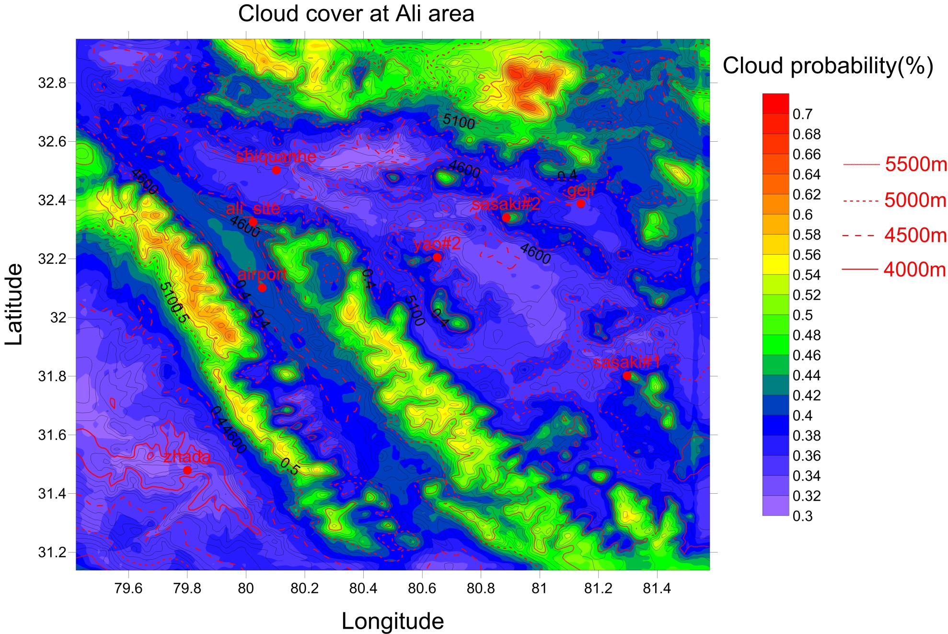
EACOA Medium-size Telescope Science Workshop, Kunming, China, June 21-25, 2013
T. Sasaki: “Ali Evaluation matters and Other Candidate Sites in Ali area?”
Other Candidate Sites in Ali area?
Weather Research and Forecasting (WRF) Model

Slide 19
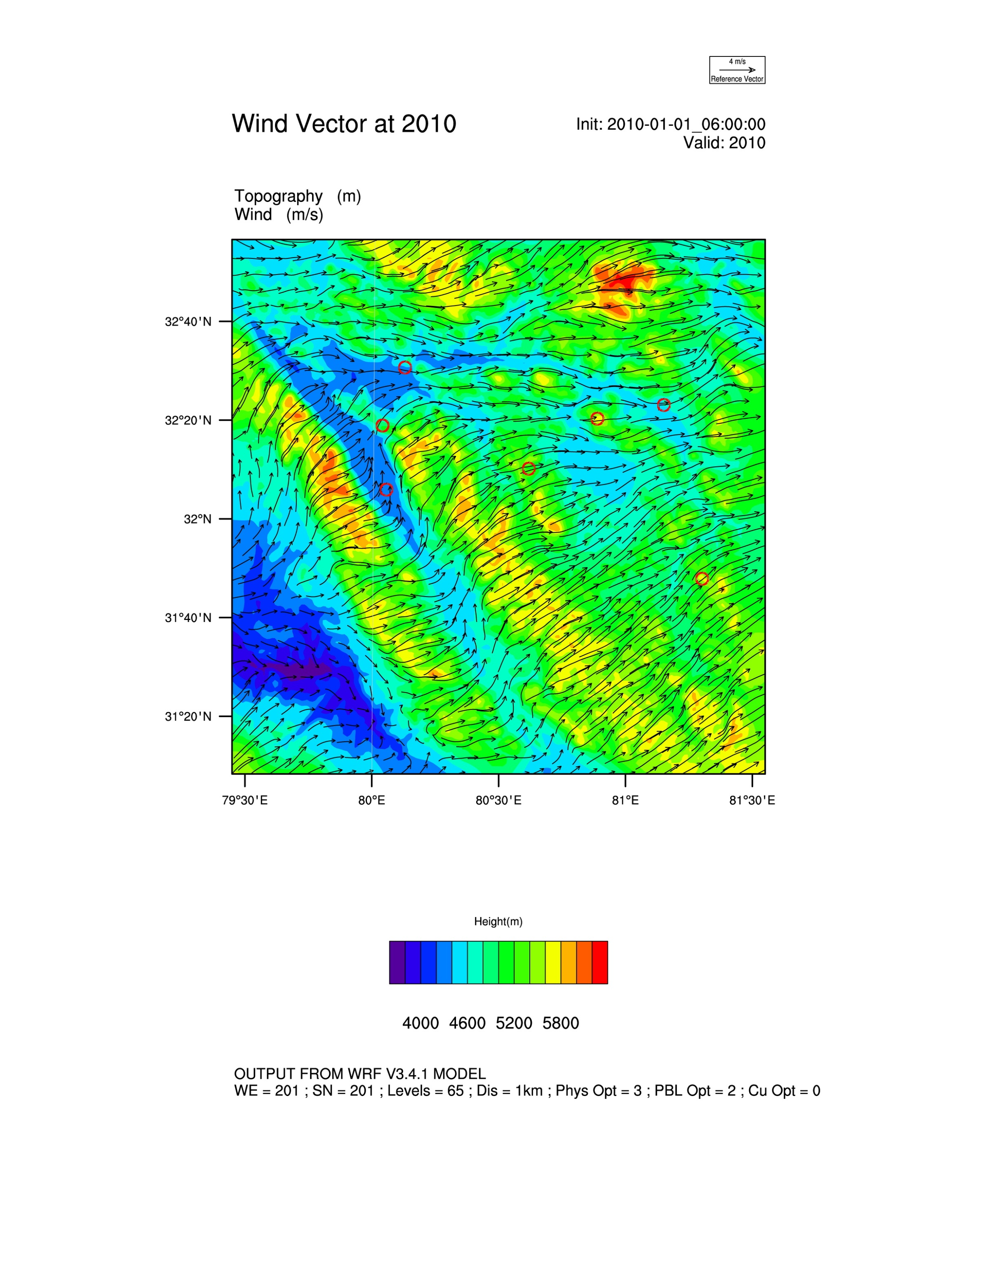
EACOA Medium-size Telescope Science Workshop, Kunming, China, June 21-25, 2013
T. Sasaki: “Ali Evaluation matters and Other Candidate Sites in Ali area?”
Other Candidate Sites in Ali area?
➔ Weather Research and Forecasting (WRF) Model with higher spatial resolution

Slide 20
EACOA Medium-size Telescope Science Workshop, Kunming, China, June 21-25, 2013
T. Sasaki: “Ali Evaluation matters and Other Candidate Sites in Ali area?”
Other Candidate Sites in Ali area?
Weather Research and Forecasting (WRF) Model
NCAR(National Center for Atmosphere Research) and NCEP(National Centers for Environmental Prediction ).
Dr. Hongshuai Wang (王紅師) and Prof. Yao has simulated weather conditions
for 72 days over 2010 around Ali area(200km×200km) with 1km horizontal resolution
and vertical resolution is 65 levels from ground to 30km(1000Pa).
- Cloud Cover at Ali area
- Wind Speed and Direction
- PWV at Ali area
- Seeing distribution over Ali area
to find more suitable site(s) around Ali ,
  WRF Model with higher spatial resolution of ～100m resolution
  in an special area of several km

Slide 21
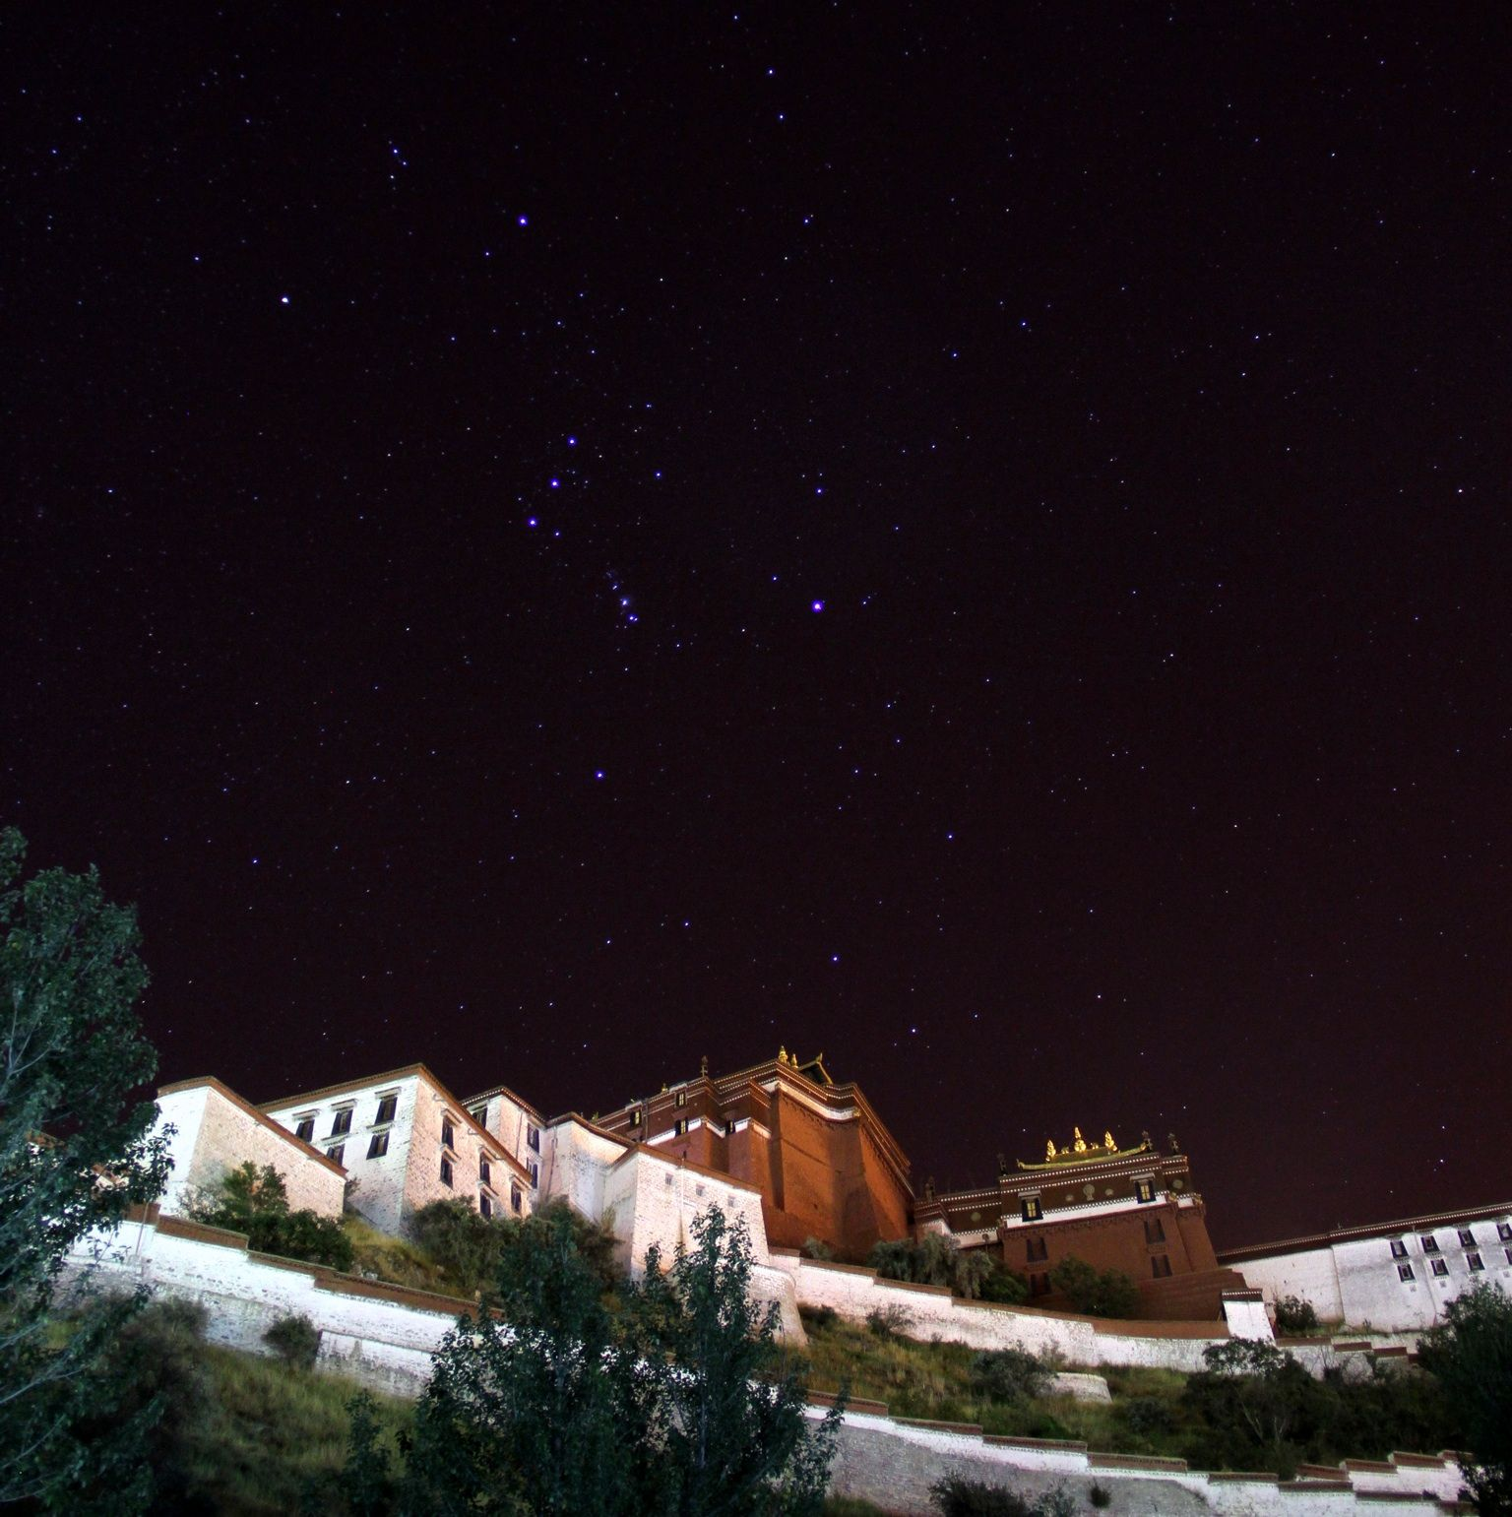
SasakiSiteSurvey_EAMA9_20131014Taiwan.pptx
China-Japan Collaborative Site Testing in West China
To Have a nice global Astronomical
Observatory closest to the Heaven
on the land of Heaven, Tibet
in near future …
謝謝、고맙습니다 、 ありがとう、Thank you！
Photo by 李林

Slide 22
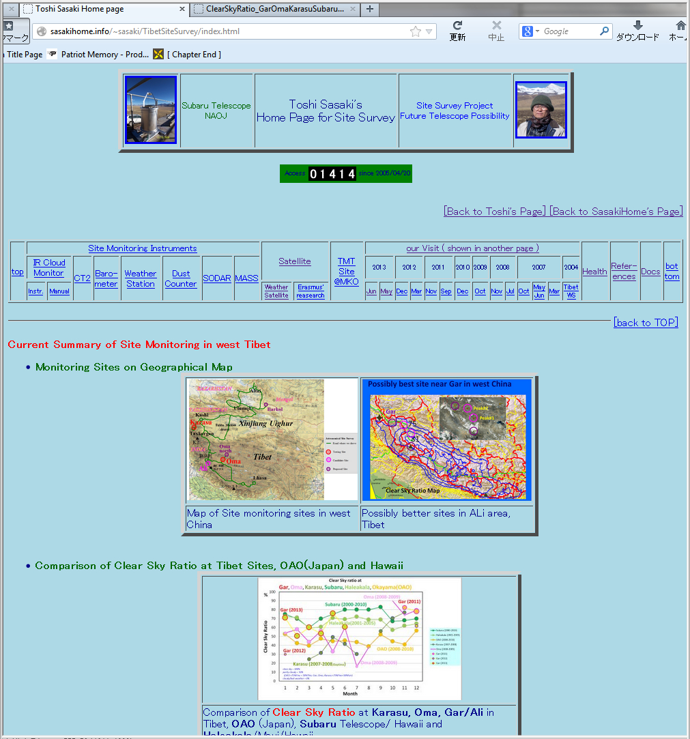
SasakiSiteSurvey_EAMA9_20131014Taiwan.pptx
China-Japan Collaborative Site Testing in West China
http://sasakihome.info/~sasaki/TibetSiteSurvey/index.html

