Slide 1
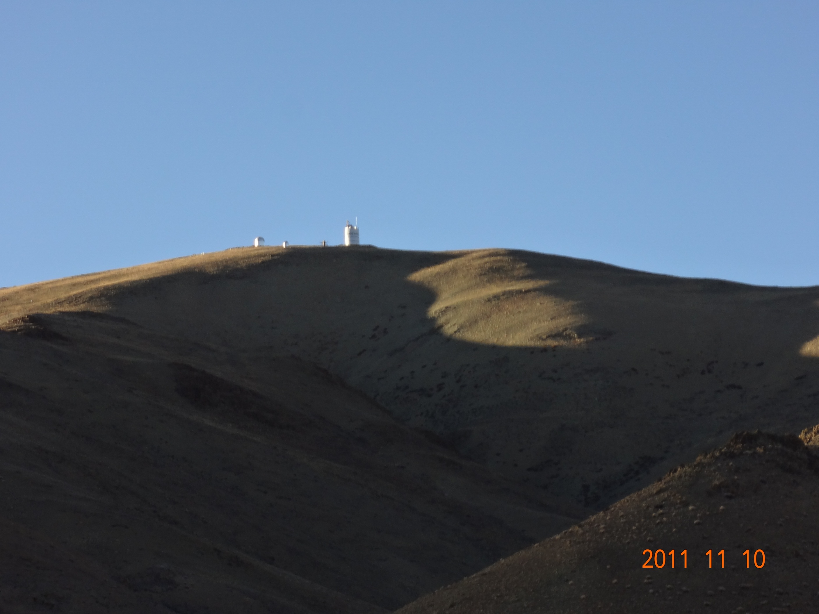
SiteSurveyWS_201204Beijing_Sasaki.pptx
China-Japan Collaborative Site Testing in West China
- A report by Japanese group -
Toshiyuki Sasaki (NAOJ)
on behalf of Site Survey Team
Prof. Yongqiang Yao (NAOC/China),
M. Yoshida(Hiroshima-u), N. Ohshima, Y. Mikami, N. Okada, H. Koyanao,
S. Nagayama, K. Sekiguchi , H. Ando (NAOJ/Japan),
L. Liu (NAOC) and Chinese collaborators
Contents
Background and monitoring instruments
Site monitor showing good conditions in winter at Oma/Tibet
- Clear Sky ratio observed with CloudMon
- image deterioration measured with micro-thermal (C_{T}²) sensors
SiteSurveyWS_201204Beijing_Sasaki.pptx

Slide 2
SiteSurveyWS_201204Beijing_Sasaki.pptx
China-Japan Collaborative Site Testing in West China
Collaborative Site Testing in West China
Summary
1) Site Survey and testing has been conducted since 2003, led by Prof. Y. Yao, and two weather-monitoring stations have been settled at Karasu (Xinjiang) and Oma (Tibet).
2) Japanese team has joined the site survey project after the workshop at Lhasa, 2004. We introduced MIR cloud monitor cameras , atmospheric micro-turbulent C_{T}² sensors, and weather stations at both sites.
At Oma site, cloud monitor camera revealed excellent sky conditions in winter, but not good in summer.
Nominal seeing measured with C_{T}² was less than 0.1 arcsec up to 36m
height in Nov. 2008. We must conduct seeing measurement through whole
atmosphere w/ DIMM/MASS/(SNODAR) to evaluate seeing condition
at the site soon.
Strong winds have been observed at Oma in winter season, which may affects seeing seriously.
We are settling site survey instruments at possibly best site near Ali in
west Tibet.

Slide 3
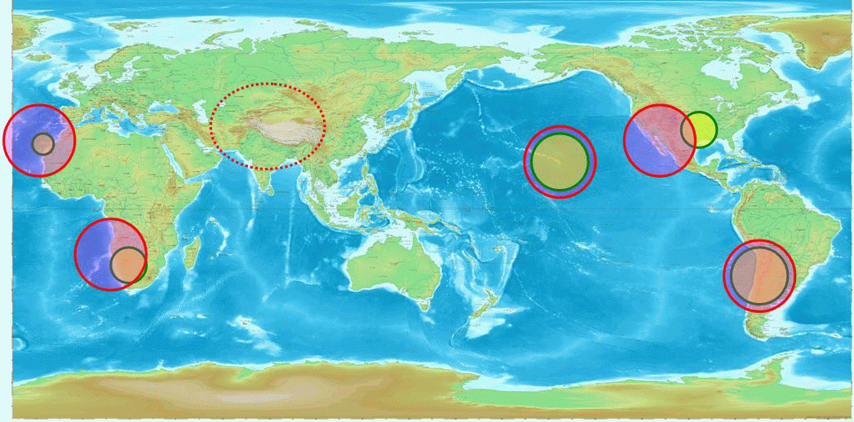
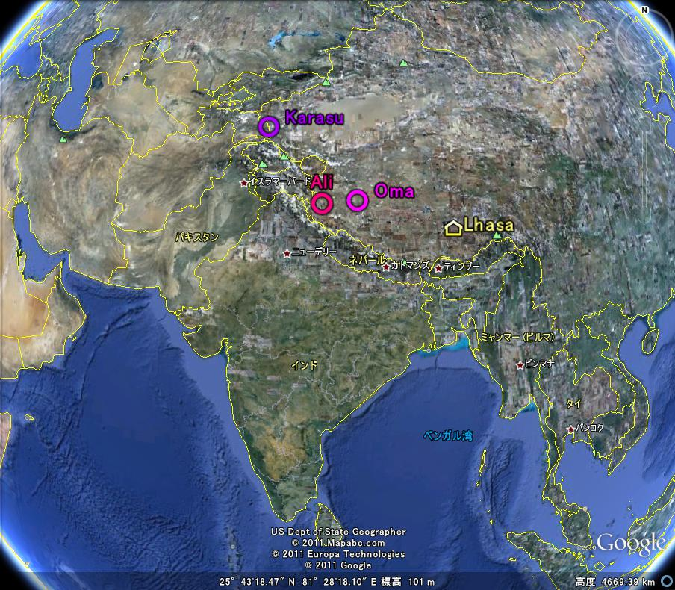
SiteSurveyWS_201204Beijing_Sasaki.pptx
China-Japan Collaborative Site Testing in West China
A site in west Tibet is in an important location for global astronomical observation network
sites in west China; Karasu, Oma, and Ali

Slide 4
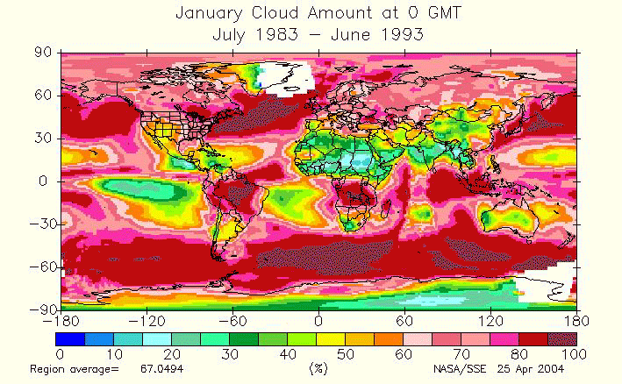
SiteSurveyWS_201204Beijing_Sasaki.pptx
China-Japan Collaborative Site Testing in West China
In Planning phase of ELT, west China is one of candidate sites
Dr. Sarazin (ESO) showed a global weather map at SPIE at Kona, 2002 .
Refer to http://eosweb.larc.nasa.gov/sse/
Meteorology and Solar Energy
Global/Regional Plots
Ｇｌｏｂａｌ Ｃｌｏｕｄ Ｄｉｓｔｒｉｂｕｔｉｏｎ

Slide 5
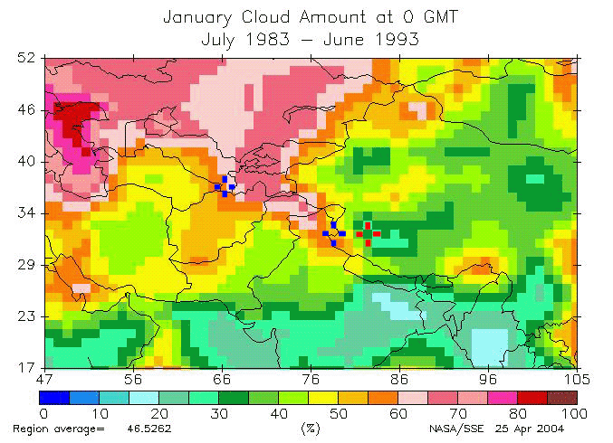
SiteSurveyWS_201204Beijing_Sasaki.pptx
China-Japan Collaborative Site Testing in West China
Arranged only for night data.
Two blue crosses show Hanle (India)
and Maidanak (Uzbekistan). Red cross
shows candidate site in Tibet.
Cloud map around west China

Slide 6
Wind Speed at Tibet and Mauna Kea at 200mb
SiteSurveyWS_201204Beijing_Sasaki.pptx
China-Japan Collaborative Site Testing in West China
Wind speed at 200mb (altitude～12000m) shows correlation with seeing size
Does it mean bad seeing during winter at Tibet? ^{(Vernin 1986 SPIE 628,142)}
Winter season
Tibet
30m/s
Mauna Kea
30m/s
From \01SatelliteData\NOAAData\AstronomicalSites\AllSites200mb.xls

Slide 7
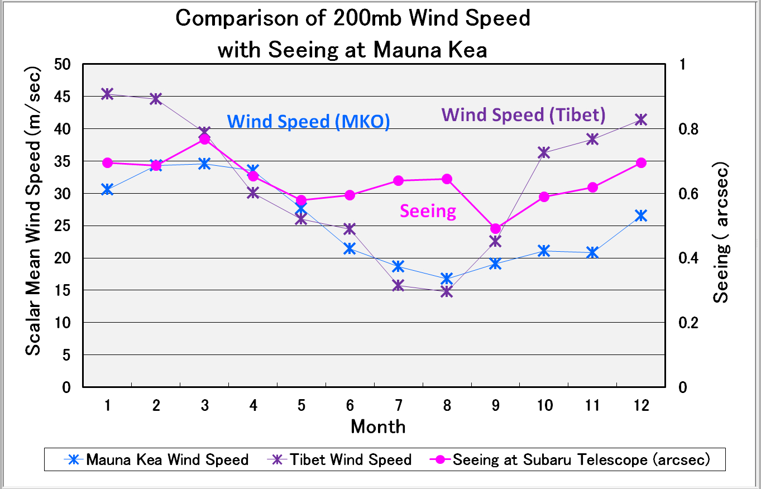
SiteSurveyWS_201204Beijing_Sasaki.pptx
China-Japan Collaborative Site Testing in West China
at MKO
Local disturbance
may affect local seeing
needs local weather
characterizing
From \01SatelliteData\NOAAData\AstronomicalSites\AllSites200mb.xls

Slide 8


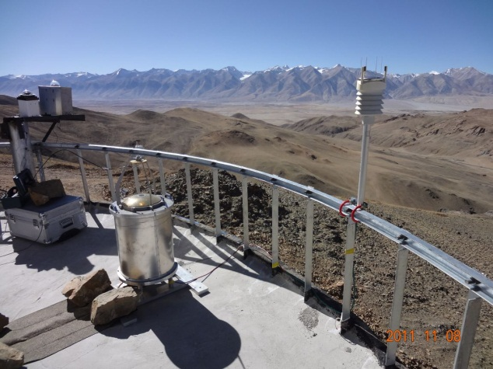
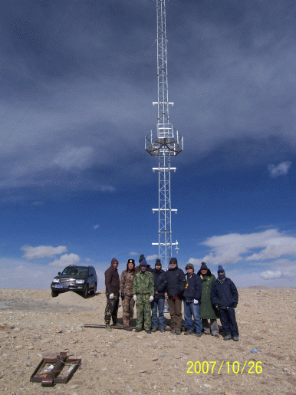
SiteSurveyWS_201204Beijing_Sasaki.pptx
China-Japan Collaborative Site Testing in West China
Site monitoring instruments available and/or planned
Instrument Method Measured value Height range
Weather Station* $ Temperature, Humidity, Wind, Pressure Meteorological data at several m
Rain, (Sunshine, IR radiation )
Dust counter* Particle counter Dust particle at several m
Visible whole-sky camera$ visible CCD camera Night sky through atmosphere
IR Cloud monitor* 10μm-band MIR camera Cloudiness through atmosphere
DIMM$ Differential Image Motion Monitor Seeing through atmosphere
MASS $ Multi-Aperture Scintillation Sensor Scintillation 1km to several 10km
SCIDAR $ Scintillation Detection and Ranging Scintillation 1km to several 10km
CT2 sensor * Micro-thermal Turbulence in Surface Layer Turbulence 0 m to several 10 m
SNODAR ^{(planned)} Surface layer Non-Doppler Acoustic Radar Scintillation 8m～200m
SODAR ^{(NOT exists)} Sound detection and ranging Scintillation 15m～1-2km
$ * Currently available instruments ($China , *Japan )
CT2 sensors on 40m tower
(at Ali)
(at Karasu)
Cloud Monitor
Weather Station

Slide 9
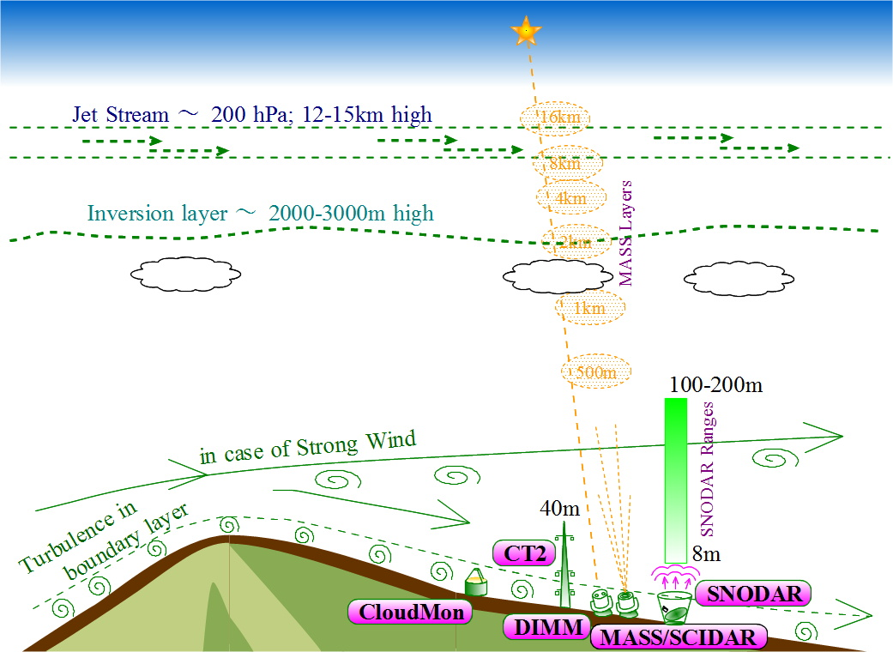
SiteSurveyWS_201204Beijing_Sasaki.pptx
China-Japan Collaborative Site Testing in West China

Slide 10
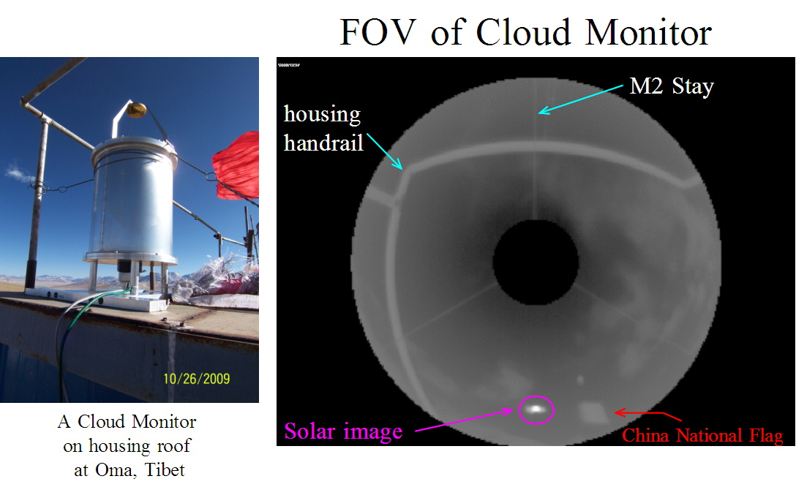
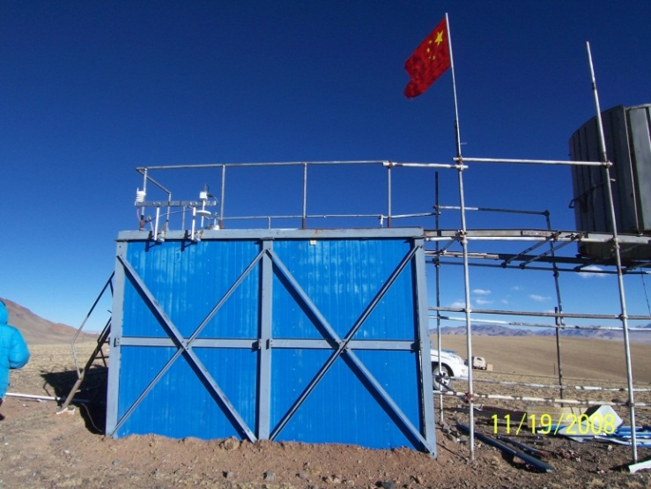
SiteSurveyWS_201204Beijing_Sasaki.pptx
China-Japan Collaborative Site Testing in West China
Cloudiness observed w/ CloudMon at Oma in 2008 and 2009

Slide 11
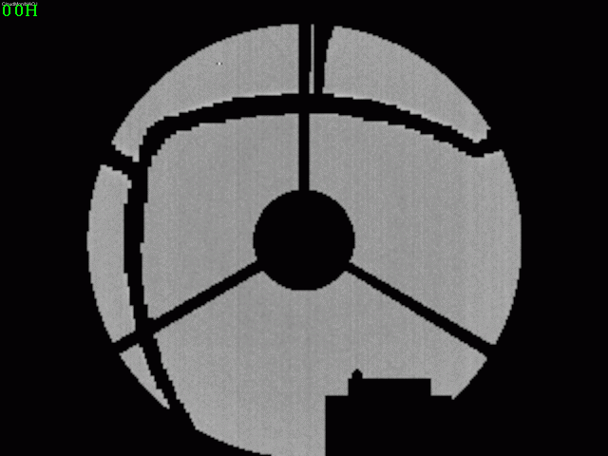
SiteSurveyWS_201204Beijing_Sasaki.pptx
China-Japan Collaborative Site Testing in West China
Sample Images of CloudMon at Oma on 2008/12/24
All-sky images, every 1 hous, taken w/Cloud Monitor at Oma on 2008-12-24
Ground-based MIR images (Thermal-Eye 2000B Camera, 7-14 μm (320x240 pixel array), 1 frame/ 1 min)

Slide 12
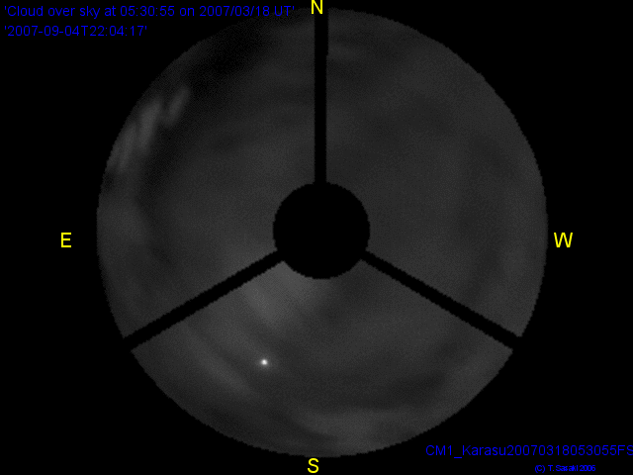
SiteSurveyWS_201204Beijing_Sasaki.pptx
China-Japan Collaborative Site Testing in West China
CloudMonitor Image
2007 March 18 at Karasu
Zenith
Z = 70°
( 20°above horizon )

Slide 13
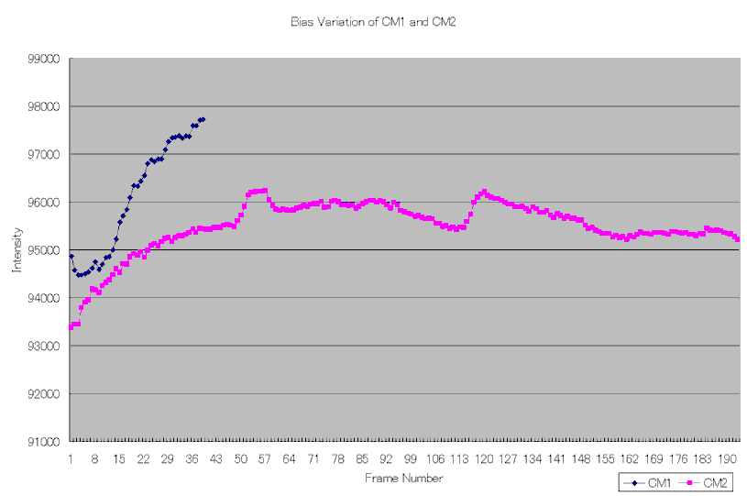
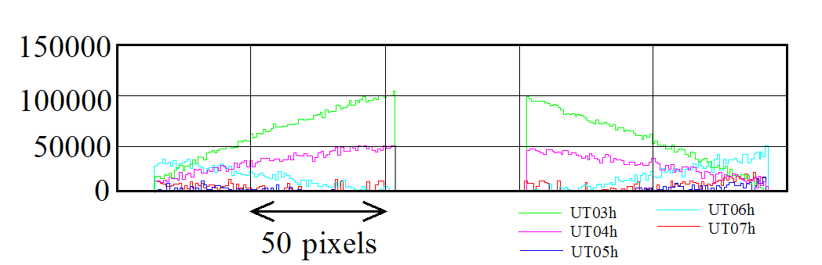
SiteSurveyWS_201204Beijing_Sasaki.pptx
China-Japan Collaborative Site Testing in West China
Error estimate of cloudiness with Cloud Monitor
Data Analysis
Flat-Fielding, 2) sky subtraction, and 3) masking
Estimated Errors
1) Flat-Fielding image with covered-wth-cap camera with variation of 3.4%.
2) Background intensity variation of 7.7% of flat-fielded images;
a part of variation are due to solar radiation,
but other might be sensitivity variation of the MIR camera.
3) time-dependent variation of sensitivity across the image of 10 - 12%
In total, intensity error might be of 14%.
Due to this large error, we use CloudMonitor images
only for qualitative evaluation of cloudiness so far.
Bias variation
Sensitivity variation

Slide 14
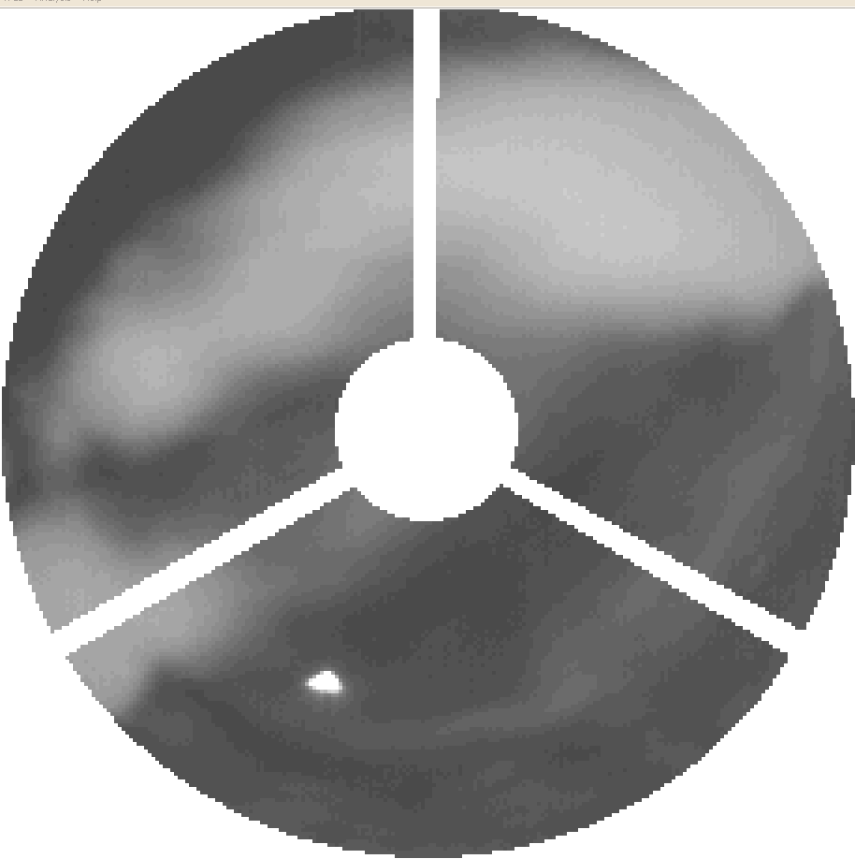
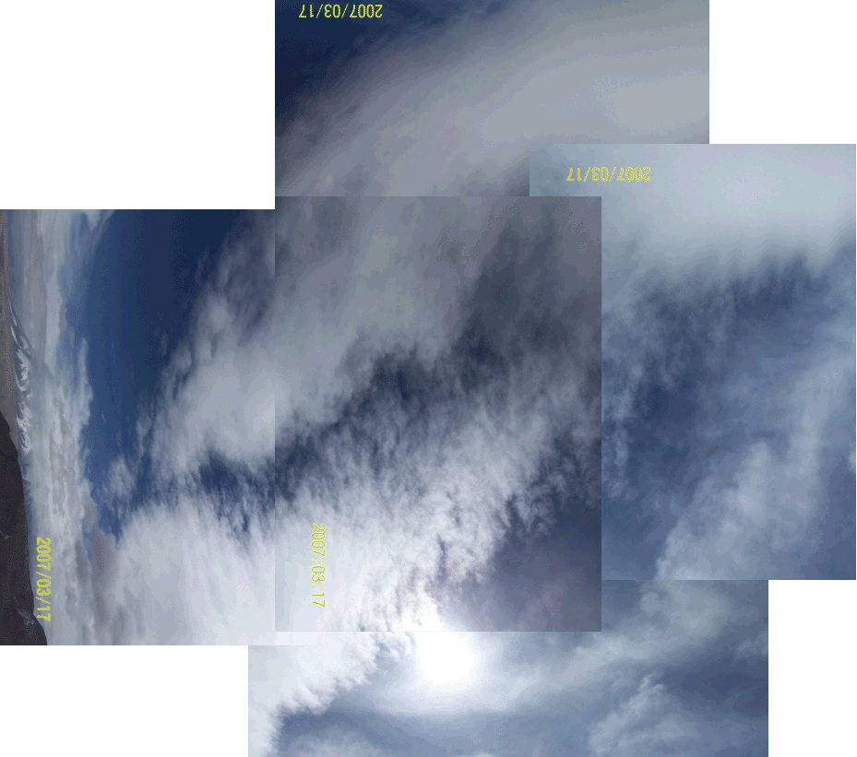
SiteSurveyWS_201204Beijing_Sasaki.pptx
China-Japan Collaborative Site Testing in West China
Comparison between CloudMon (MIR) image and Visible image
on 2007 March 17 05:35:55UT
Using intensity of solar image
CloudMon detection limit of Cloud w/ 5 % extinction
Sun
CloudMonitor image
(MIR)
Digital camera
(Visible)

Slide 15
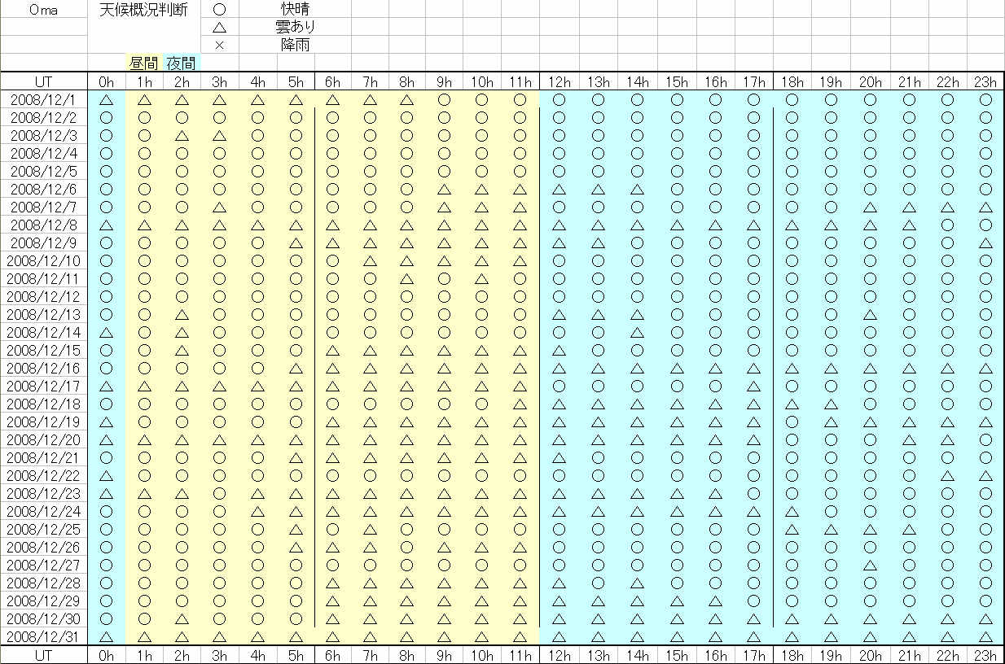
SiteSurveyWS_201204Beijing_Sasaki.pptx
China-Japan Collaborative Site Testing in West China
Cloudiness judged w/ CloudMon Images at Oma in 2008 Dec.
Clear
Fine/fair/partly cloudy
Cloudy/rainy

Slide 16
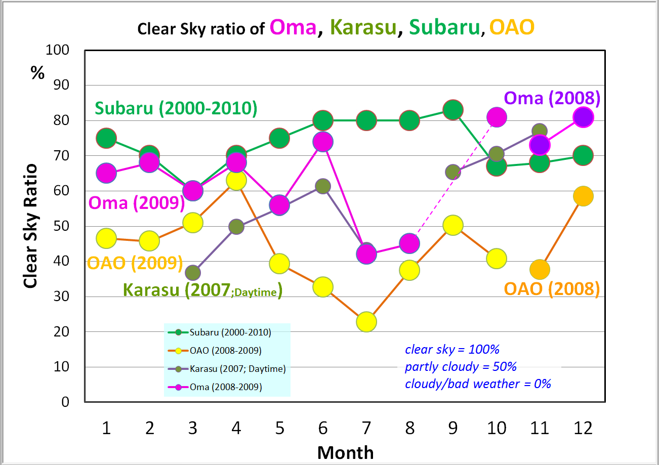
SiteSurveyWS_201204Beijing_Sasaki.pptx
China-Japan Collaborative Site Testing in West China
Clear sky ratios at Oma, except summer monsoon season, are around 70%, which are comparable to at Mauna Kea, Hawaii, and much bettre than at Okayama, Japan.
Subaru : statistics during 2000-2010
OAO: summary report during 2008-2009

Slide 17
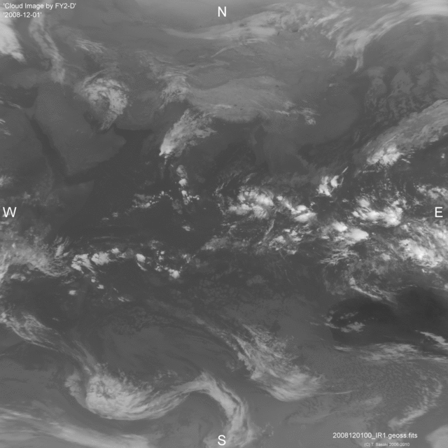
SiteSurveyWS_201204Beijing_Sasaki.pptx
China-Japan Collaborative Site Testing in West China
Weather Satellite, FY2-D, Image
Chinese Weather Satellite, FY2-D,
is currently working and their data
are available at Chiba-U, Japan
on Web site,
ftp://fy.cr.chiba-u.ac.jp/
( Resolution = 0.04°～ 4km )

Slide 18
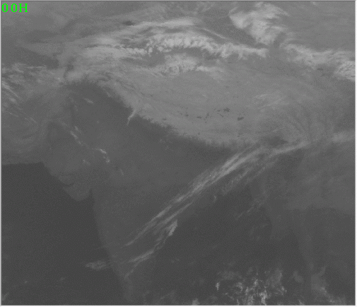
SiteSurveyWS_201204Beijing_Sasaki.pptx
China-Japan Collaborative Site Testing in West China
Clouds observed w/Weather Satellite and ground-based CloudMon
Weather Satellite, FY2-D in IR(10μm)
MIR Cloud Monitor Camera (7-14μm)
Ground-based Monitoring of Clouds in the sky is very useful to evaluate the site,
as weather satellite data is difficult to clarify localized cloud behaviors.

Slide 19
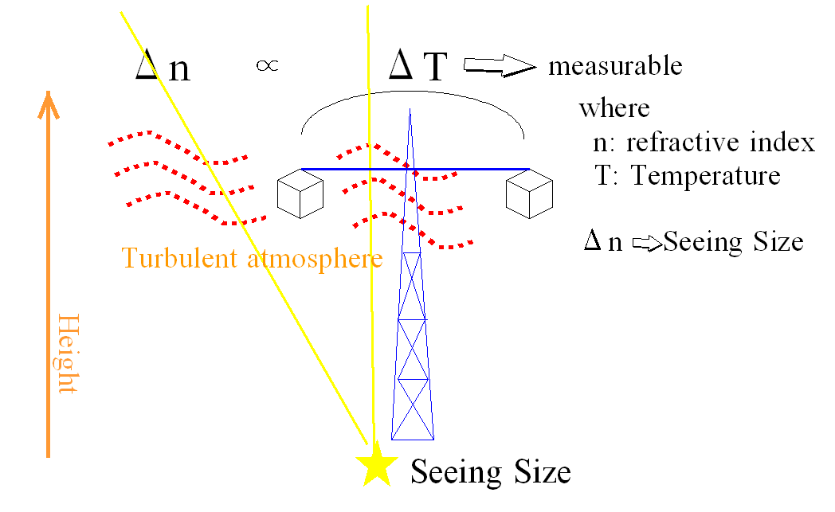
SiteSurveyWS_201204Beijing_Sasaki.pptx
China-Japan Collaborative Site Testing in West China
Micro-thermal turbulence detected with C_{T}² sensors
C_{T}² : temperature structure coefficient
C_{n}² ∝ P² T⁻⁴ C_{T}²
C_{n}² : refractive index structure coefficient
Related Site testing instruments
・DIMM: Differential Image Motion Monitor
・MASS/SCIDAR: Multi Aperture Scintillation Sensor
・C_{T}² sensor : Micro-thermal turbulence in surface layer
to measure height variation
・SNODAR: Surface layer Non-Doppler Acoustic Radar to measure Scintillation
・SODAR: Sound detection and ranging to measure Scintillation

Slide 20
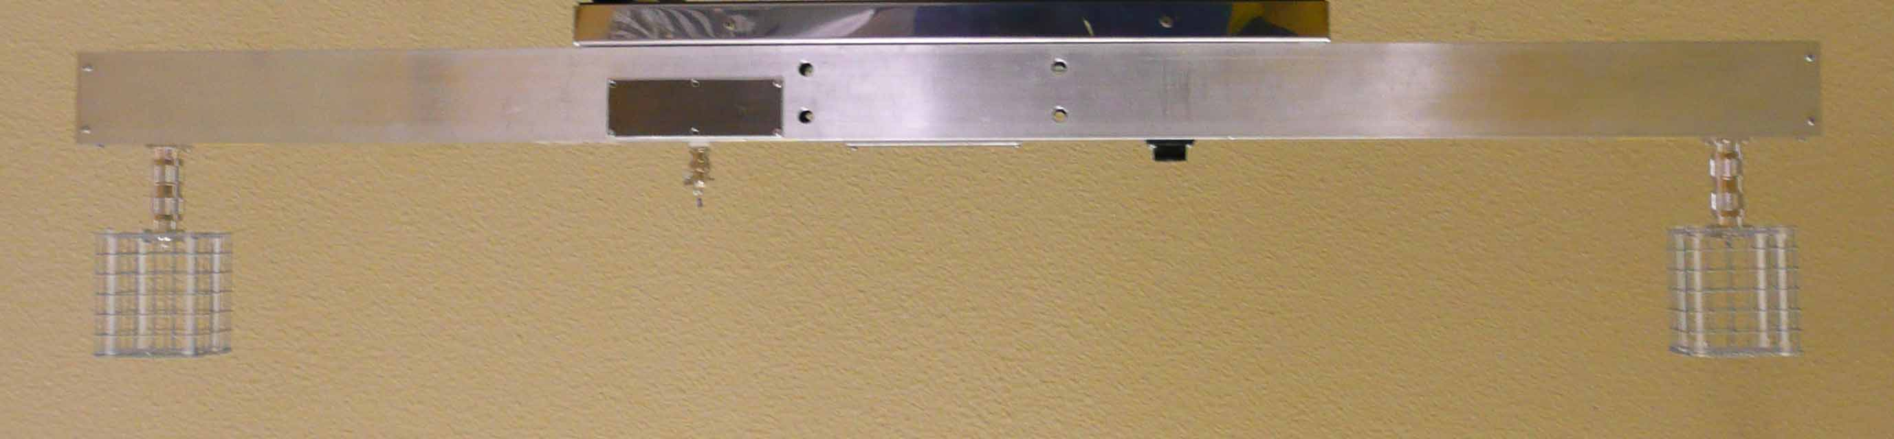
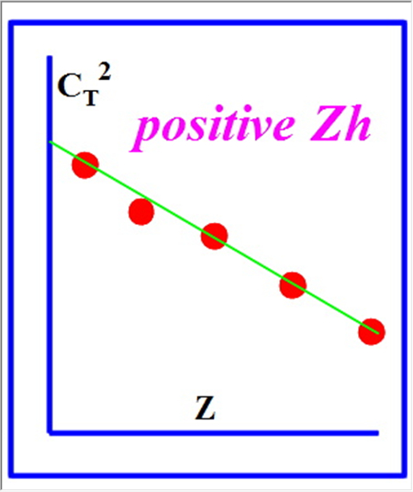
SiteSurveyWS_201204Beijing_Sasaki.pptx
China-Japan Collaborative Site Testing in West China
CT2 measurements at Karasu and at Oma
Temperature sensor
A pair of CT2 sensors w/ 25μm Ni wire
Temperature Structure Coefficient
Image deterioration estimated from C_{T}²

Slide 21
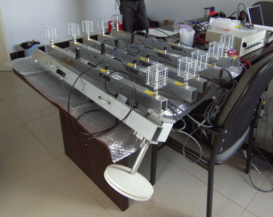
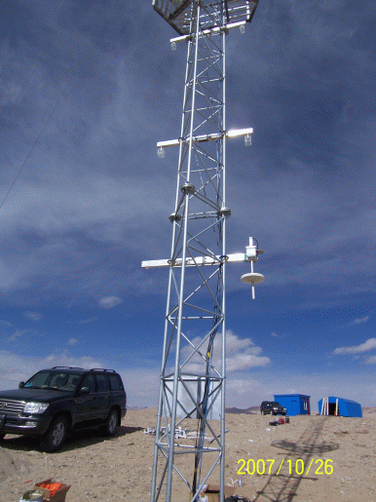
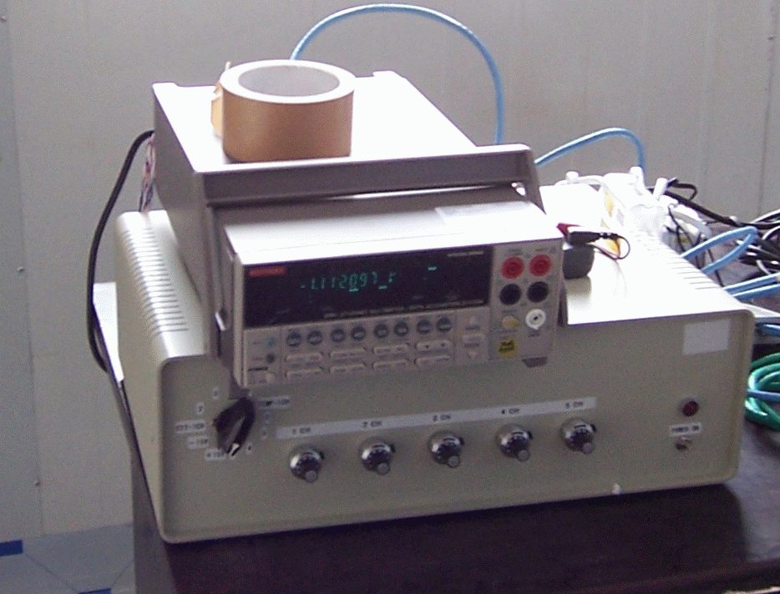
SiteSurveyWS_201204Beijing_Sasaki.pptx
China-Japan Collaborative Site Testing in West China
C_{T}² measurements at Karasu and at Oma
5 Layers of a C_{T}² sensor pair
Barometer
Barometer
Controller and
Digital Multimeter
Karasu

Slide 22
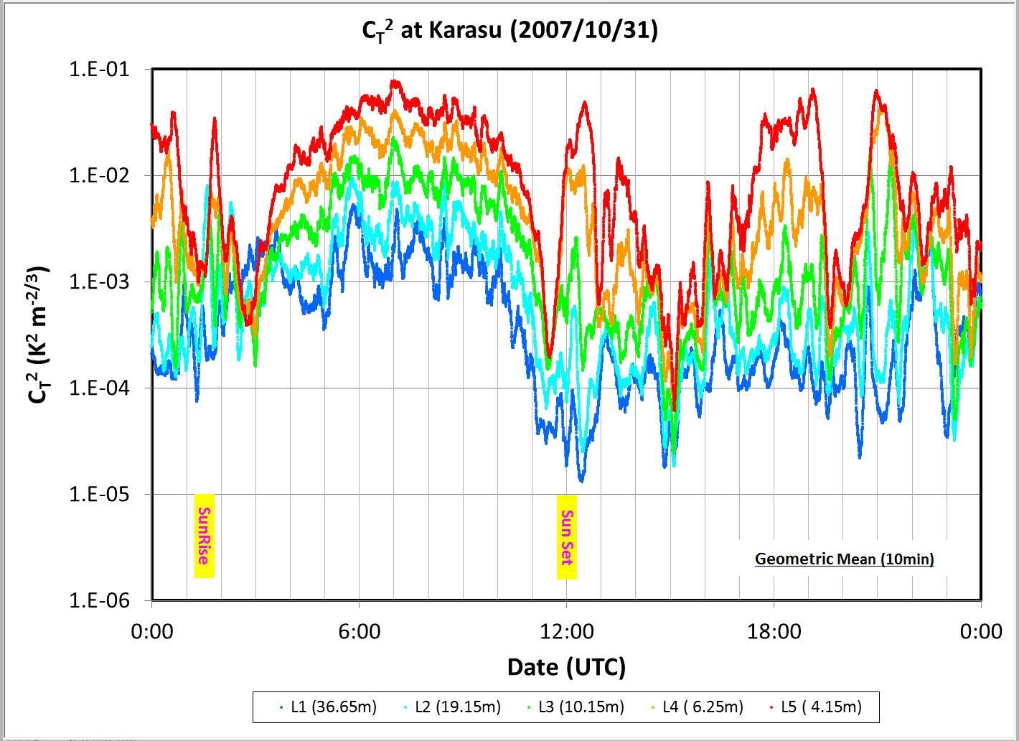
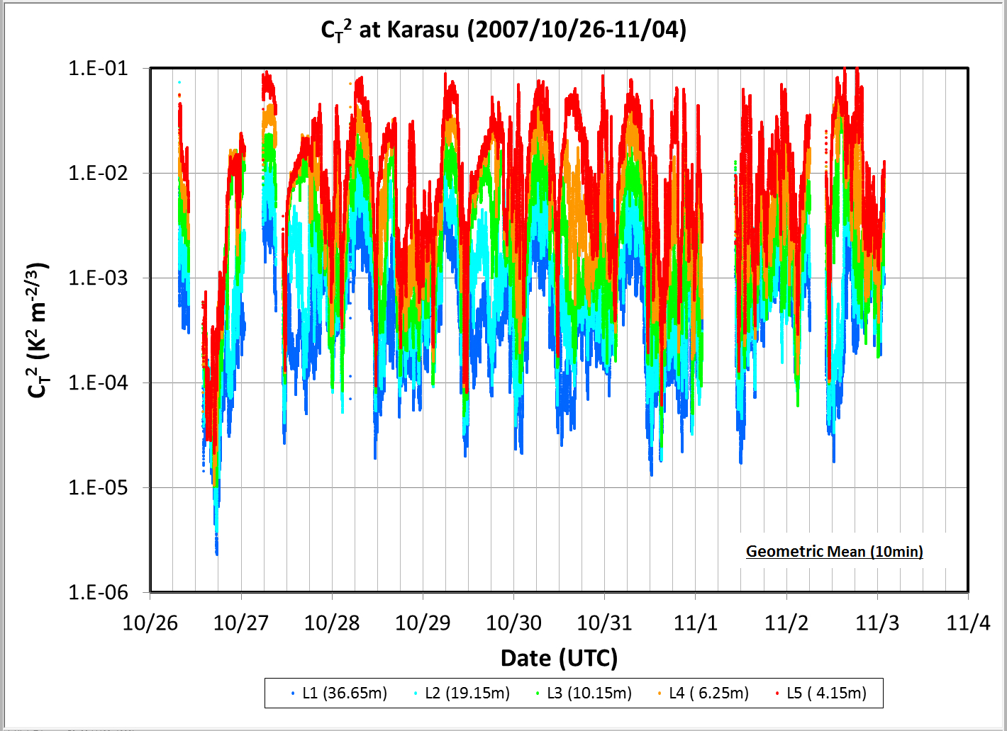
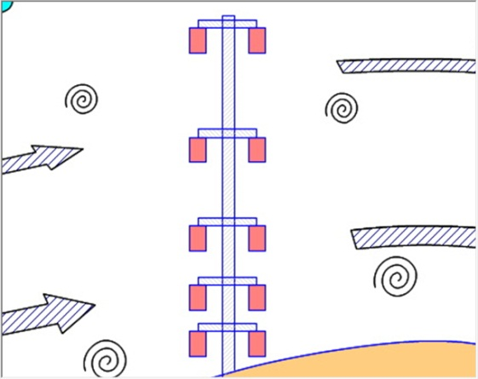
SiteSurveyWS_201204Beijing_Sasaki.pptx
China-Japan Collaborative Site Testing in West China
Micro-thermal turbulence detected with C_{T}² sensors
at Karasu
L1
36.65m
L2
19.15m
L3
10.15m
Daytime
Nighttime
L4
6.25m
L5
4.15m

Slide 23
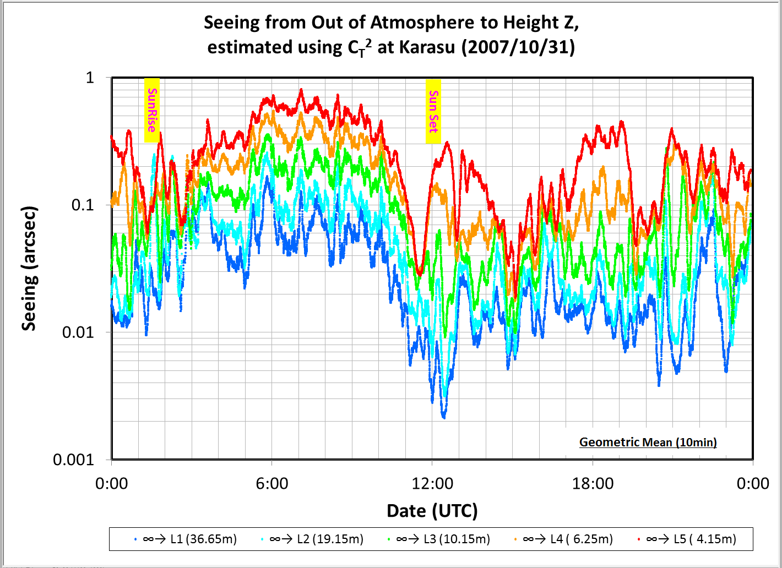
SiteSurveyWS_201204Beijing_Sasaki.pptx
China-Japan Collaborative Site Testing in West China
Image deterioration estimated with C_{T}² data
C_{T}² distribution
Image deterioration derived from C_{T}² distribution
at Karasu

Slide 24
SiteSurveyWS_201204Beijing_Sasaki.pptx
China-Japan Collaborative Site Testing in West China
Image deterioration estimated with C_{T}² data
at Karasu
L1
36.65m
L2
19.15m
L3
10.15m
Daytime
Nighttime
L4
6.25m
L5
4.15m

Slide 25
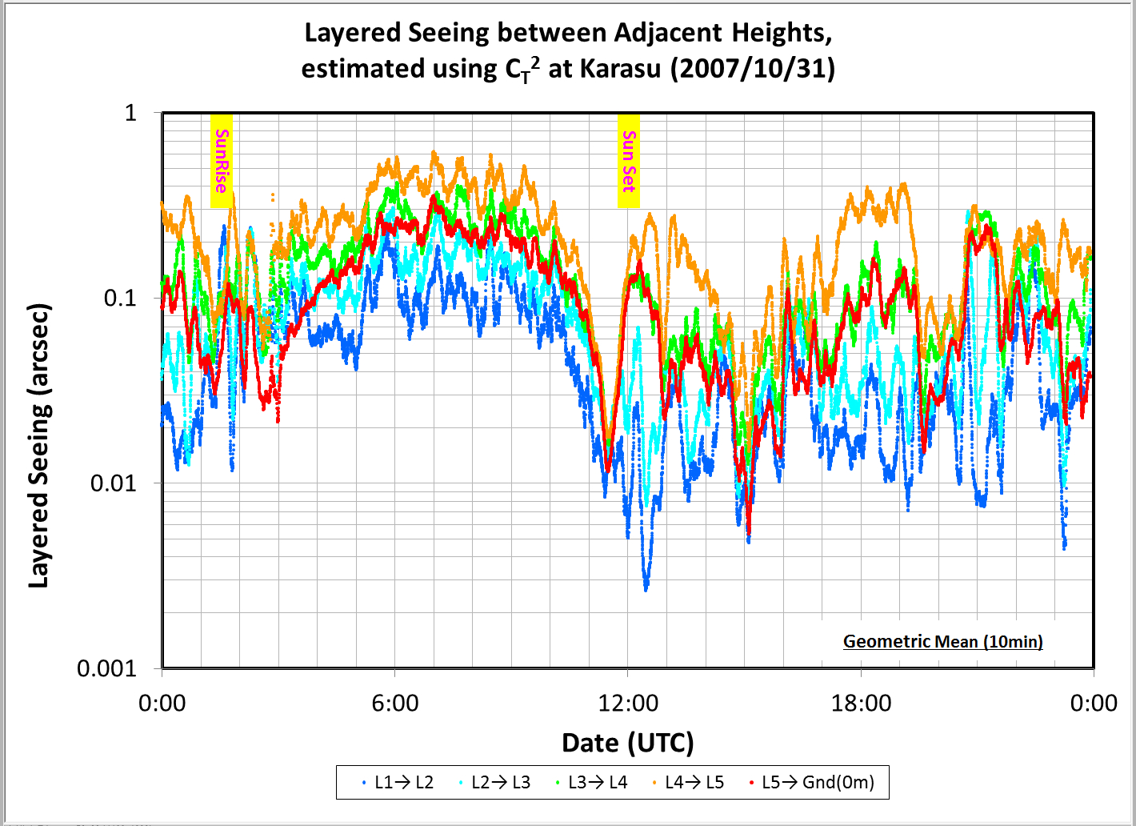
SiteSurveyWS_201204Beijing_Sasaki.pptx
China-Japan Collaborative Site Testing in West China
Layered Image deterioration estimated with C_{T}² data
at Karasu
L1
36.65m
L2
19.15m
Daytime
Nighttime
L3
10.15m
L4
6.25m
L5
4.15m
Local Image deterioration between heights of z1 and z0

Slide 26
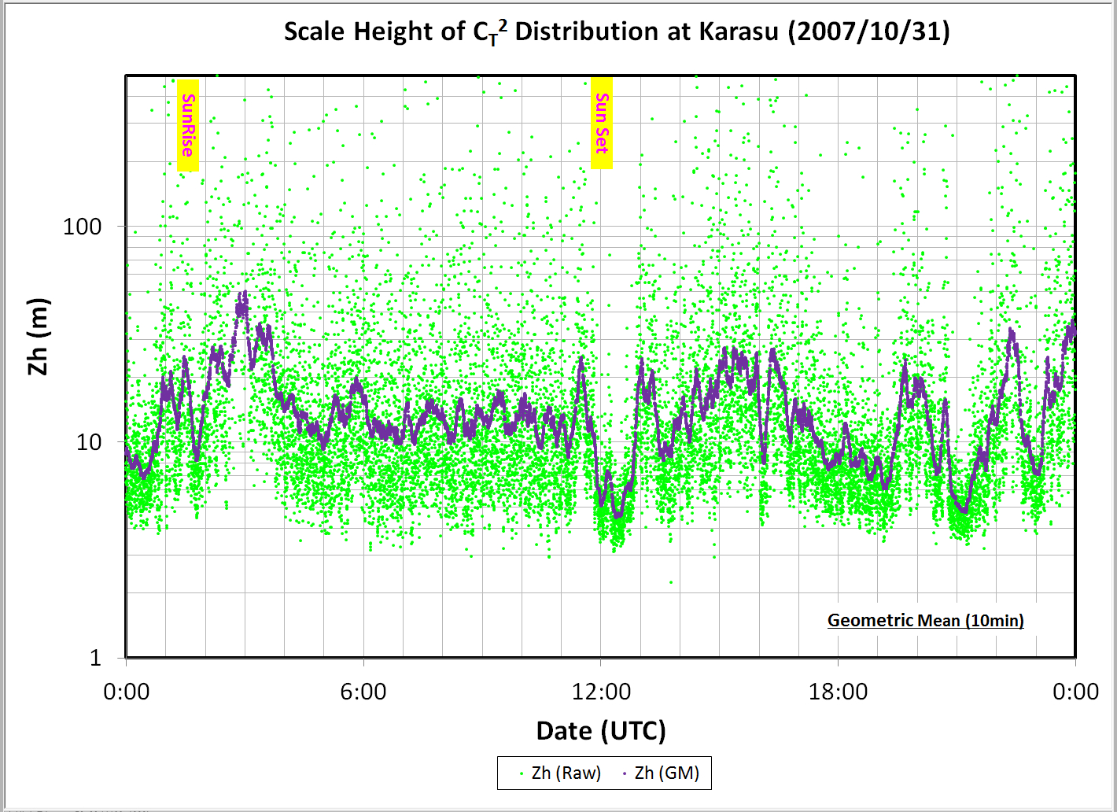
SiteSurveyWS_201204Beijing_Sasaki.pptx
China-Japan Collaborative Site Testing in West China
Scale Height of vertical distribution of C_{T}² data
derive Z_{h}
at Karasu

Slide 27
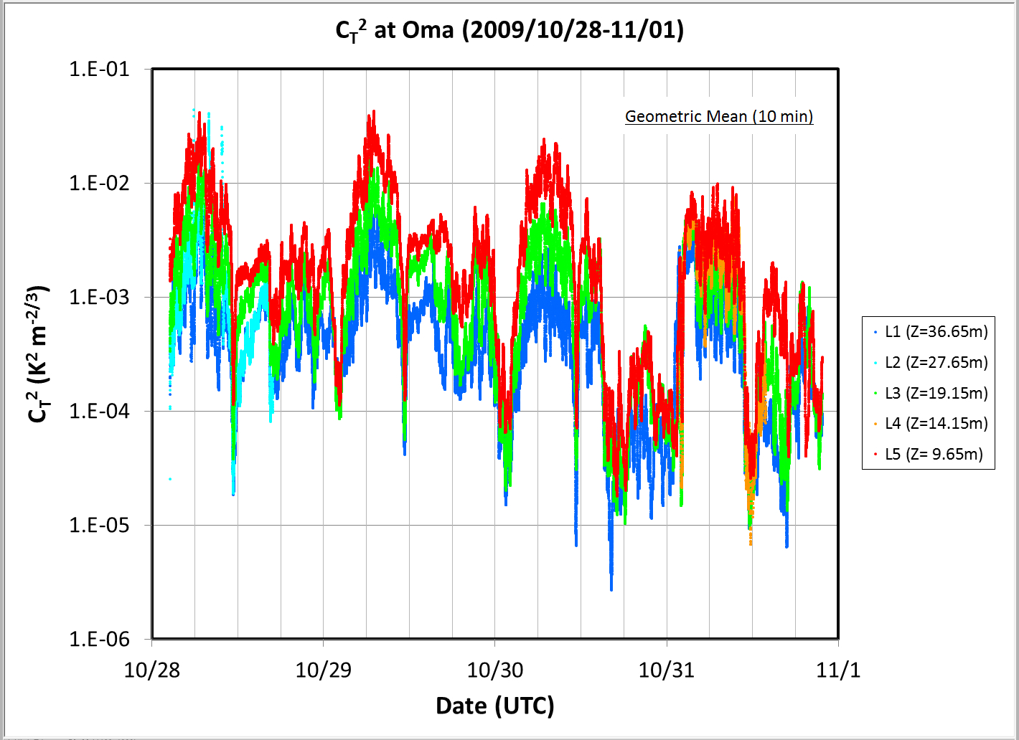
SiteSurveyWS_201204Beijing_Sasaki.pptx
China-Japan Collaborative Site Testing in West China
Micro-thermal turbulence detected with C_{T}² sensors
at Oma
L1
36.65m
L2
27.65m
L3
19.15m
L4
14.15m
L5
9.65m

Slide 28
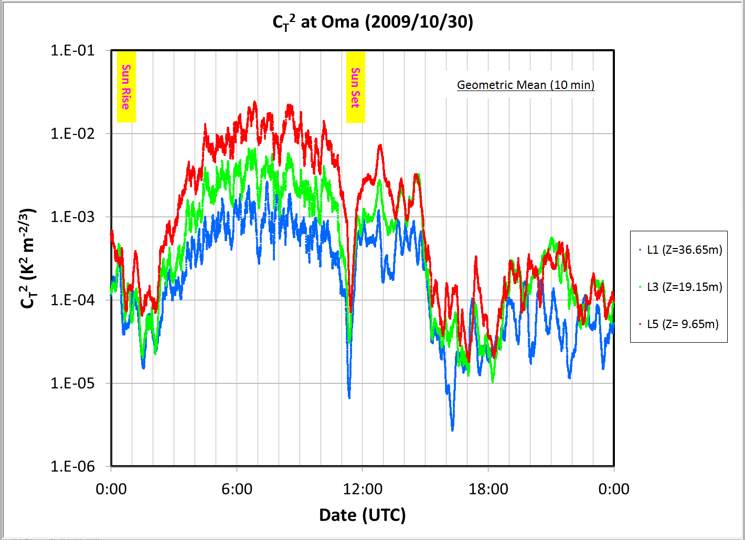
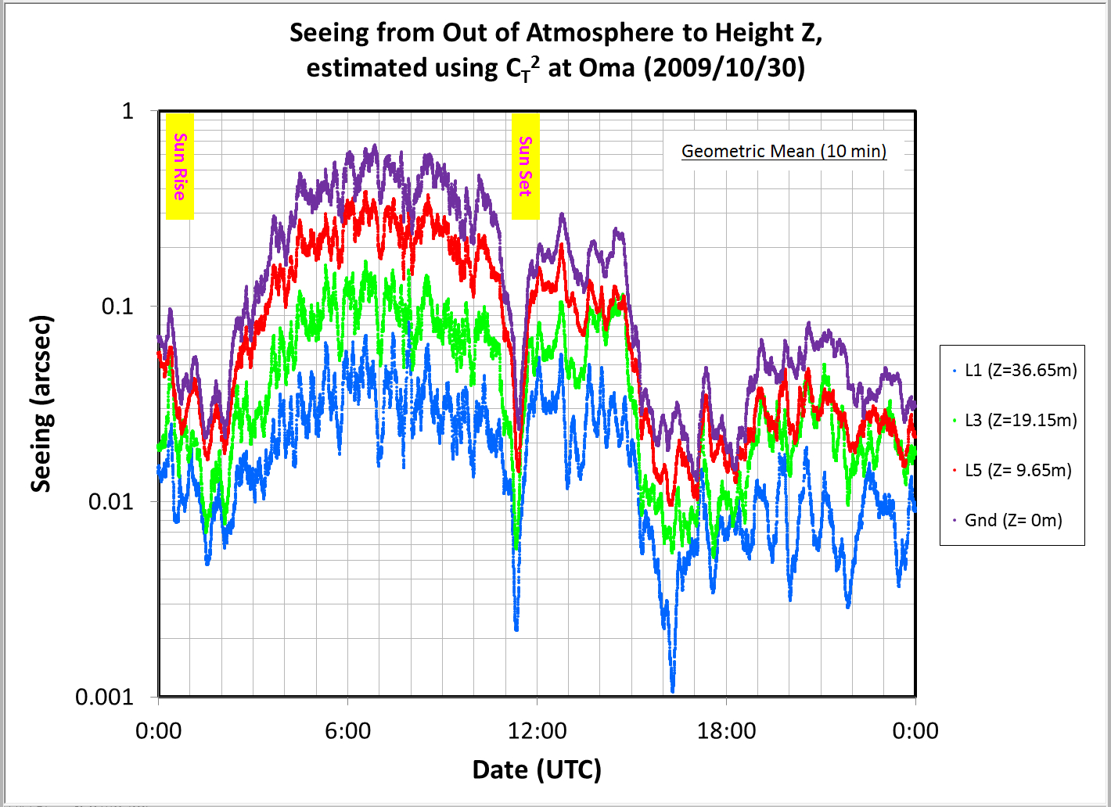
SiteSurveyWS_201204Beijing_Sasaki.pptx
China-Japan Collaborative Site Testing in West China
Image deterioration estimated with C_{T}² data
CT2 distribution
Image deterioration derived from CT2 distribution
at Oma

Slide 29
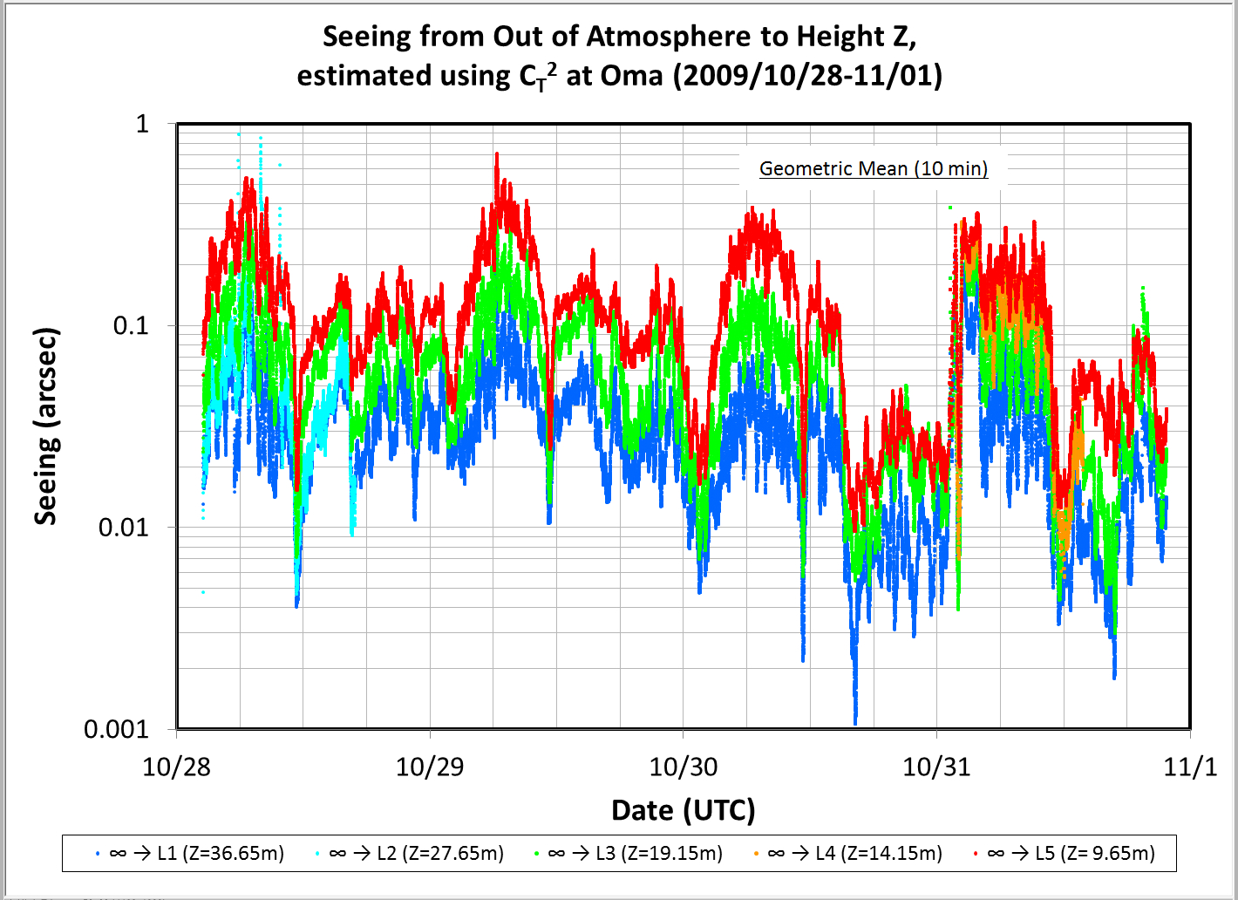
SiteSurveyWS_201204Beijing_Sasaki.pptx
China-Japan Collaborative Site Testing in West China
Image deterioration estimated with C_{T}² data
at Oma
L1
36.65m
L2
27.65m
L3
19.15m
L4
14.15m
L5
9.65m

Slide 30
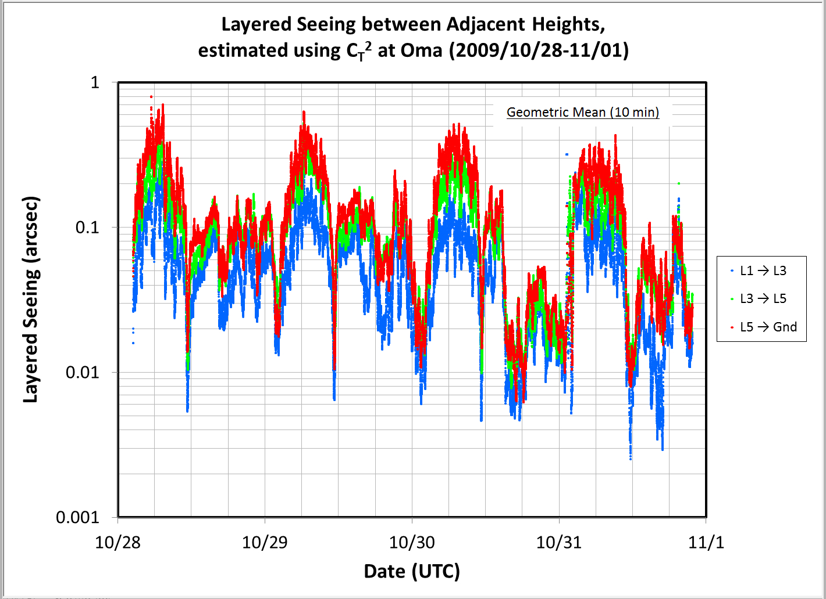
SiteSurveyWS_201204Beijing_Sasaki.pptx
China-Japan Collaborative Site Testing in West China
Layered Image deterioration estimated with C_{T}² data
at Oma
L1
36.65m
L2
27.65m
L3
19.15m
L4
14.15m
L5
9.65m

Slide 31
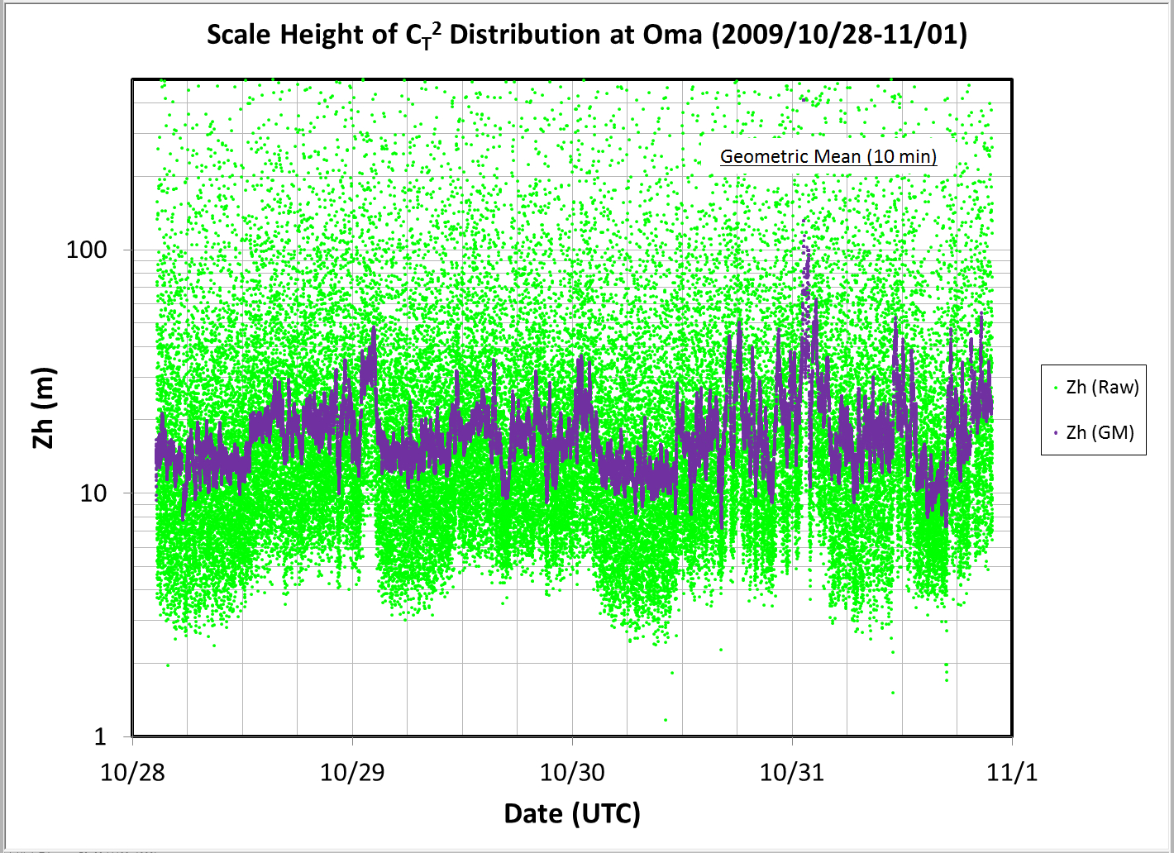
SiteSurveyWS_201204Beijing_Sasaki.pptx
China-Japan Collaborative Site Testing in West China
Scale Height of vertical distribution of C_{T}² data
derive Z_{h}
at Oma

Slide 32
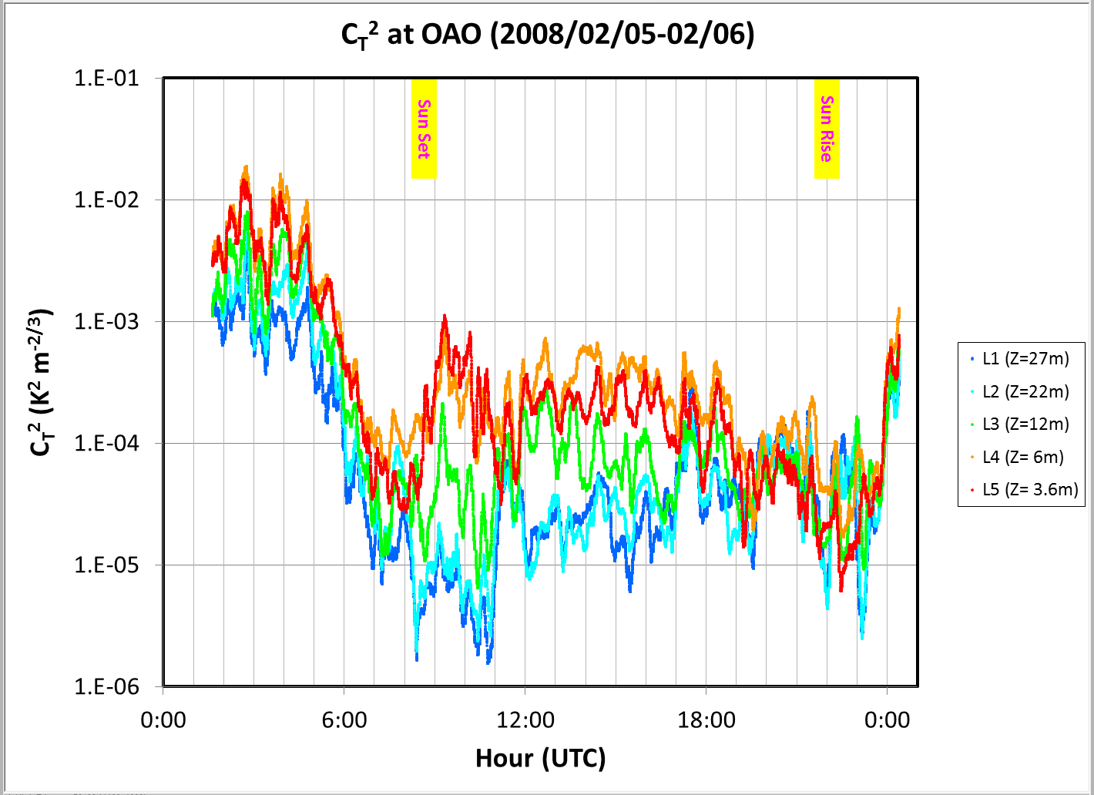
SiteSurveyWS_201204Beijing_Sasaki.pptx
China-Japan Collaborative Site Testing in West China
Micro-thermal turbulence detected with C_{T}² sensors
at OAO (Japan)
27m
22m
12m
6m
3.6m

Slide 33
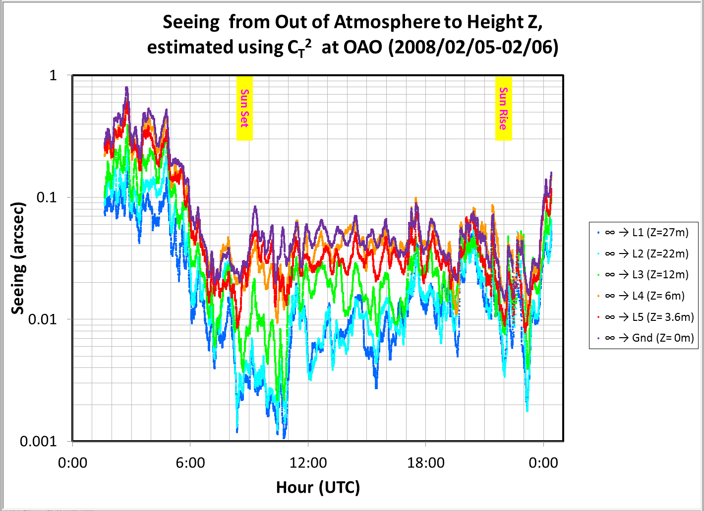
SiteSurveyWS_201204Beijing_Sasaki.pptx
China-Japan Collaborative Site Testing in West China
Image deterioration estimated with C_{T}² data
CT2 distribution
Image deterioration derived from CT2 distribution
at OAO (Japan)

Slide 34
SiteSurveyWS_201204Beijing_Sasaki.pptx
China-Japan Collaborative Site Testing in West China
Image deterioration estimated with C_{T}² data
at OAO (Japan)
27m
22m
12m
6m
3.6m

Slide 35
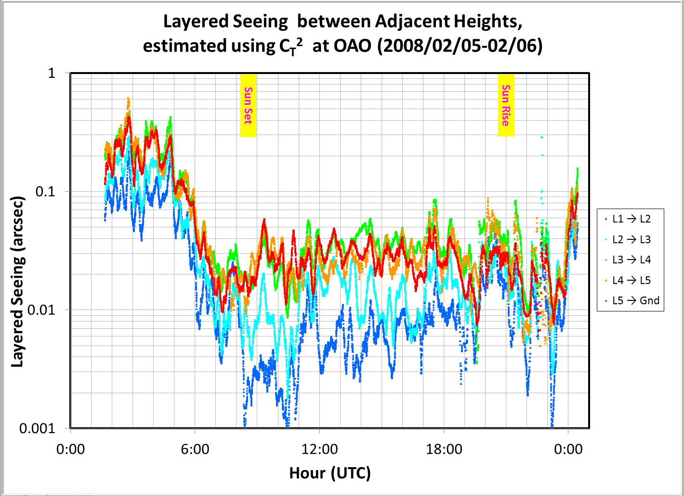
SiteSurveyWS_201204Beijing_Sasaki.pptx
China-Japan Collaborative Site Testing in West China
Layered Image deterioration estimated with C_{T}² data
at OAO (Japan)
27m
22m
12m
6m
3.6m

Slide 36
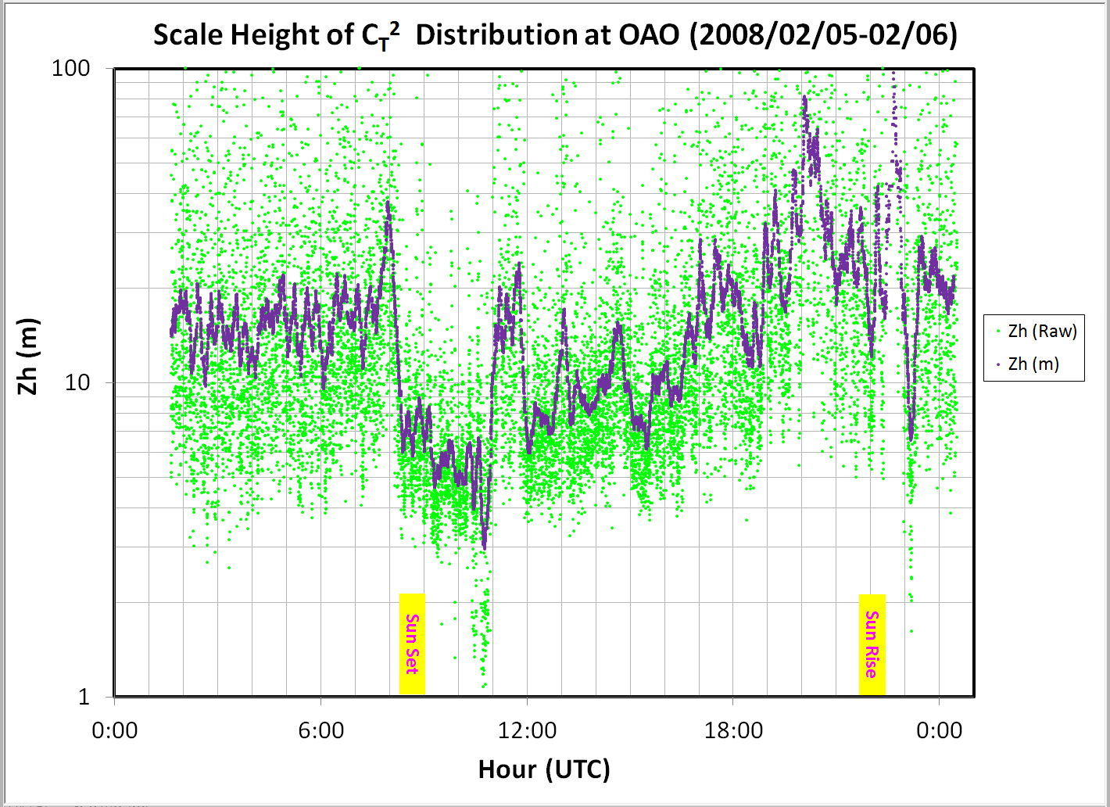
SiteSurveyWS_201204Beijing_Sasaki.pptx
China-Japan Collaborative Site Testing in West China
Scale Height of vertical distribution of C_{T}² data
derive Z_{h}
at OAO (Japan)

Slide 37
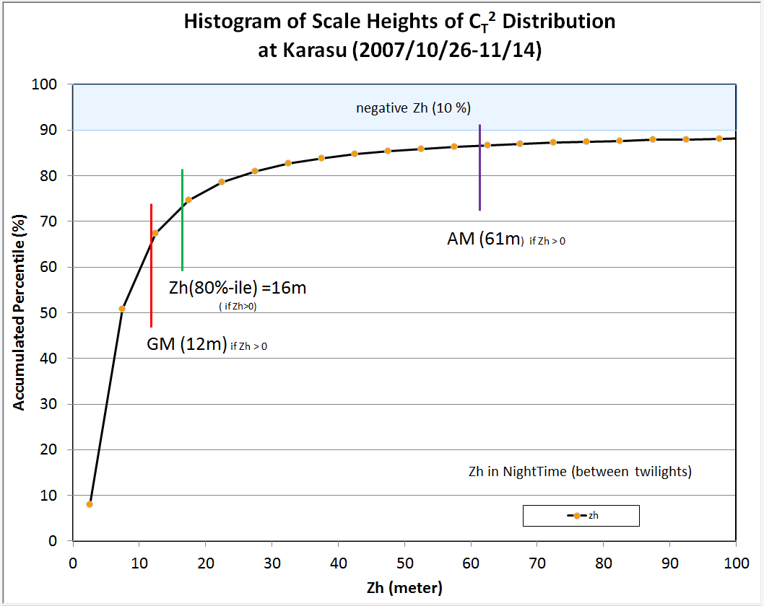
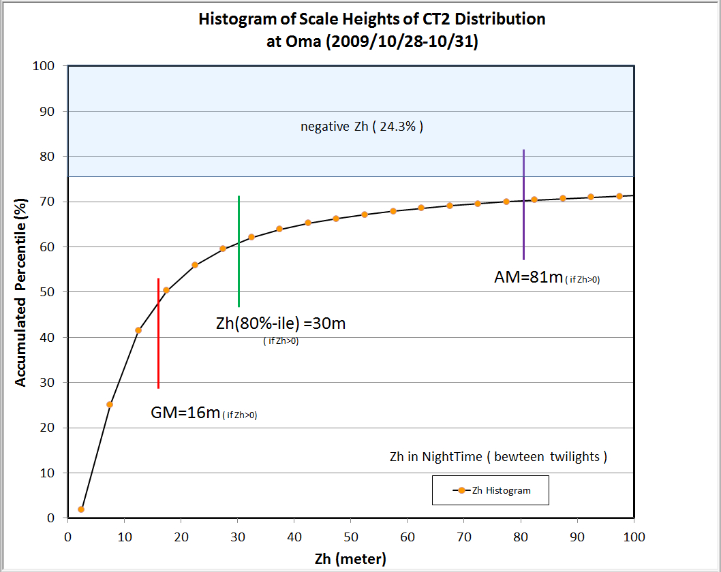
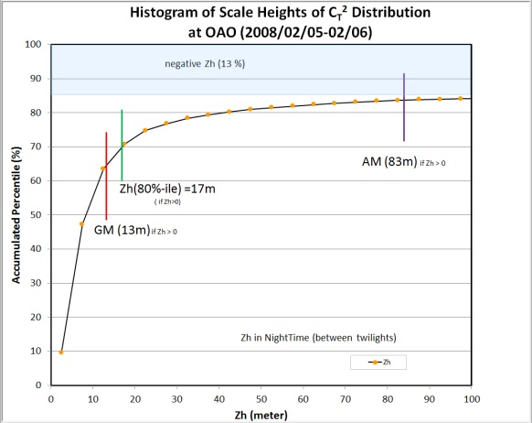
SiteSurveyWS_201204Beijing_Sasaki.pptx
China-Japan Collaborative Site Testing in West China
Histogram of scale height, Z_{h} , of vertical C_{T}² distribution
at Karasu
CT2Karasu_20071026UT07H_20071115UT01_Seeing_10min_1.xlsx
at Oma
CT2Oma_20091028UT02H_20091111UT10H_Seeing_10min_1.xlsx
CT2Okayama_20080205UT01H_20080206UT00H_Seeing_10min_1.xlsx
Location | GM of Scale Height Zh (meter) | Z of 80%-ile (for Zh>0)
Karasu | 12 m | 16m (@72%)
Oma | 16 m | 30m (@61%)
OAO (Japan) | 13 m | 17m (@70%)
at OAO (Japan)

Slide 38
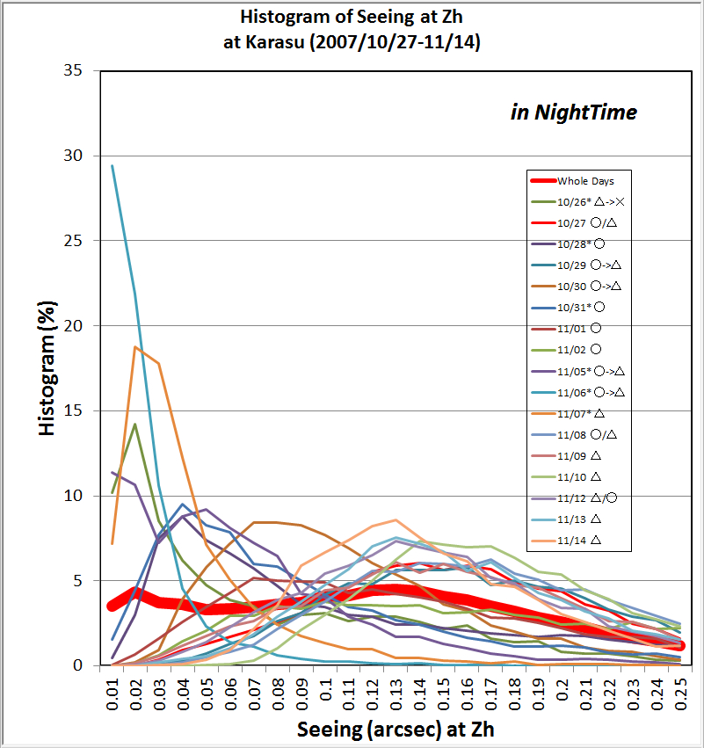
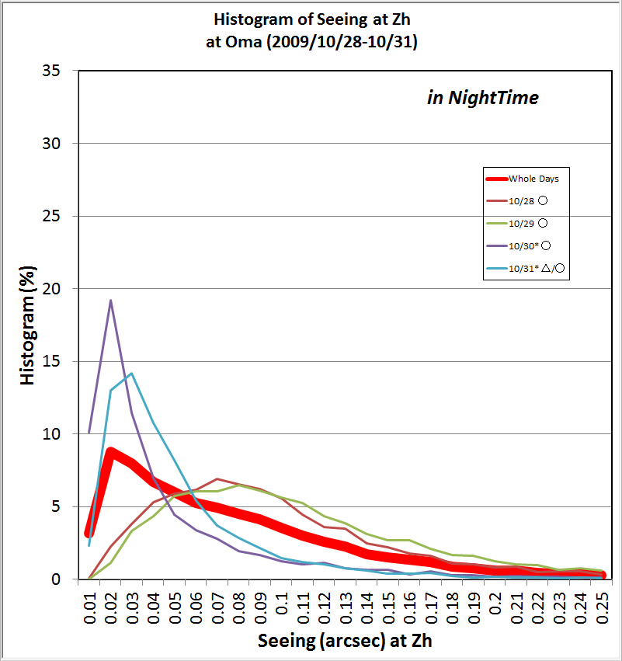
SiteSurveyWS_201204Beijing_Sasaki.pptx
China-Japan Collaborative Site Testing in West China
Histogram of image deterioration at Z_{h} estimated from C_{T}²
Location | Scale Height Zh (meter) | Image Deterio. at Zh (arcsec)
Karasu | 12 m | 0.14
Oma | 16 m | 0.08
OAO(Japan) | 13 m | 0.03
Ave: 0.14”
Ave: 0.08”
at Karasu
at Oma
CT2Karasu_20071026UT07H_20071115UT01_Seeing_10min_1.xlsx
CT2Oma_20091028UT02H_20091111UT10H_Seeing_10min_1.xlsx

Slide 39
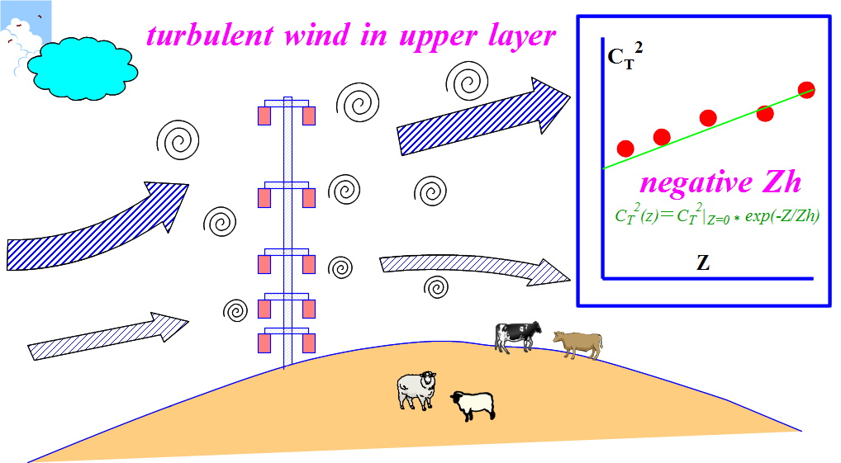
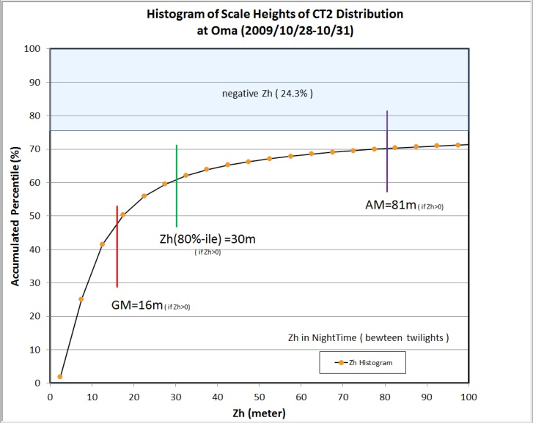

SiteSurveyWS_201204Beijing_Sasaki.pptx
China-Japan Collaborative Site Testing in West China
Negative Zh means higher turbulent atmosphere caused by strong wind
at Oma
Negative Zh
CT2Oma_20091028UT02H_20091111UT10H_Seeing_10min_1.xlsx
Upper atmosphere should be measured on turbulent motions
with SNODAR (planned).

Slide 40

SiteSurveyWS_201204Beijing_Sasaki.pptx
China-Japan Collaborative Site Testing in West China
Comparison of image deterioration at Z_{h} with seeing by SBIG camera at Oma
SBIG
Camera
C_{T}²
CT2Oma_20091028UT02H_20091111UT10H_Seeing_10min_1.xlsx
CT2Oma_20091028UT02H_20091111UT10H_Seeing_10min_1.xlsx

Slide 41

SiteSurveyWS_201204Beijing_Sasaki.pptx
China-Japan Collaborative Site Testing in West China
Comparison of image deterioration at Z_{h} with seeing w/ SBIG camera at Oma
CT2Oma_20091028UT02H_20091111UT10H_Seeing_10min_1.xlsx
CT2Oma_20091028UT02H_20091111UT10H_Seeing_10min_1.xlsx

Slide 42

SiteSurveyWS_201204Beijing_Sasaki.pptx
China-Japan Collaborative Site Testing in West China
Weather data at Oma in 2008 and 2009
Daytime
Nighttime

Slide 43

SiteSurveyWS_201204Beijing_Sasaki.pptx
China-Japan Collaborative Site Testing in West China
Weather data at Oma in 2008 and 2009
Daytime
Nighttime

Slide 44

EACOA in Jeju (Korea), 2010
China-Japan Collaborative Site Testing in West China
SiteSurveyWS_201204Beijing_Sasaki.pptx
Collaborative Site Testing in West China ( Sasaki et al.)
Weather data at Oma in 2008 and 2009
14m/sec
7 m/sec
Daytime
Nighttime
Wind Speed in winter is typically strong at Oma, which affects local seeing.
For Subaru telescope, operation is limited under Wind Speed of 14 m/sec
and its perfromance is guranteed under 7m/sec.

Slide 45

EACOA in Jeju (Korea), 2010
China-Japan Collaborative Site Testing in West China
SiteSurveyWS_201204Beijing_Sasaki.pptx
Collaborative Site Testing in West China ( Sasaki et al.)
Weather Direction at Oma in 2008 and 2009

Slide 46

SiteSurveyWS_201204Beijing_Sasaki.pptx
China-Japan Collaborative Site Testing in West China
Sky is clear or fine?
Relation among C_{T}² distribution
and Wind Speed
(2009-10-31 at Oma)
Wind Speed
Temperature
Z:\00SiteSurveyData\000_aSiteSurveySummary\
Oma_20091031_CT2_Seeing_WindSpeed_Temp.jpg

Slide 47

SiteSurveyWS_201204Beijing_Sasaki.pptx
China-Japan Collaborative Site Testing in West China
Sky is clear or fine?
Relation among C_{T}² distribution
and Wind Speed
(2009-10-31 at Oma)
Zh histogram
Wind Speed
Temperature
Z:\00SiteSurveyData\000_aSiteSurveySummary\
Oma_20091031_CT2_Seeing_WindSpeed_Temp.jpg

Slide 48

SiteSurveyWS_201204Beijing_Sasaki.pptx
China-Japan Collaborative Site Testing in West China
Earthquake in China
SeismicBigMagCentralAsia_USGS.gif

Slide 49

Candidate Site in Tibet from Satellite Data Site Survey WS at Lhasa, July, 2004
Seismic activity in Tibet
Data from GAME-Tibet project
20060506_SasakiCandidateSiteInTibet.ppt

Slide 50
SiteSurveyWS_201204Beijing_Sasaki.pptx
China-Japan Collaborative Site Testing in West China
MIR CloudMonitor
Clear sky ratios at Oma, except summer monsoon season, are around 70%, which are comparable to at Mauna Kea, Hawaii, and much bettre than at Okayama, Japan.
Subaru : statistics during 2000-2010
OAO: summary report during 2008-2009
C_{T}² measurements
Location | Scale Height Zh (meter) | Image Deterio. at Zh (arcsec)
Karasu | 12 m | 0.14
Oma | 16 m | 0.08
OAO (Japan) | 13 m | 0.03
should evaluate bad effect
of Strong wind at the sites

Slide 51

SiteSurveyWS_201204Beijing_Sasaki.pptx
China-Japan Collaborative Site Testing in West China
On-going Collaborative Site Testing at Ali
Item | Instrument |  | Status
Weather condition | Vaisala:WXT510 |  | Working at Ali
Sky condition | MIR Cloud Mon Visible all-sky camera |  | Working at Ali Working at Ali
Dust | Dust Counter TSI:DustTrak8520 |  | Working at Ali
DIMM | (NAOC) |  | Working (need Manual Operations)
SCIDAR | (NAOC) |  | Working (need Manual Operations)
Surface Layer Turbulence | CT2 sensors on tower |  | Constructed soon this year
Turbulence in upper layer | SNODAR |  | Planning (tomorrow talk)
Housing | w/ electric power |  | Available at Ali
 | O₂ supply |  | Comfortable at 5100m !
Road |  |  | need 4WD
Internet | LAN |  | Planned (not yet available stably)
apply site testing instruments with analysis tools to evaluate observational conditions at Ali for years.

Slide 52

SiteSurveyWS_201204Beijing_Sasaki.pptx
China-Japan Collaborative Site Testing in West China
The End
謝謝、ありがとう、Thank you！

