Slide 1
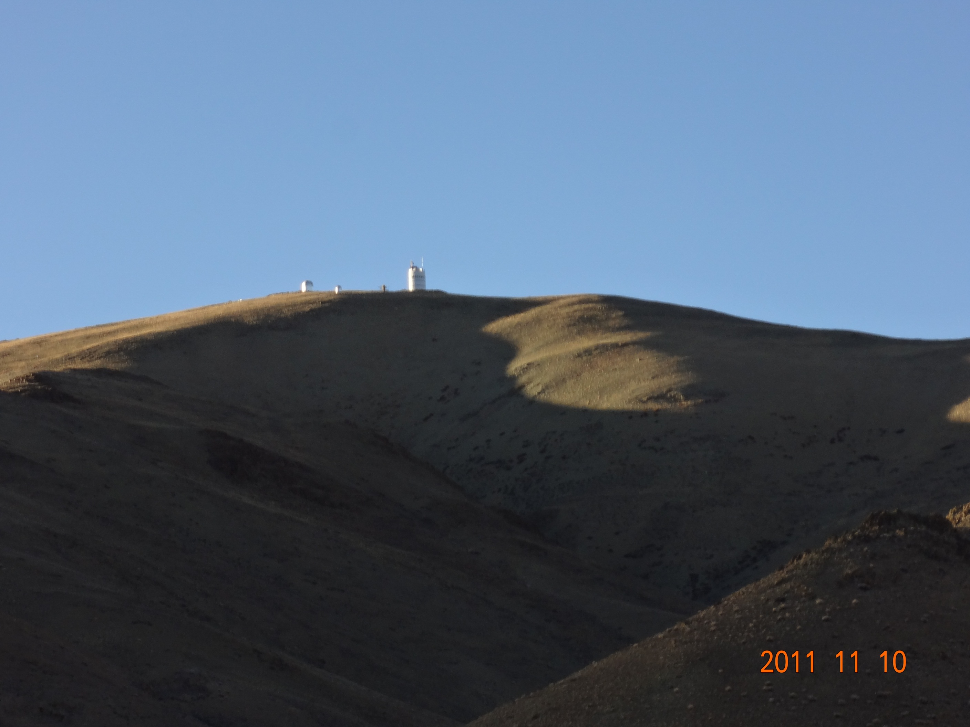
SiteSurveyWS_201204Beijing_Sasaki.pptx
China-Japan Collaborative Site Testing in West China
- A report by Japanese group -
Toshiyuki Sasaki (NAOJ)
on behalf of Site Survey Team
Prof. Yongqiang Yao (NAOC/China),
M. Yoshida(Hiroshima-u), N. Ohshima, Y. Mikami, N. Okada, H. Koyanao,
S. Nagayama, K. Sekiguchi , H. Ando (NAOJ/Japan),
L. Liu (NAOC) and Chinese collaborators
Contents
Background and monitoring instruments
Site monitor showing good conditions in winter at Oma/Tibet
- Clear Sky ratio observed with CloudMon
- image deterioration measured with micro-thermal (C_{T}²) sensors
SiteSurveyWS_201204Beijing_Sasaki.pptx

Slide 2
SiteSurveyWS_201204Beijing_Sasaki.pptx
China-Japan Collaborative Site Testing in West China
- A report by Japanese group -
Toshiyuki Sasaki (NAOJ)
on behalf of Site Survey Team
Prof. Yongqiang Yao (NAOC/China),
M. Yoshida(Hiroshima-u), N. Ohshima, Y. Mikami, N. Okada, H. Koyanao,
S. Nagayama, K. Sekiguchi , H. Ando (NAOJ/Japan),
L. Liu (NAOC) and Chinese collaborators
Contents
Background and monitoring instruments
Site monitor showing good conditions in winter at Oma/Tibet
Telescope Plan near Ali and possible 4m telescope in future for Asian astronomers
SiteSurveyWS_201204Beijing_Sasaki.pptx

Slide 3
SiteSurveyWS_201204Beijing_Sasaki.pptx
China-Japan Collaborative Site Testing in West China
Collaborative Site Testing in West China
Summary
1) Site Survey and testing has been conducted since 2003, led by Prof. Y. Yao, and two weather-monitoring stations have been settled at Karasu (Xinjiang) and Oma (Tibet).
2) Japanese team has joined the site survey project after the workshop at Lhasa, 2004. We introduced MIR cloud monitor cameras , atmospheric micro-turbulent C_{T}² sensors, and weather stations at both sites.
At Oma site, cloud monitor camera revealed excellent sky conditions in winter, but not good in summer.
Nominal seeing measured with C_{T}² was less than 0.1 arcsec up to 36m
height in Nov. 2008. We must conduct seeing measurement through whole
atmosphere w/ DIMM/MASS/(SNODAR) to evaluate seeing condition
at the site soon.
Strong winds have been observed at Oma in winter season, which may affects seeing seriously.
We are settling site survey instruments at possibly best site near Ali in
west Tibet.

Slide 4
SiteSurveyWS_201204Beijing_Sasaki.pptx
China-Japan Collaborative Site Testing in West China
Collaborative Site Testing in West China
Summary
1) Site Survey and testing has been conducted since 2003, led by Prof. Y. Yao, and two weather-monitoring stations have been settled at Karasu (Xinjiang) and Oma (Tibet).
2) Japanese team has joined the site survey project after the workshop at Lhasa, 2004. We introduced MIR cloud monitor cameras , atmospheric micro-turbulent C_{T}² sensors, and weather stations at both sites.
At Oma site, cloud monitor camera revealed excellent sky conditions in winter, but not good in summer.
Nominal seeing measured with C_{T}² was less than 0.1 arcsec up to 36m
height in Nov. 2008. We must conduct seeing measurement through whole
atmosphere w/ DIMM/MASS/(SNODAR) to evaluate seeing condition
at the site soon.
Strong winds have been observed at Oma in winter season, which may affects seeing seriously.
We are settling site survey instruments at possibly best site near Ali in
west Tibet.
7) We are discussing to deploy a small telescope w/some observation instruments and negotiating to introduce a possible 4m telescope near Ali.

Slide 5
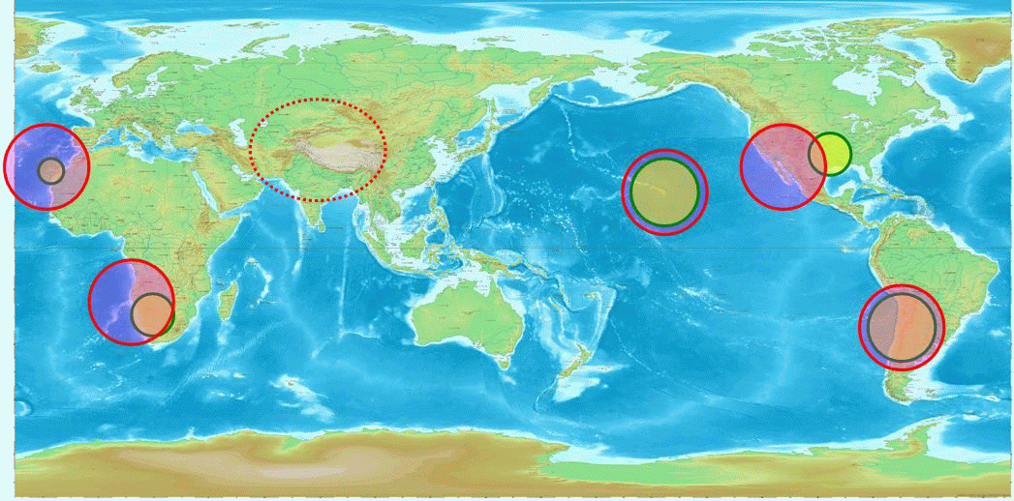
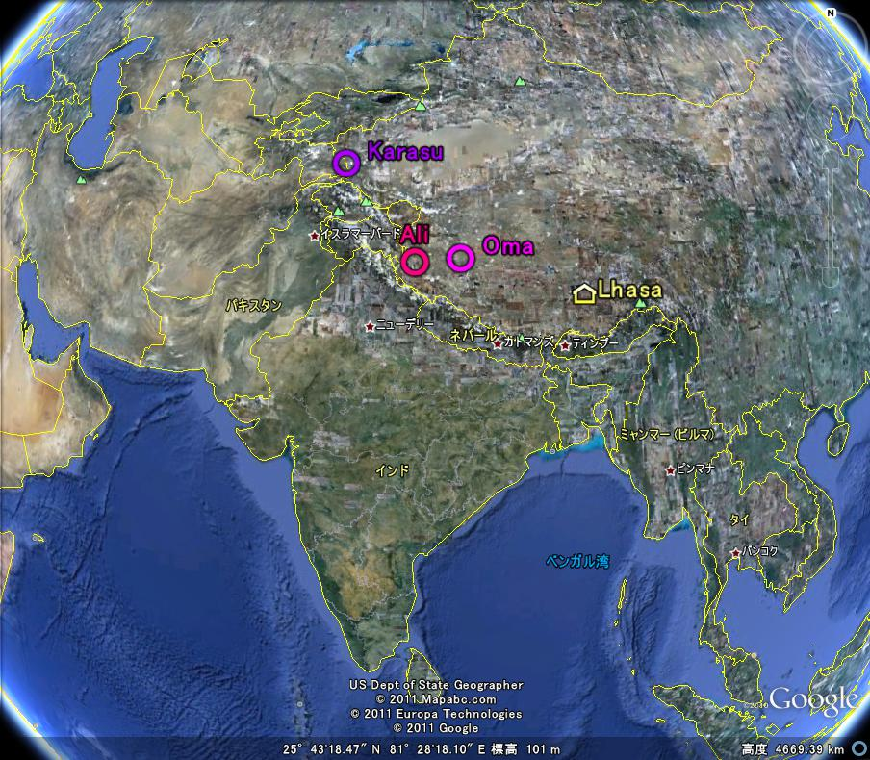
SiteSurveyWS_201204Beijing_Sasaki.pptx
China-Japan Collaborative Site Testing in West China
A site in west Tibet is in an important location for global astronomical observation network
sites in west China; Karasu, Oma, and Ali

Slide 6
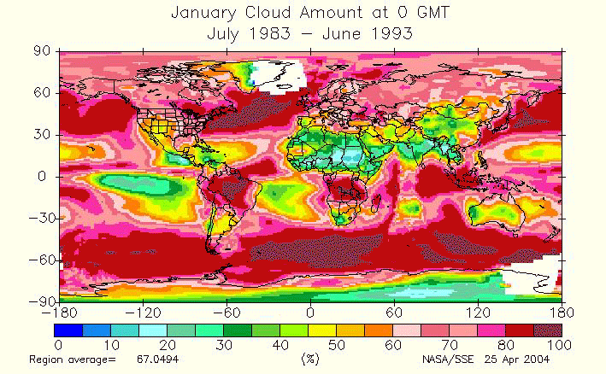
SiteSurveyWS_201204Beijing_Sasaki.pptx
China-Japan Collaborative Site Testing in West China
In Planning phase of ELT, west China is one of candidate sites
Dr. Sarazin (ESO) showed a global weather map at SPIE at Kona, 2002 .
Refer to http://eosweb.larc.nasa.gov/sse/
Meteorology and Solar Energy
Global/Regional Plots
Ｇｌｏｂａｌ Ｃｌｏｕｄ Ｄｉｓｔｒｉｂｕｔｉｏｎ

Slide 7
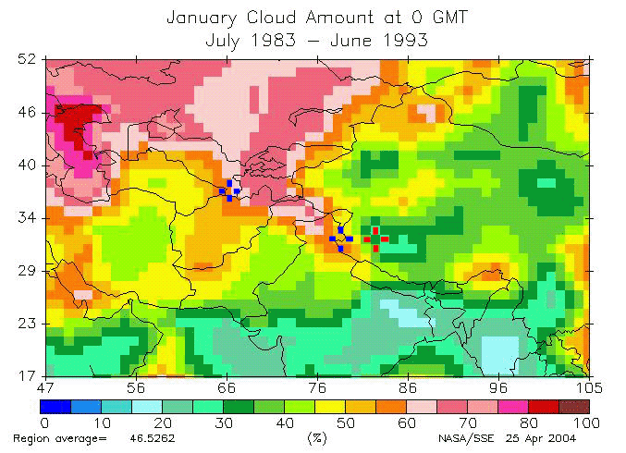
SiteSurveyWS_201204Beijing_Sasaki.pptx
China-Japan Collaborative Site Testing in West China
Arranged only for night data.
Two blue crosses show Hanle (India)
and Maidanak (Uzbekistan). Red cross
shows candidate site in Tibet.
Cloud map around west China

Slide 8
Wind Speed at Tibet and Mauna Kea at 200mb
SiteSurveyWS_201204Beijing_Sasaki.pptx
China-Japan Collaborative Site Testing in West China
Wind speed at 200mb (altitude～12000m) shows correlation with seeing size
Does it mean bad seeing during winter at Tibet? ^{(Vernin 1986 SPIE 628,142)}
Winter season
Tibet
30m/s
Mauna Kea
30m/s
From \01SatelliteData\NOAAData\AstronomicalSites\AllSites200mb.xls

Slide 9
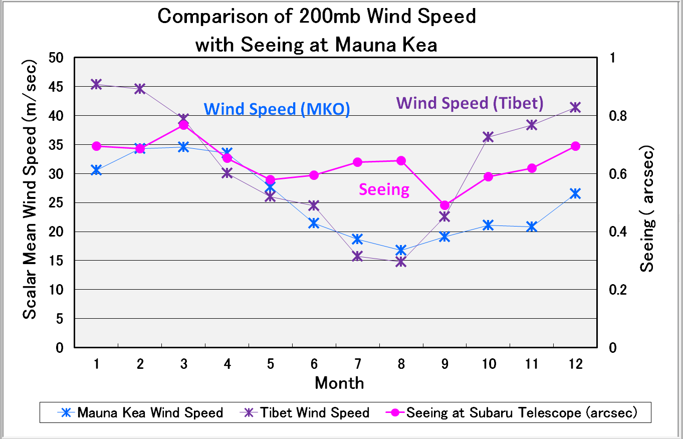
SiteSurveyWS_201204Beijing_Sasaki.pptx
China-Japan Collaborative Site Testing in West China
at MKO
Local disturbance
may affect local seeing
needs local weather
characterizing
From \01SatelliteData\NOAAData\AstronomicalSites\AllSites200mb.xls

Slide 10
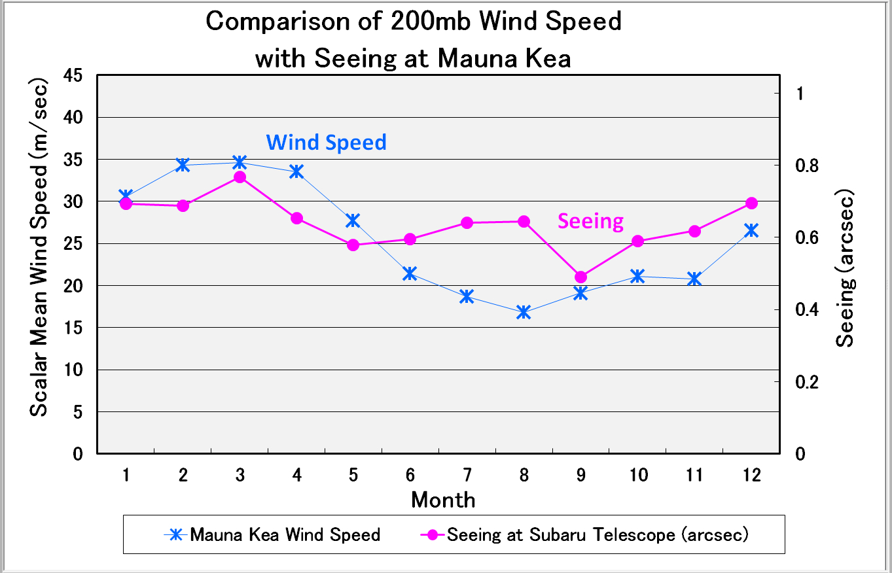
SiteSurveyWS_201204Beijing_Sasaki.pptx
China-Japan Collaborative Site Testing in West China
Local disturbance
may affect local seeing
needs local weather
characterizing
From \01SatelliteData\NOAAData\AstronomicalSites\AllSites200mb.xls

Slide 11
SiteSurveyWS_201204Beijing_Sasaki.pptx
China-Japan Collaborative Site Testing in West China
Site Surevy Project in west China
中国西部選址的協力
Future telescope plan is considered on base of
Science, Telescope, Instruments and Site.
Site is one of the very important factors for future telescopes.
Site Characteristics:
Clear night, less Cloudiness most important !
Seeing
precipitable water vapor
Wind strength
Scale height of ground-layer turbulence
coherence time
wavefront outer scale
dust
Earthquake
Accessibility
Infrastructure at Site:
Access road
Housing / Rest room
Electric Power
Water supply
Lab house
Internet connection
Food, Bed
O₂ supply for people at high mountain

Slide 12


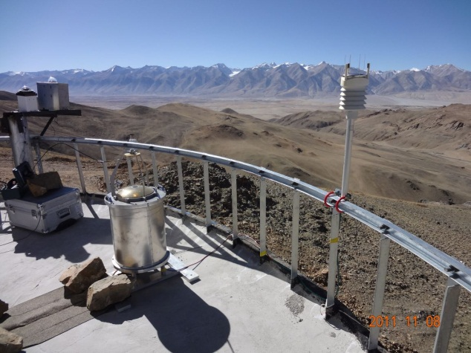
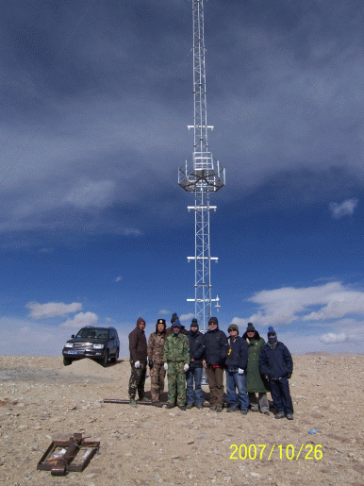
SiteSurveyWS_201204Beijing_Sasaki.pptx
China-Japan Collaborative Site Testing in West China
Site monitoring instruments available and/or planned
Instrument Method Measured value Height range
Weather Station* $ Temperature, Humidity, Wind, Pressure Meteorological data at several m
Rain, (Sunshine, IR radiation )
Dust counter* Particle counter Dust particle at several m
Visible whole-sky camera$ visible CCD camera Night sky through atmosphere
IR Cloud monitor* 10μm-band MIR camera Cloudiness through atmosphere
DIMM$ Differential Image Motion Monitor Seeing through atmosphere
MASS $ Multi-Aperture Scintillation Sensor Scintillation 1km to several 10km
SCIDAR $ Scintillation Detection and Ranging Scintillation 1km to several 10km
CT2 sensor * Micro-thermal Turbulence in Surface Layer Turbulence 0 m to several 10 m
SNODAR ^{(planned)} Surface layer Non-Doppler Acoustic Radar Scintillation 8m～200m
SODAR ^{(NOT exists)} Sound detection and ranging Scintillation 15m～1-2km
$ * Currently available instruments ($China , *Japan )
CT2 sensors on 40m tower
(at Ali)
(at Karasu)
Cloud Monitor
Weather Station

Slide 13
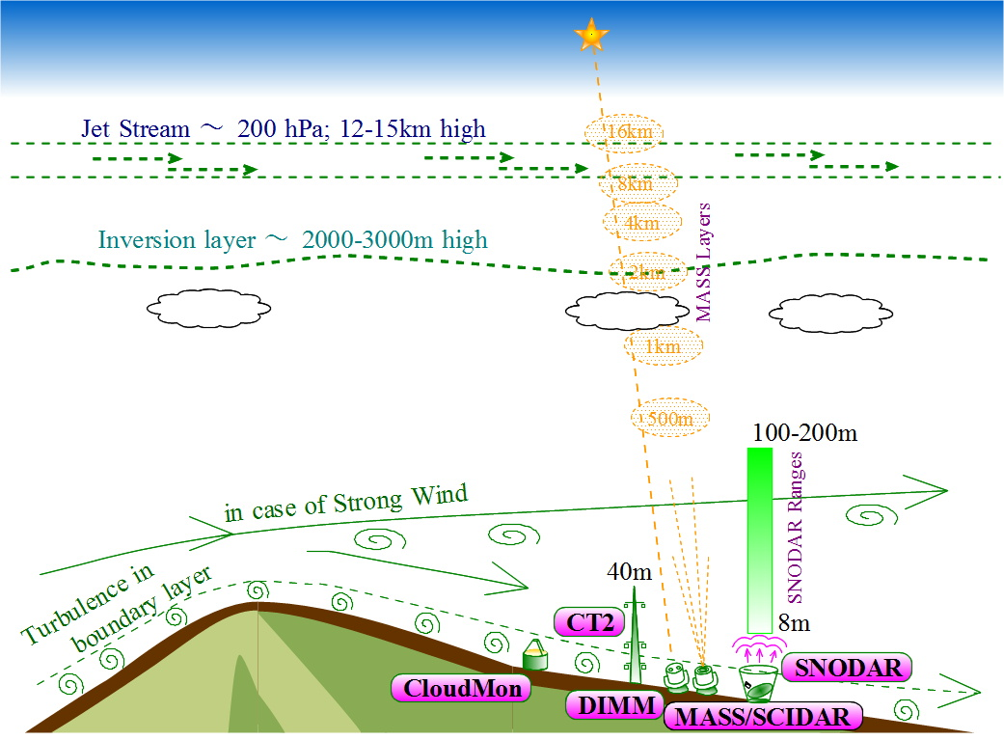
SiteSurveyWS_201204Beijing_Sasaki.pptx
China-Japan Collaborative Site Testing in West China

Slide 14
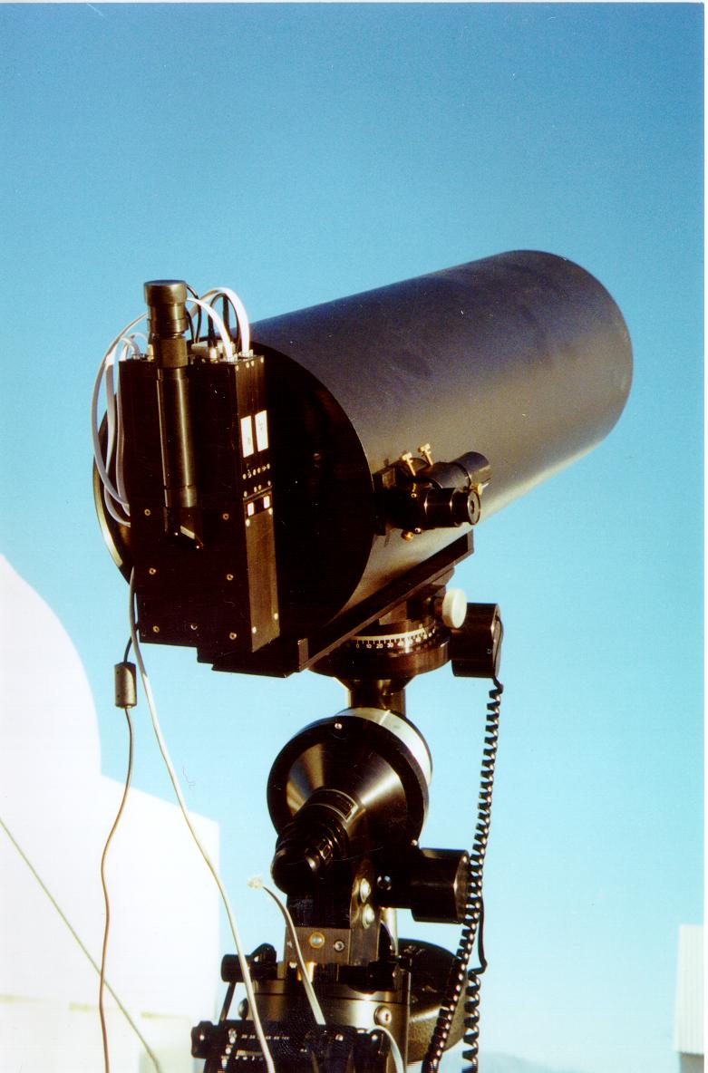
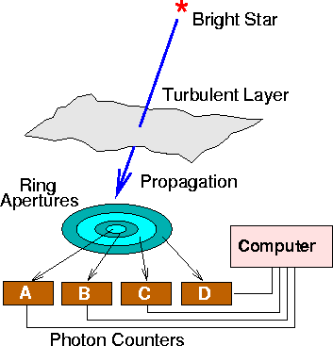
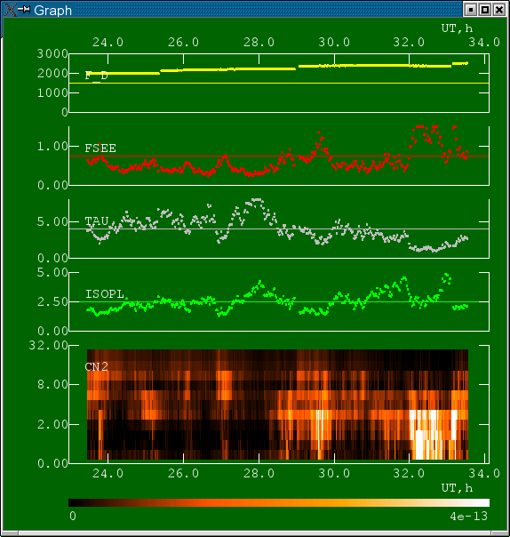
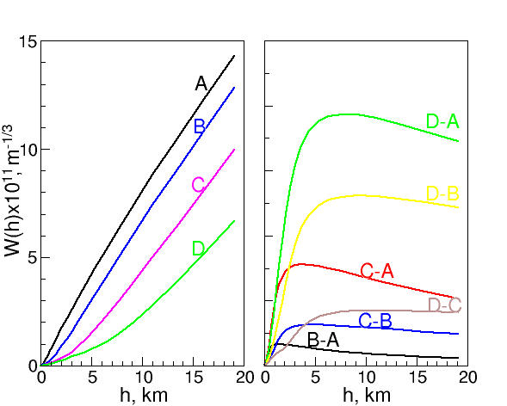
SiteSurveyWS_201204Beijing_Sasaki.pptx
China-Japan Collaborative Site Testing in West China
MASS
(Multi-Aperture Scintillation Sensor)
Figures from V.Kornilov, A.Tokovinin,2004
6 fixed layers model
( 0.5, 1, 2, 4, 8, 16 km)

Slide 15
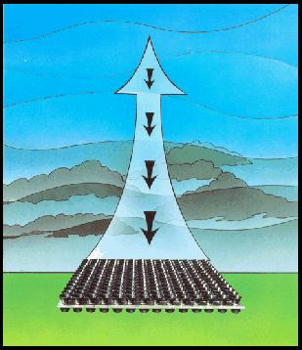
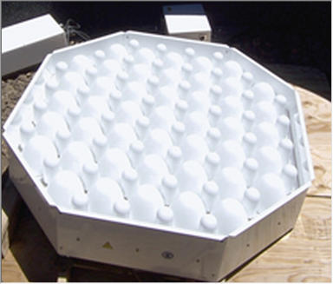
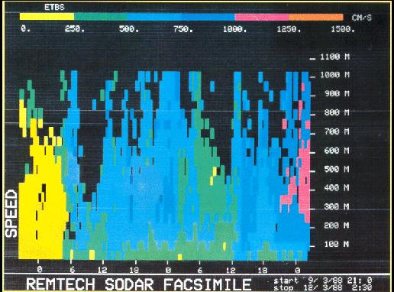
SiteSurveyWS_201204Beijing_Sasaki.pptx
China-Japan Collaborative Site Testing in West China
SODAR
(Sound detection and ranging)
Figures from http://www.remtechinc.com/sodar.htm
・An acoustic pulse into the atmosphere
・Frequency shift of the echo varies according to the wind speed (DOPPLER effect )
・Echo intensity varies according to thermal turbulence and structure.
52 elements
40 cm x 40 cm x 15 cm in size weight less than 20 kg
SODAR for TMT site survey at MKO(2006)

Slide 16
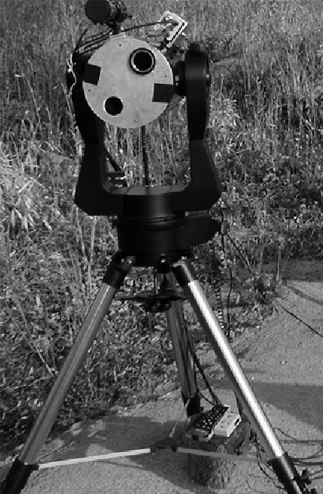
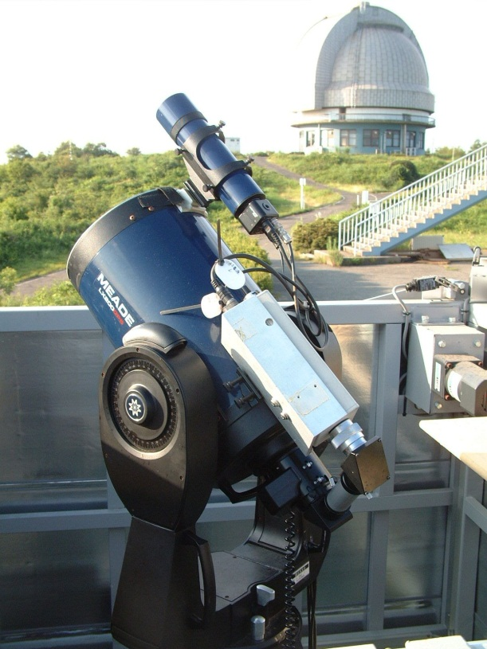
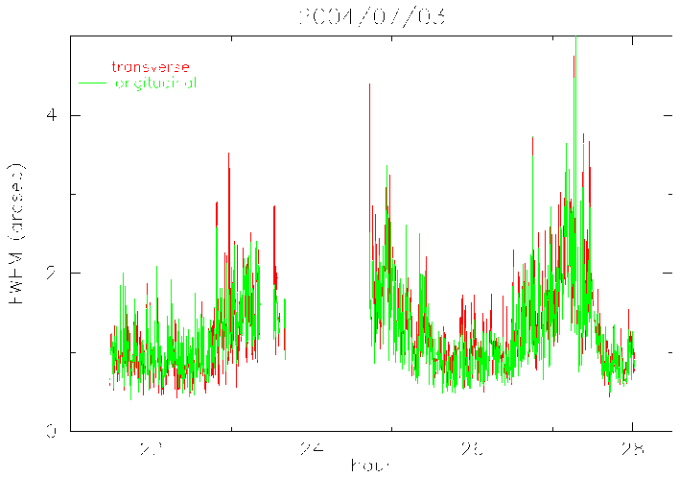
SiteSurveyWS_201204Beijing_Sasaki.pptx
China-Japan Collaborative Site Testing in West China
DIMM/OAO (Yoshida 2004)
  Meade 20 cm telescope
Two 4cmφ apertures with a separation of 15 cm
  Image-Intensified CCD
  Exposure time = 2 – 6.7 msec
  Data sampling interval = 1/30 sec
Thin cloud
High Humidity
Dome Closed
Thin cloud
DIMM/OAO
automated DIMM at OAO
1 arcsec

Slide 17
SiteSurveyWS_201204Beijing_Sasaki.pptx
China-Japan Collaborative Site Testing in West China
History of Site Survey in West China (Japanese group)
2004 Jul | Lhasa WS on Site Survey and Negotiation starts
2006 Mar | MOU between NAOC and NAOJ
2007 Mar | Install CloudMon w/ MIR camera at Karasu/Pamir
2007 Oct | Install CT2 system at Karasu/Pamir
2008 Jul | Relocate CT2 sensors at higher positions Car accident from Kashi to Hotan Visit Hami area. Total eclipse
2008 Nov | Install CloudMon, CT2 at Oma/Tibet Install WeatherStation WXT510 at Karasu
2009 Oct | Repair CT2 sensor system and replace RAID for data at Oma Extend MOU
2010 Dec | Move instruments at Oma to Ali Sasaki got “High altitude sickness” for 3 days in hospital
2011 Sep | Install CloudMonitor, Barometer, T-sensors and UPS at Ali
2011 Nov | Install WeatherStation WXT510, DustCounter at Ali
2012 Apr | Review Site survey project shall extend MOU

Slide 18
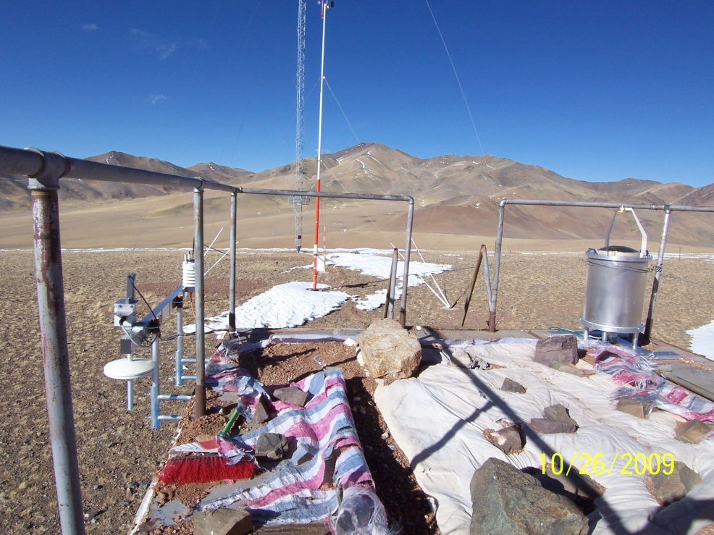
Site Monitoring Instruments at Oma (Japanese group)
SiteSurveyWS_201204Beijing_Sasaki.pptx
China-Japan Collaborative Site Testing in West China
CT2 sensor on 40m tower
Cloud Monitor camera
Weather station
and
Barometer

Slide 19
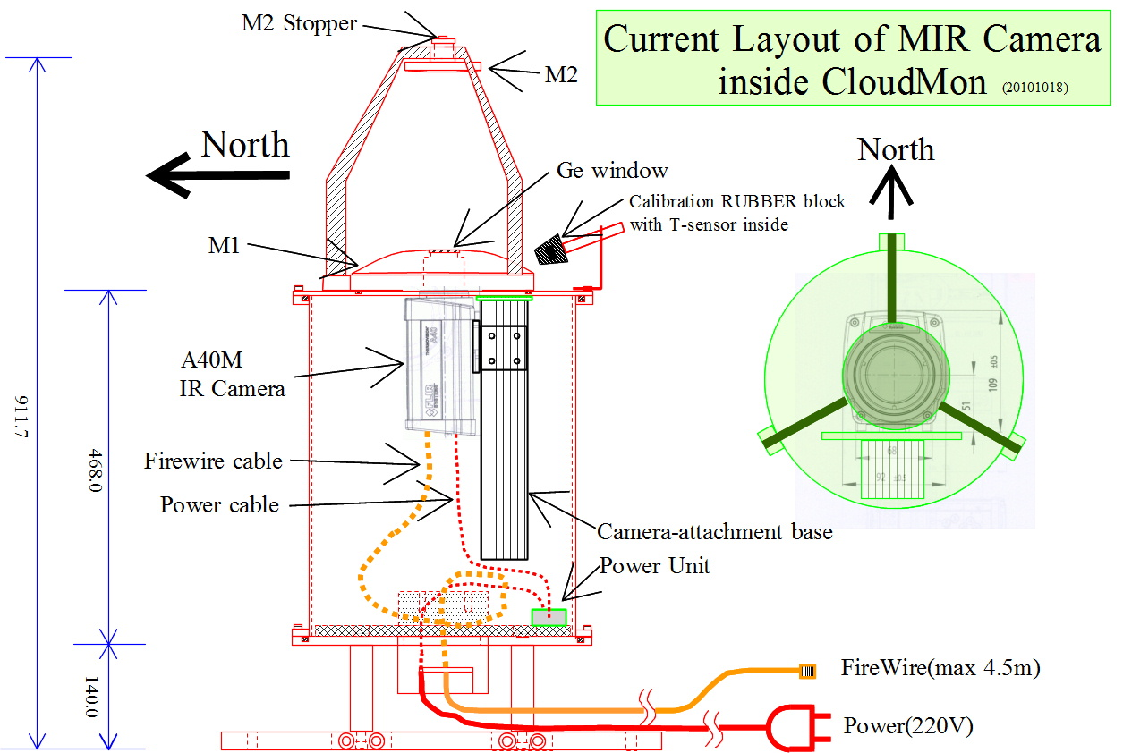
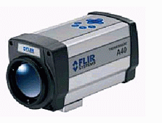
SiteSurveyWS_201204Beijing_Sasaki.pptx
China-Japan Collaborative Site Testing in West China
With mid-infrared camera (7.5 to 13 μm )
to detect cloud distribution with MIR emission of
water vapor
CloudMonitor at Karasu and at Oma
FLIR A40M：
MIR 7.5 to 13 μm
Lens 24° F/1.0 φ36mm
320x240 pixel array, 7.5Hz

Slide 20
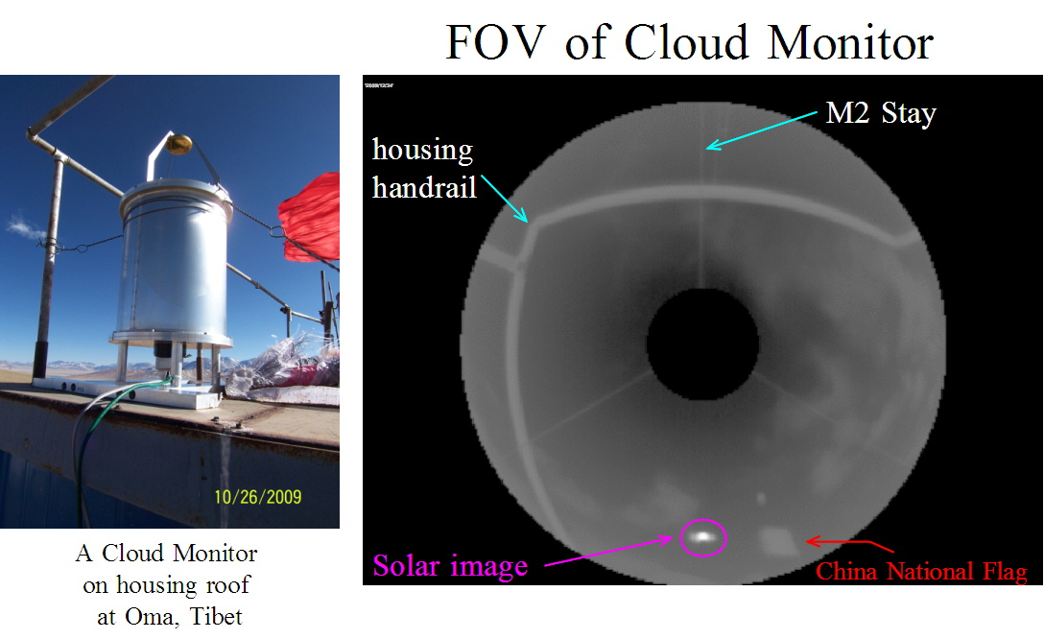
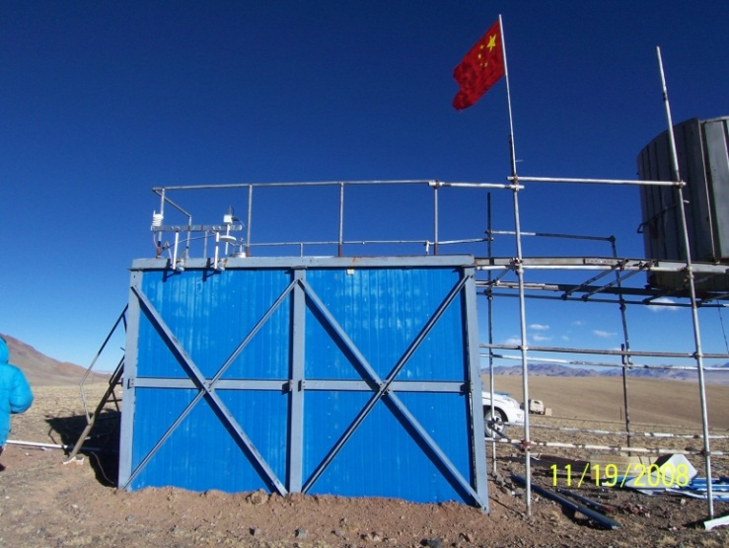
SiteSurveyWS_201204Beijing_Sasaki.pptx
China-Japan Collaborative Site Testing in West China
Cloudiness observed w/ CloudMon at Oma in 2008 and 2009

Slide 21
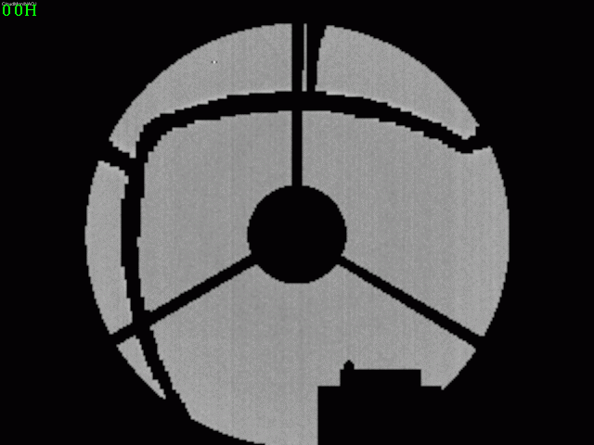
SiteSurveyWS_201204Beijing_Sasaki.pptx
China-Japan Collaborative Site Testing in West China
Sample Images of CloudMon at Oma on 2008/12/24
All-sky images, every 1 hous, taken w/Cloud Monitor at Oma on 2008-12-24
Ground-based MIR images (Thermal-Eye 2000B Camera, 7-14 μm (320x240 pixel array), 1 frame/ 1 min)

Slide 22
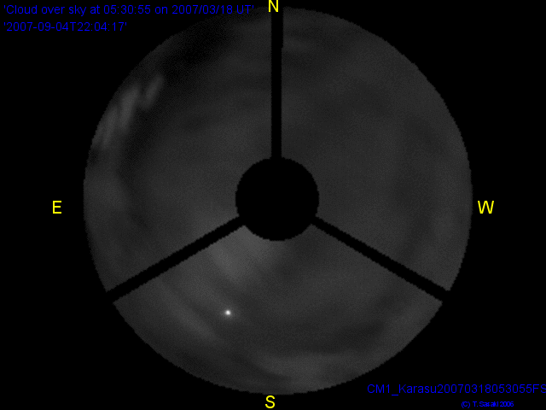
SiteSurveyWS_201204Beijing_Sasaki.pptx
China-Japan Collaborative Site Testing in West China
CloudMonitor Image
2007 March 18 at Karasu
Zenith
Z = 70°
( 20°above horizon )

Slide 23
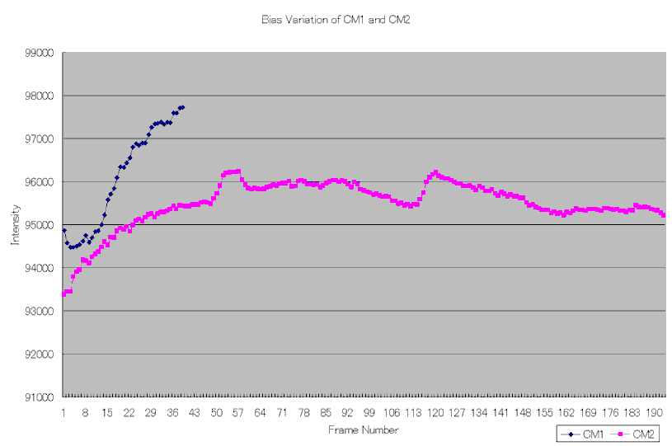
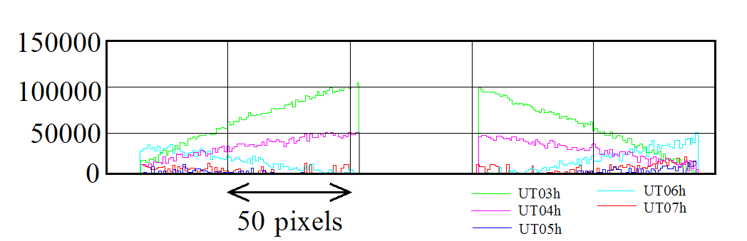
SiteSurveyWS_201204Beijing_Sasaki.pptx
China-Japan Collaborative Site Testing in West China
Error estimate of cloudiness with Cloud Monitor
Data Analysis
Flat-Fielding, 2) sky subtraction, and 3) masking
Estimated Errors
1) Flat-Fielding image with covered-wth-cap camera with variation of 3.4%.
2) Background intensity variation of 7.7% of flat-fielded images;
a part of variation are due to solar radiation,
but other might be sensitivity variation of the MIR camera.
3) time-dependent variation of sensitivity across the image of 10 - 12%
In total, intensity error might be of 14%.
Due to this large error, we use CloudMonitor images
only for qualitative evaluation of cloudiness so far.
Bias variation
Sensitivity variation

Slide 24
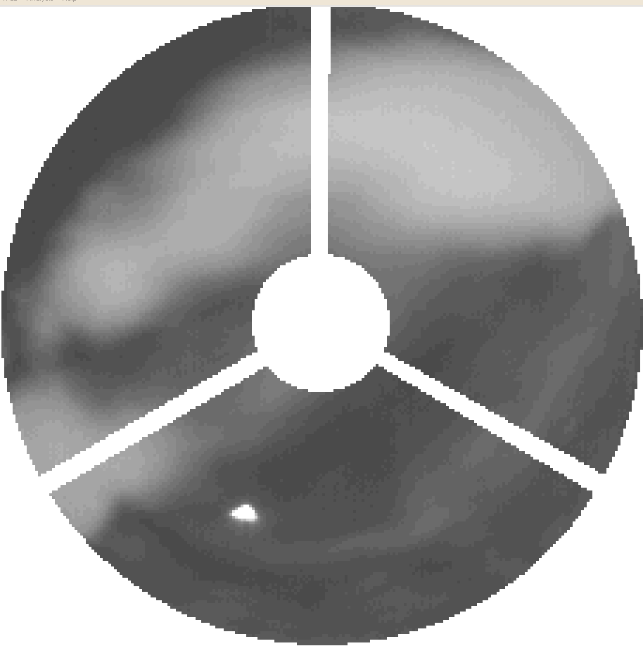
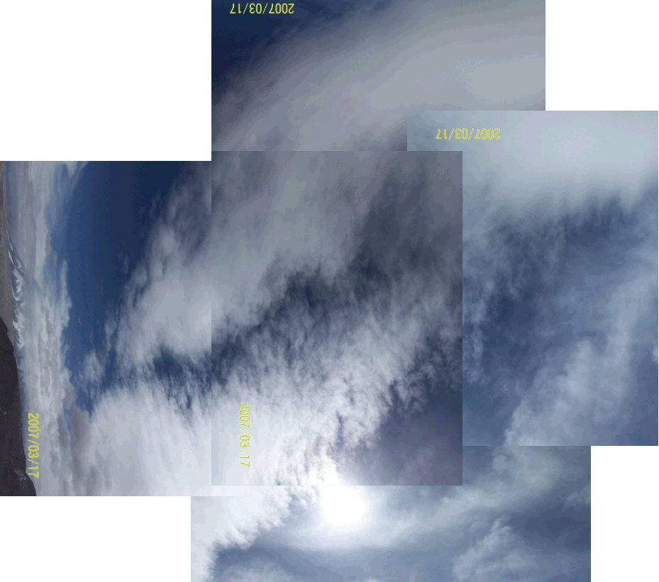
SiteSurveyWS_201204Beijing_Sasaki.pptx
China-Japan Collaborative Site Testing in West China
Comparison between CloudMon (MIR) image and Visible image
on 2007 March 17 05:35:55UT
Using intensity of solar image
CloudMon detection limit of Cloud w/ 5 % extinction
Sun
CloudMonitor image
(MIR)
Digital camera
(Visible)

Slide 25
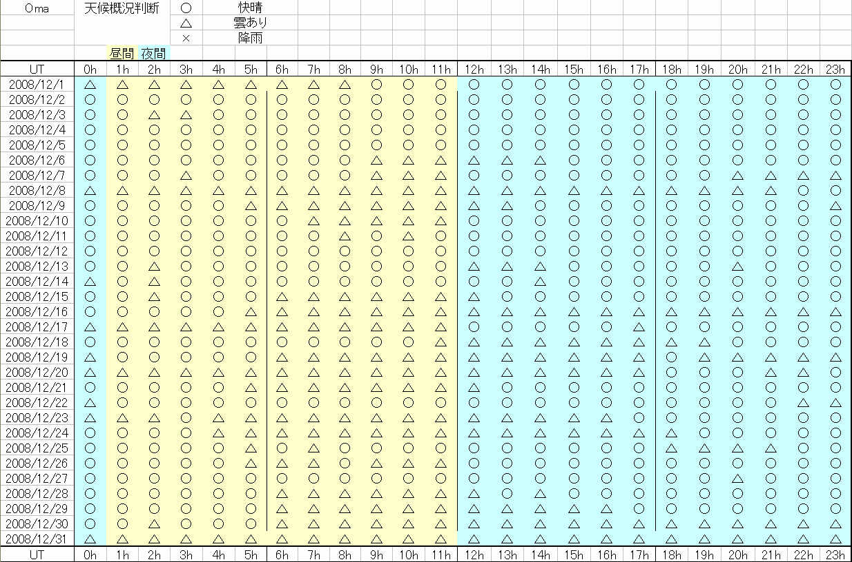
SiteSurveyWS_201204Beijing_Sasaki.pptx
China-Japan Collaborative Site Testing in West China
Cloudiness judged w/ CloudMon Images at Oma in 2008 Dec.
Clear
Fine/fair/partly cloudy
Cloudy/rainy

Slide 26
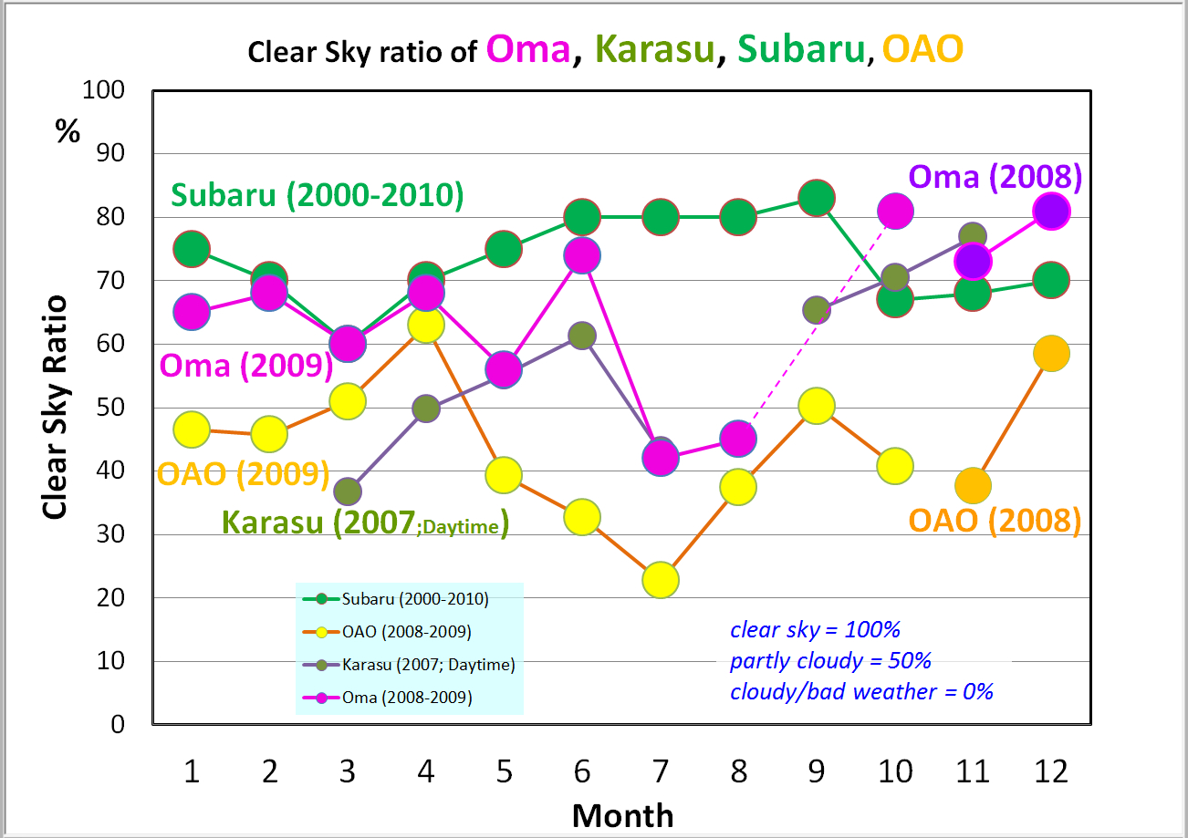
SiteSurveyWS_201204Beijing_Sasaki.pptx
China-Japan Collaborative Site Testing in West China
Clear sky ratios at Oma, except summer monsoon season, are around 70%, which are comparable to at Mauna Kea, Hawaii, and much bettre than at Okayama, Japan.
Subaru : statistics during 2000-2010
OAO: summary report during 2008-2009

Slide 27
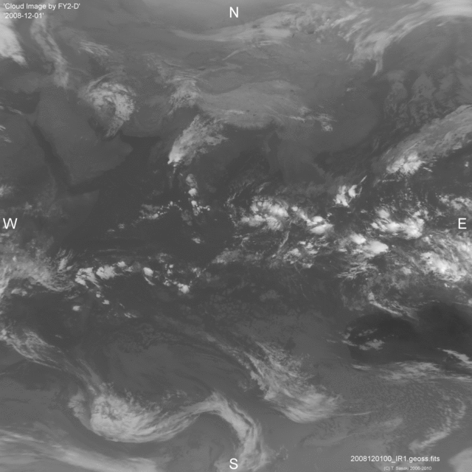
SiteSurveyWS_201204Beijing_Sasaki.pptx
China-Japan Collaborative Site Testing in West China
Weather Satellite, FY2-D, Image
Chinese Weather Satellite, FY2-D,
is currently working and their data
are available at Chiba-U, Japan
on Web site,
ftp://fy.cr.chiba-u.ac.jp/
( Resolution = 0.04°～ 4km )

Slide 28
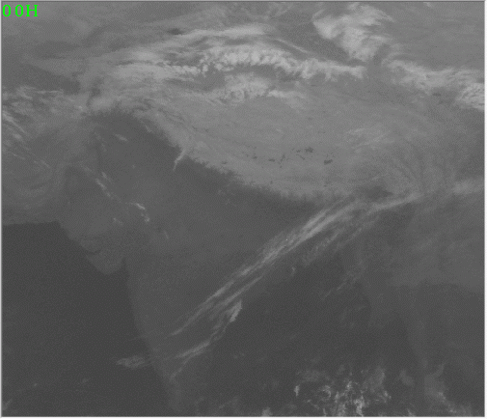
SiteSurveyWS_201204Beijing_Sasaki.pptx
China-Japan Collaborative Site Testing in West China
Clouds observed w/Weather Satellite and ground-based CloudMon
Weather Satellite, FY2-D in IR(10μm)
MIR Cloud Monitor Camera (7-14μm)
Ground-based Monitoring of Clouds in the sky is very useful to evaluate the site,
as weather satellite data is difficult to clarify localized cloud behaviors.

Slide 29
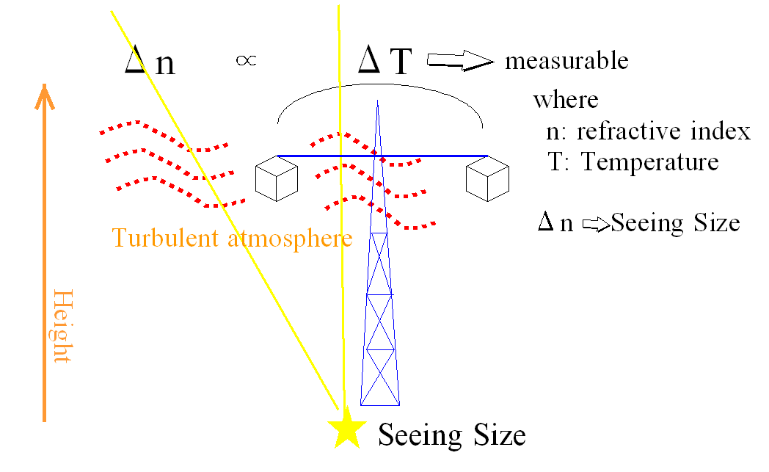
SiteSurveyWS_201204Beijing_Sasaki.pptx
China-Japan Collaborative Site Testing in West China
Micro-thermal turbulence detected with C_{T}² sensors
C_{T}² : temperature structure coefficient
C_{n}² ∝ P² T⁻⁴ C_{T}²
C_{n}² : refractive index structure coefficient
Related Site testing instruments
・DIMM: Differential Image Motion Monitor
・MASS/SCIDAR: Multi Aperture Scintillation Sensor
・C_{T}² sensor : Micro-thermal turbulence in surface layer
to measure height variation
・SNODAR: Surface layer Non-Doppler Acoustic Radar to measure Scintillation
・SODAR: Sound detection and ranging to measure Scintillation

Slide 30
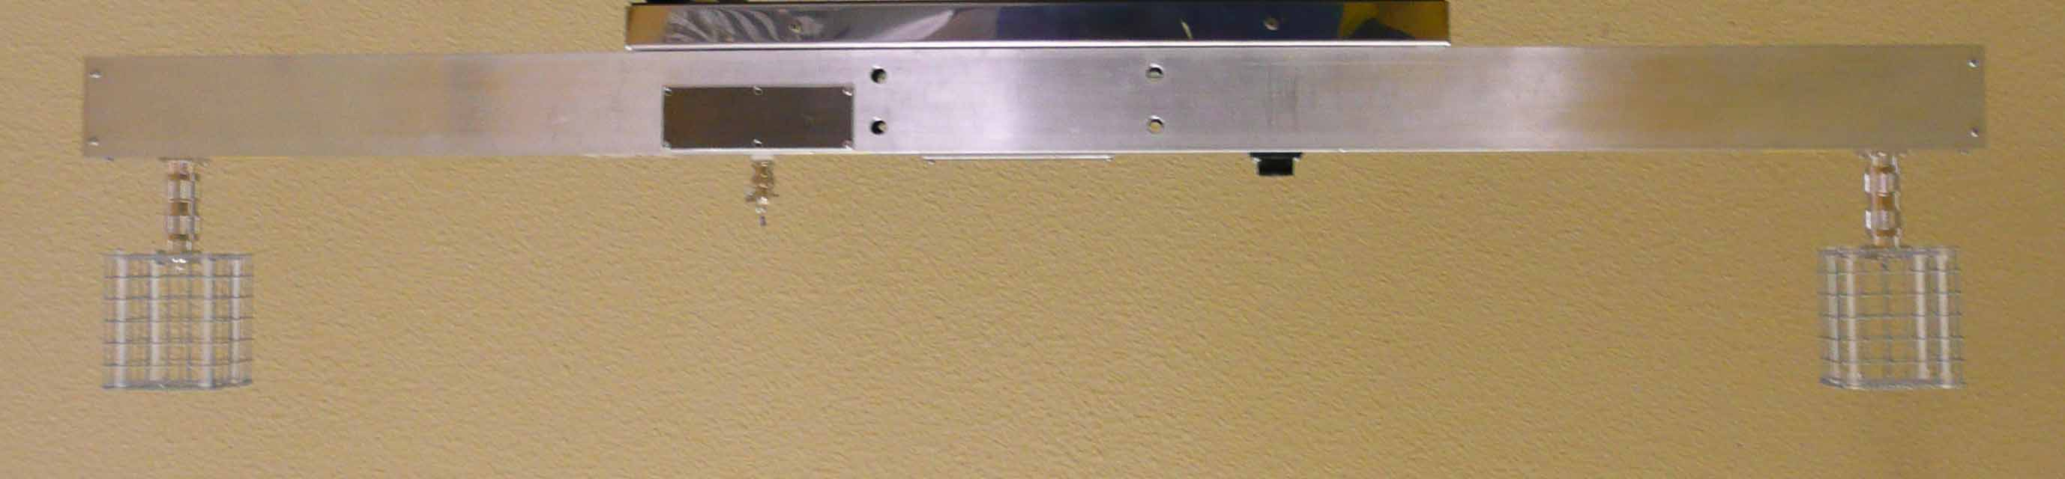
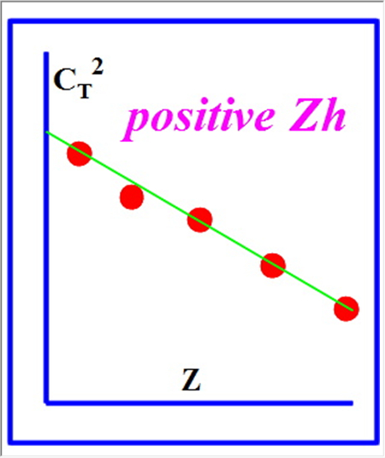
SiteSurveyWS_201204Beijing_Sasaki.pptx
China-Japan Collaborative Site Testing in West China
CT2 measurements at Karasu and at Oma
Temperature sensor
A pair of CT2 sensors w/ 25μm Ni wire
Temperature Structure Coefficient
Image deterioration estimated from C_{T}²

Slide 31
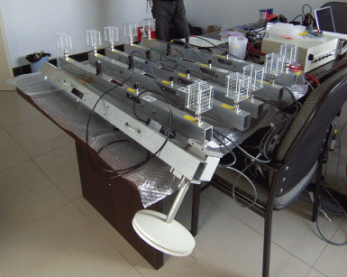
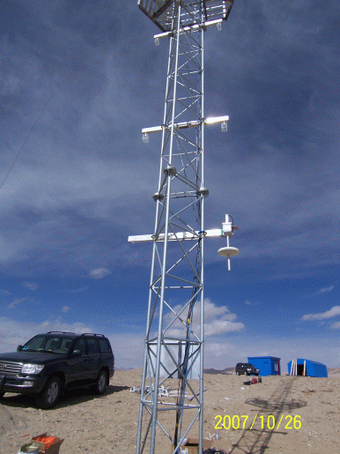
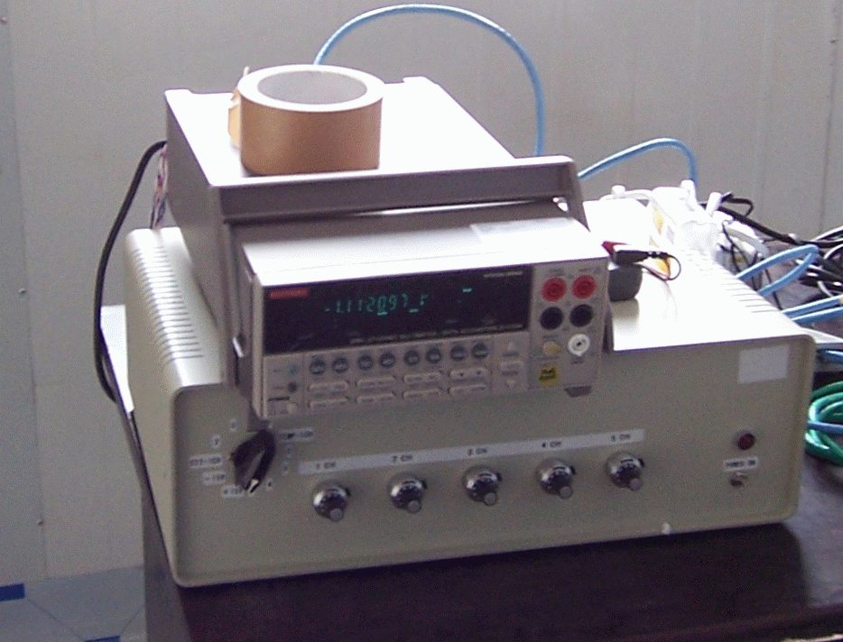
SiteSurveyWS_201204Beijing_Sasaki.pptx
China-Japan Collaborative Site Testing in West China
C_{T}² measurements at Karasu and at Oma
5 Layers of a C_{T}² sensor pair
Barometer
Barometer
Controller and
Digital Multimeter
Karasu

Slide 32
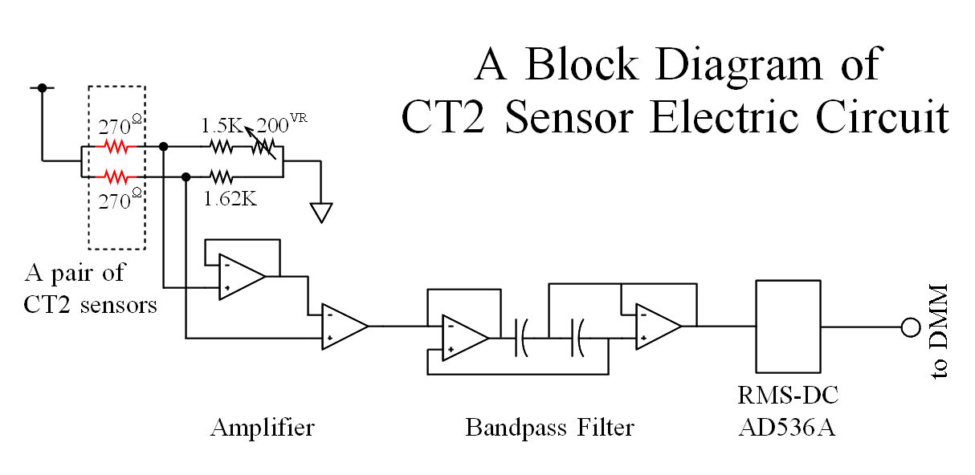
SiteSurveyWS_201204Beijing_Sasaki.pptx
China-Japan Collaborative Site Testing in West China
CT2 measurements at Karasu and at Oma
Temperature sensor
A pair of CT2 sensors w/ 25μm Ni wire
Temperature Structure Coefficient
Seeing estimated from C_{T}²

Slide 33
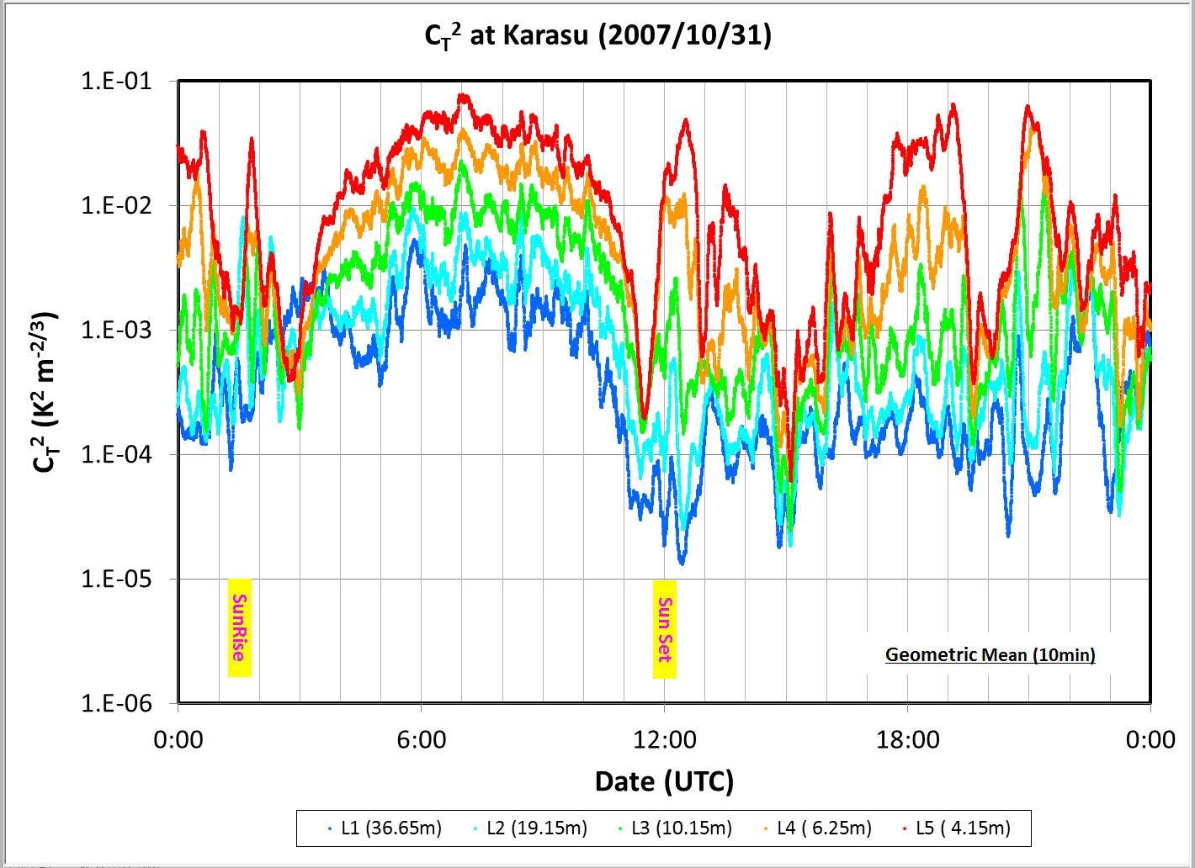
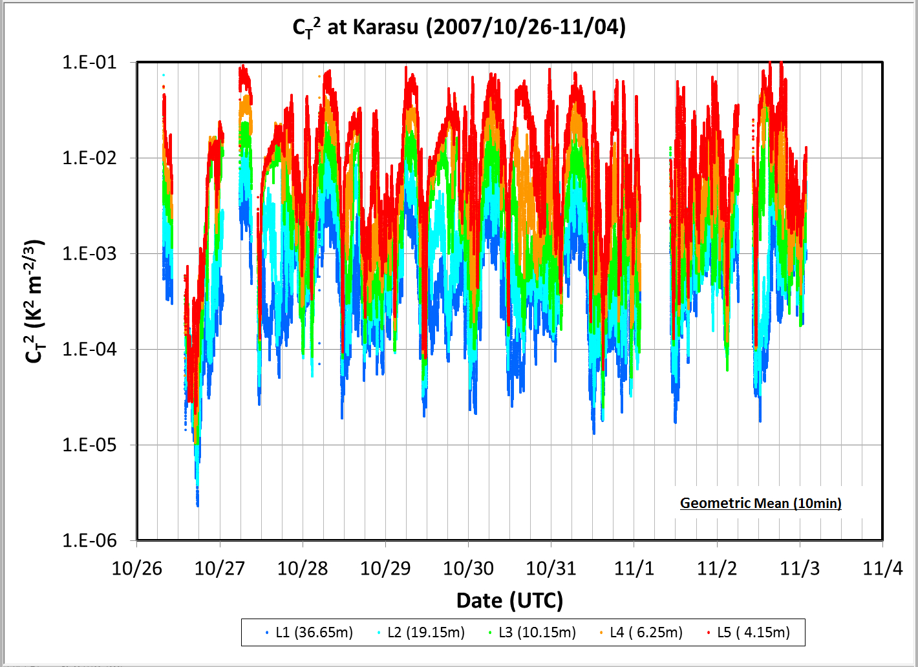
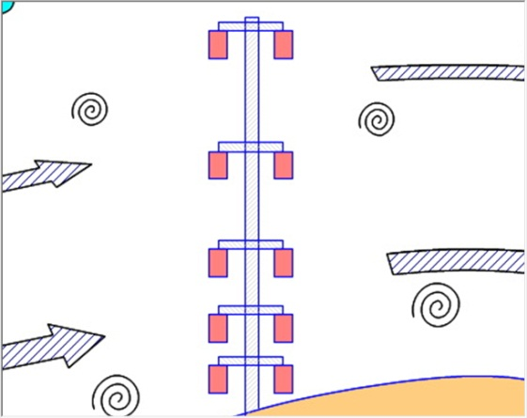
SiteSurveyWS_201204Beijing_Sasaki.pptx
China-Japan Collaborative Site Testing in West China
Micro-thermal turbulence detected with C_{T}² sensors
at Karasu
L1
36.65m
L2
19.15m
L3
10.15m
Daytime
Nighttime
L4
6.25m
L5
4.15m

Slide 34
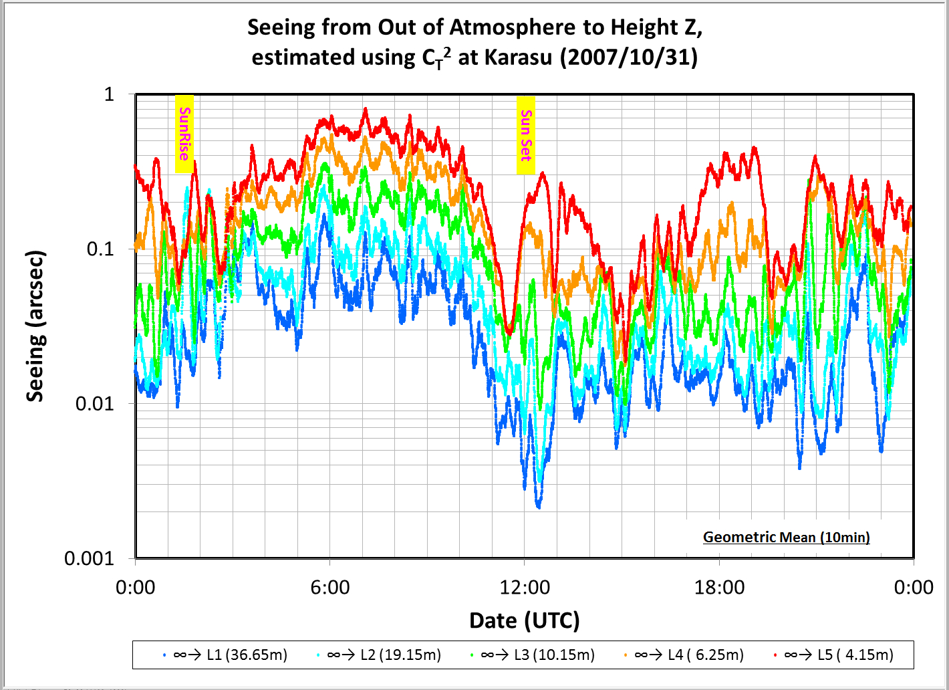
SiteSurveyWS_201204Beijing_Sasaki.pptx
China-Japan Collaborative Site Testing in West China
Image deterioration estimated with C_{T}² data
C_{T}² distribution
Image deterioration derived from C_{T}² distribution
at Karasu

Slide 35
SiteSurveyWS_201204Beijing_Sasaki.pptx
China-Japan Collaborative Site Testing in West China
Image deterioration estimated with C_{T}² data
at Karasu
L1
36.65m
L2
19.15m
L3
10.15m
Daytime
Nighttime
L4
6.25m
L5
4.15m

Slide 36
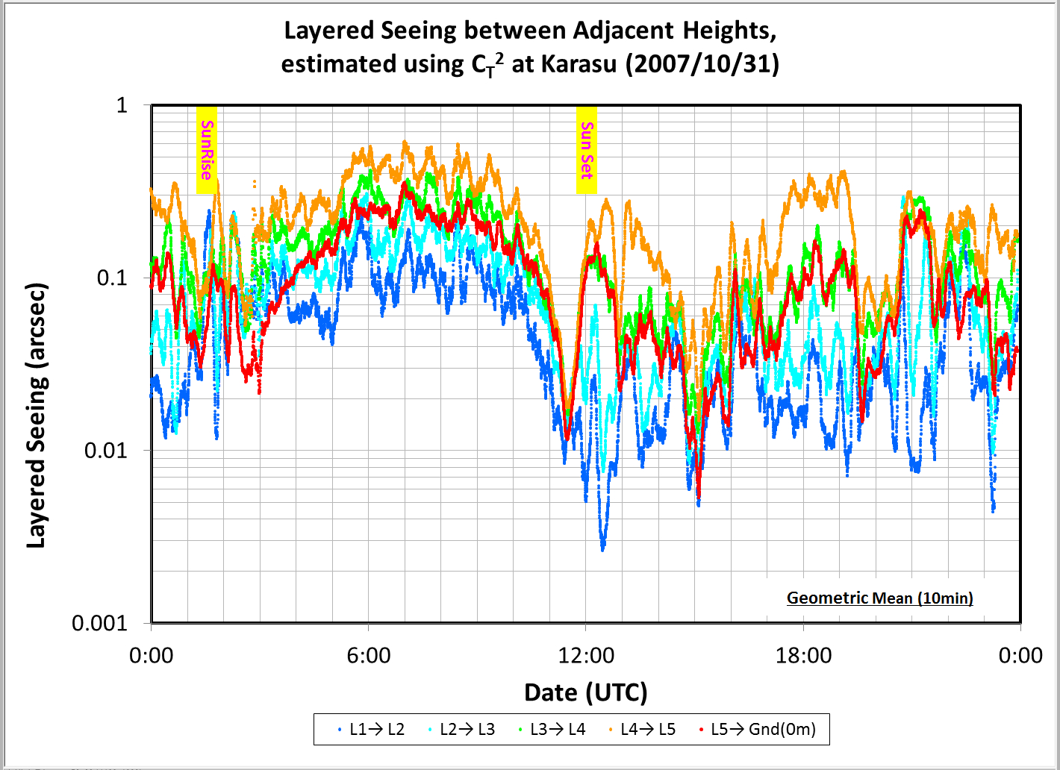
SiteSurveyWS_201204Beijing_Sasaki.pptx
China-Japan Collaborative Site Testing in West China
Layered Image deterioration estimated with C_{T}² data
at Karasu
L1
36.65m
L2
19.15m
Daytime
Nighttime
L3
10.15m
L4
6.25m
L5
4.15m
Local Image deterioration between heights of z1 and z0

Slide 37
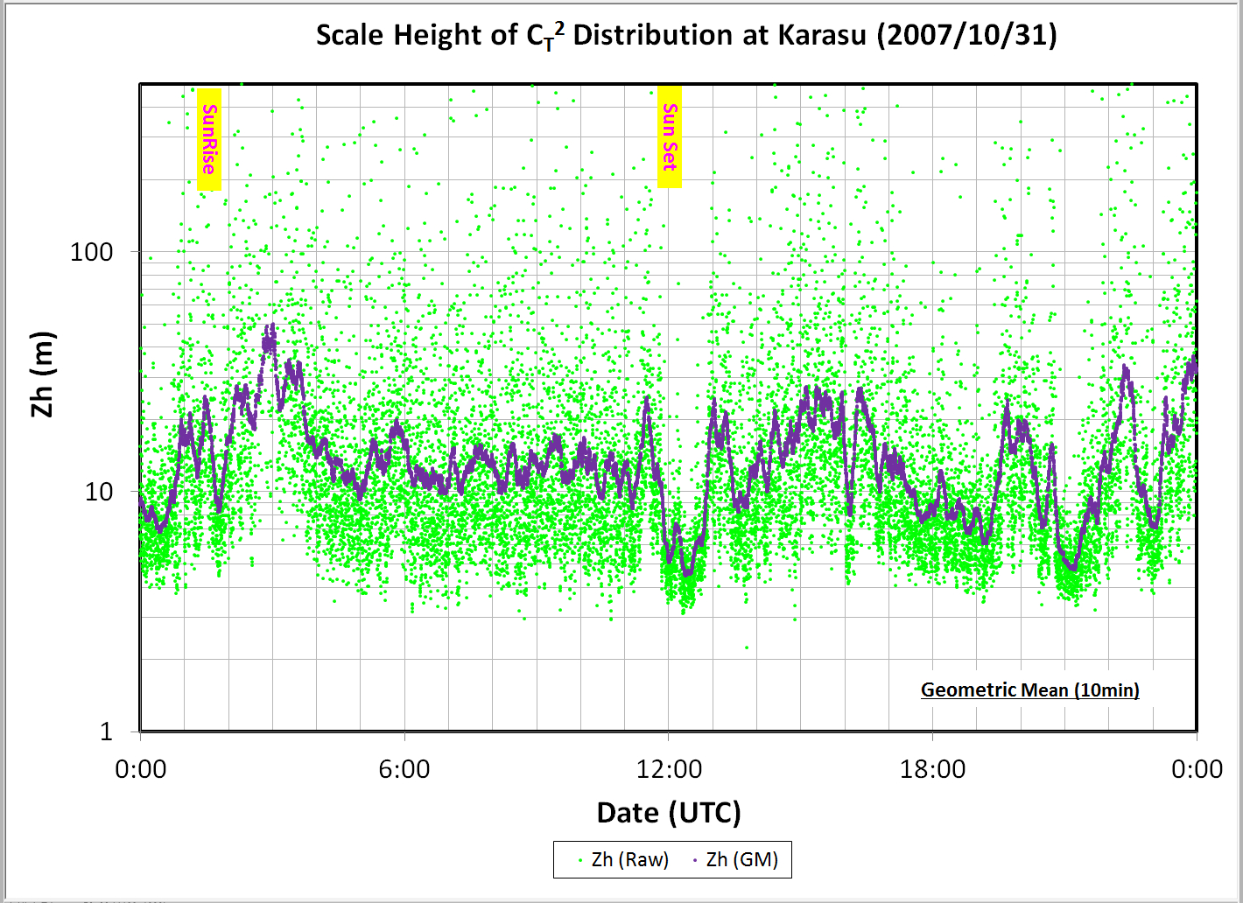
SiteSurveyWS_201204Beijing_Sasaki.pptx
China-Japan Collaborative Site Testing in West China
Scale Height of vertical distribution of C_{T}² data
derive Z_{h}
at Karasu

Slide 38
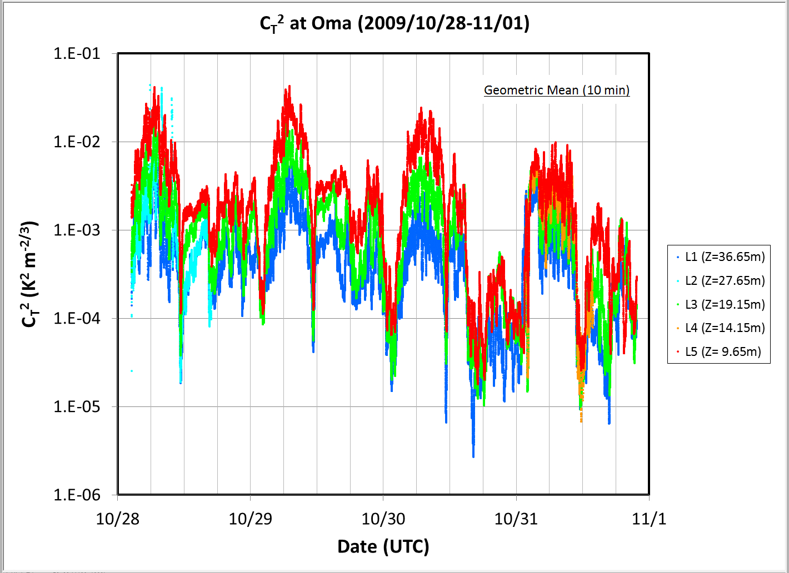
SiteSurveyWS_201204Beijing_Sasaki.pptx
China-Japan Collaborative Site Testing in West China
Micro-thermal turbulence detected with C_{T}² sensors
at Oma
L1
36.65m
L2
27.65m
L3
19.15m
L4
14.15m
L5
9.65m

Slide 39
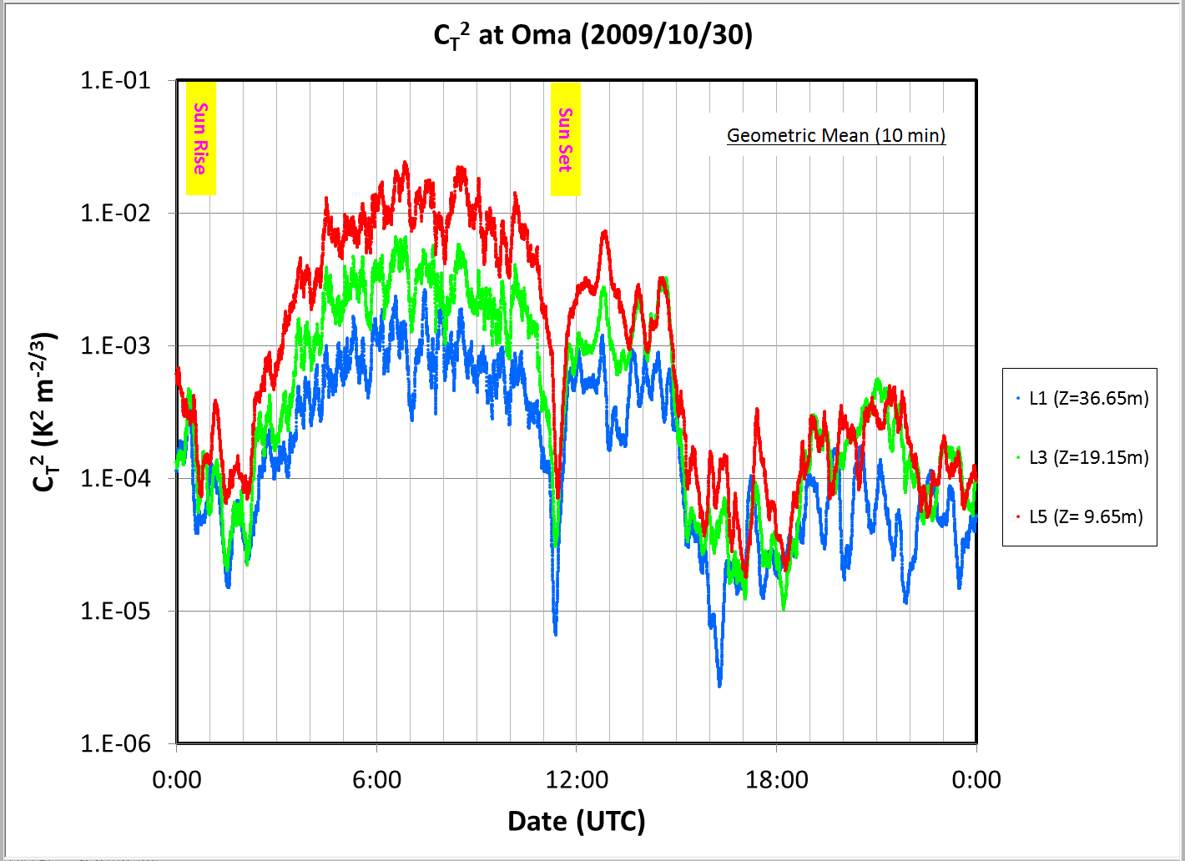

SiteSurveyWS_201204Beijing_Sasaki.pptx
China-Japan Collaborative Site Testing in West China
Image deterioration estimated with C_{T}² data
CT2 distribution
Image deterioration derived from CT2 distribution
at Oma

Slide 40

SiteSurveyWS_201204Beijing_Sasaki.pptx
China-Japan Collaborative Site Testing in West China
Image deterioration estimated with C_{T}² data
at Oma
L1
36.65m
L2
27.65m
L3
19.15m
L4
14.15m
L5
9.65m

Slide 41

SiteSurveyWS_201204Beijing_Sasaki.pptx
China-Japan Collaborative Site Testing in West China
Layered Image deterioration estimated with C_{T}² data
at Oma
L1
36.65m
L2
27.65m
L3
19.15m
L4
14.15m
L5
9.65m

Slide 42

SiteSurveyWS_201204Beijing_Sasaki.pptx
China-Japan Collaborative Site Testing in West China
Scale Height of vertical distribution of C_{T}² data
derive Z_{h}
at Oma

Slide 43

SiteSurveyWS_201204Beijing_Sasaki.pptx
China-Japan Collaborative Site Testing in West China
Micro-thermal turbulence detected with C_{T}² sensors
at OAO (Japan)
27m
22m
12m
6m
3.6m

Slide 44

SiteSurveyWS_201204Beijing_Sasaki.pptx
China-Japan Collaborative Site Testing in West China
Image deterioration estimated with C_{T}² data
CT2 distribution
Image deterioration derived from CT2 distribution
at OAO (Japan)

Slide 45
SiteSurveyWS_201204Beijing_Sasaki.pptx
China-Japan Collaborative Site Testing in West China
Image deterioration estimated with C_{T}² data
at OAO (Japan)
27m
22m
12m
6m
3.6m

Slide 46

SiteSurveyWS_201204Beijing_Sasaki.pptx
China-Japan Collaborative Site Testing in West China
Layered Image deterioration estimated with C_{T}² data
at OAO (Japan)
27m
22m
12m
6m
3.6m

Slide 47

SiteSurveyWS_201204Beijing_Sasaki.pptx
China-Japan Collaborative Site Testing in West China
Scale Height of vertical distribution of C_{T}² data
derive Z_{h}
at OAO (Japan)

Slide 48



SiteSurveyWS_201204Beijing_Sasaki.pptx
China-Japan Collaborative Site Testing in West China
Histogram of scale height, Z_{h} , of vertical C_{T}² distribution
at Karasu
CT2Karasu_20071026UT07H_20071115UT01_Seeing_10min_1.xlsx
at Oma
CT2Oma_20091028UT02H_20091111UT10H_Seeing_10min_1.xlsx
CT2Okayama_20080205UT01H_20080206UT00H_Seeing_10min_1.xlsx
Location | GM of Scale Height Zh (meter) | Z of 80%-ile (for Zh>0)
Karasu | 12 m | 16m (@72%)
Oma | 16 m | 30m (@61%)
OAO (Japan) | 13 m | 17m (@70%)
at OAO (Japan)

Slide 49


SiteSurveyWS_201204Beijing_Sasaki.pptx
China-Japan Collaborative Site Testing in West China
Histogram of image deterioration at Z_{h} estimated from C_{T}²
Location | Scale Height Zh (meter) | Image Deterio. at Zh (arcsec)
Karasu | 12 m | 0.14
Oma | 16 m | 0.08
OAO(Japan) | 13 m | 0.03
Ave: 0.14”
Ave: 0.08”
at Karasu
at Oma
CT2Karasu_20071026UT07H_20071115UT01_Seeing_10min_1.xlsx
CT2Oma_20091028UT02H_20091111UT10H_Seeing_10min_1.xlsx

Slide 50



SiteSurveyWS_201204Beijing_Sasaki.pptx
China-Japan Collaborative Site Testing in West China
Negative Zh means higher turbulent atmosphere caused by strong wind
at Oma
Negative Zh
CT2Oma_20091028UT02H_20091111UT10H_Seeing_10min_1.xlsx
Upper atmosphere should be measured on turbulent motions
with SNODAR (planned).

Slide 51

SiteSurveyWS_201204Beijing_Sasaki.pptx
China-Japan Collaborative Site Testing in West China
Comparison of image deterioration at Z_{h} with seeing by SBIG camera at Oma
SBIG
Camera
C_{T}²
CT2Oma_20091028UT02H_20091111UT10H_Seeing_10min_1.xlsx
CT2Oma_20091028UT02H_20091111UT10H_Seeing_10min_1.xlsx

Slide 52

SiteSurveyWS_201204Beijing_Sasaki.pptx
China-Japan Collaborative Site Testing in West China
Comparison of image deterioration at Z_{h} with seeing w/ SBIG camera at Oma
CT2Oma_20091028UT02H_20091111UT10H_Seeing_10min_1.xlsx
CT2Oma_20091028UT02H_20091111UT10H_Seeing_10min_1.xlsx

Slide 53

SiteSurveyWS_201204Beijing_Sasaki.pptx
China-Japan Collaborative Site Testing in West China
Weather data at Oma in 2008 and 2009
Daytime
Nighttime

Slide 54

SiteSurveyWS_201204Beijing_Sasaki.pptx
China-Japan Collaborative Site Testing in West China
Weather data at Oma in 2008 and 2009
Daytime
Nighttime

Slide 55

EACOA in Jeju (Korea), 2010
China-Japan Collaborative Site Testing in West China
SiteSurveyWS_201204Beijing_Sasaki.pptx
Collaborative Site Testing in West China ( Sasaki et al.)
Weather data at Oma in 2008 and 2009
14m/sec
7 m/sec
Daytime
Nighttime
Wind Speed in winter is typically strong at Oma, which affects local seeing.
For Subaru telescope, operation is limited under Wind Speed of 14 m/sec
and its perfromance is guranteed under 7m/sec.

Slide 56

EACOA in Jeju (Korea), 2010
China-Japan Collaborative Site Testing in West China
SiteSurveyWS_201204Beijing_Sasaki.pptx
Collaborative Site Testing in West China ( Sasaki et al.)
Weather Direction at Oma in 2008 and 2009

Slide 57

SiteSurveyWS_201204Beijing_Sasaki.pptx
China-Japan Collaborative Site Testing in West China
Sky is clear or fine?
Relation among C_{T}² distribution
and Wind Speed
(2009-10-31 at Oma)
Wind Speed
Temperature
Z:\00SiteSurveyData\000_aSiteSurveySummary\
Oma_20091031_CT2_Seeing_WindSpeed_Temp.jpg

Slide 58

SiteSurveyWS_201204Beijing_Sasaki.pptx
China-Japan Collaborative Site Testing in West China
Sky is clear or fine?
Relation among C_{T}² distribution
and Wind Speed
(2009-10-31 at Oma)
Zh histogram
Wind Speed
Temperature
Z:\00SiteSurveyData\000_aSiteSurveySummary\
Oma_20091031_CT2_Seeing_WindSpeed_Temp.jpg

Slide 59

SiteSurveyWS_201204Beijing_Sasaki.pptx
China-Japan Collaborative Site Testing in West China
Earthquake in China
SeismicBigMagCentralAsia_USGS.gif

Slide 60

Candidate Site in Tibet from Satellite Data Site Survey WS at Lhasa, July, 2004
Seismic activity in Tibet
Data from GAME-Tibet project
20060506_SasakiCandidateSiteInTibet.ppt

Slide 61
SiteSurveyWS_201204Beijing_Sasaki.pptx
China-Japan Collaborative Site Testing in West China
MIR CloudMonitor
Clear sky ratios at Oma, except summer monsoon season, are around 70%, which are comparable to at Mauna Kea, Hawaii, and much bettre than at Okayama, Japan.
Subaru : statistics during 2000-2010
OAO: summary report during 2008-2009
C_{T}² measurements
Location | Scale Height Zh (meter) | Image Deterio. at Zh (arcsec)
Karasu | 12 m | 0.14
Oma | 16 m | 0.08
OAO (Japan) | 13 m | 0.03
should evaluate bad effect
of Strong wind at the sites

Slide 62

SiteSurveyWS_201204Beijing_Sasaki.pptx
China-Japan Collaborative Site Testing in West China
On-going Collaborative Site Testing at Ali
Item | Instrument |  | Status
Weather condition | Vaisala:WXT510 |  | Working at Ali
Sky condition | MIR Cloud Mon Visible all-sky camera |  | Working at Ali Working at Ali
Dust | Dust Counter TSI:DustTrak8520 |  | Working at Ali
DIMM | (NAOC) |  | Working (need Manual Operations)
SCIDAR | (NAOC) |  | Working (need Manual Operations)
Surface Layer Turbulence | CT2 sensors on tower |  | Constructed soon this year
Turbulence in upper layer | SNODAR |  | Planning (tomorrow talk)
Housing | w/ electric power |  | Available at Ali
 | O₂ supply |  | Comfortable at 5100m !
Road |  |  | need 4WD
Internet | LAN |  | Planned (not yet available stably)
apply site testing instruments with analysis tools to evaluate observational conditions at Ali for years.

Slide 63

SiteSurveyWS_201204Beijing_Sasaki.pptx
China-Japan Collaborative Site Testing in West China
The End
謝謝、ありがとう、Thank you！

Slide 64
SiteSurveyWS_201204Beijing_Sasaki.pptx
China-Japan Collaborative Site Testing in West China
Possible Telescope plan at Ali site
After we evaluate and confirm the good condition around Ali,
We’d like to promote to deploy a small telescope w/observation instruments.
- 1m 〜2m Telescope, like TAO 1m telescope made by NISHIMURA’s.
- Optical Imaging/Spectroscopic/Polarimetric Instrument,
like Hiroshima-U’s HOWPol
( HOWPol use two Optical CCDs, which are exported into China easily even now. )
And also we like to introduce a possible 4m telescope near Ali.
A Copy of Kyoto-U 3.8m telescope, under development to install at OAO, Japan.
- Now negotiating to make a copy with Kyoto-U leading people.

Slide 65

SiteSurveyWS_201204Beijing_Sasaki.pptx
China-Japan Collaborative Site Testing in West China
Kyoto 3.8m telescope, possibly installed in west China
http://www.kusastro.kyoto-u.ac.jp/~nagata/Kyoto3m/
- Fan-shaped segmented 18 mirros
light-weighted truss structure
1st light in 2014(?)
Notes:
車サイズ～1.8m-2.0m 望遠鏡3．8mなので少し大きい表示!

Slide 66

SiteSurveyWS_201204Beijing_Sasaki.pptx
China-Japan Collaborative Site Testing in West China

Slide 67

Mount of Kyoto 3.8m Telescope
従来の1/5程度の質量
weight～1/5 nomial Telescope
  鏡筒質量8トン（うち構造物：4トン）
54個の主鏡支持点での相対変形<100 μm
relative deformation <100 μm
遺伝的アルゴリズムによる最適化プログラムを開発し、構造の最適化を行った。
Hereditary algorithm
-> Structure optimized (patented)
  高速 駆動 High-speed drive
  低 熱容量 low thermal capacity
  低 熱慣性 low thermal inertia
  低 風抵抗 low wind resistance

Slide 68









計測 Mirror measurement
コリメータ
ハーフミラー
非球面波面の生成に
CGHを使用
イメージングレンズ
被検光と参照光の光路長が等しい
被検面と参照面を近接して配置
参照面
セグメント鏡（曲率半径～10m）

Slide 69





Structure optimized with Hereditary algorithm and its FEM analysis
初期解
最適解の一例
0%
200%
許容変形量

Slide 70



２．分割鏡の制御
分割鏡制御の要素
Control of segmented mirrors
光学センサ：鏡の向きと段差を計測
ギャップセンサ：鏡の段差を計測
支持機構、アクチュエータ：鏡を支持し駆動
プロセッサ：センサ値から指令値を算出
Optical sensors
gap sensors
Support and actuators
Control Processors
鏡
支持機構
支持機構
センサ
アクチュエータ
アクチュエータ
プロセッサ
図5.28 自己位相測定の方法。
焦点から照射した光の一部をハーフミラーで戻すことで2鏡面での干渉を調べる。

Slide 71

SiteSurveyWS_201204Beijing_Sasaki.pptx
China-Japan Collaborative Site Testing in West China
Possible Telescope plan at Ali site
Telescope located covering global telescope network
Follow-up observation of GRB to find primordial objects
in the early universe and reveal its characteristics
continuous observations of Blazar, Supernova, nova, X-ray binaries,
cataclysmic variables, variable stars, so on.
- Proper astronomical observations for Asian astronomers
GRB 090423, z=8.2
13.0 billion l.y.
(GRB 090423 : Most distant galaxies ever detected : z= 8.2, 13 b.l.y. )

Slide 72







SiteSurveyWS_201204Beijing_Sasaki.pptx
China-Japan Collaborative Site Testing in West China
〜1m Tel
for Asian Astronomers in coming era
⇒〜4m Tel
Ali > 5000 m
Mauna Kea
4200 m
謝謝、ありがとう、Thank you！
Mauna Kea, viewed from Wailoa Park, Hilo
Mauna Kea, viewed from Wailoa Park, Hilo

Slide 73
SiteSurveyWS_201204Beijing_Sasaki.pptx
China-Japan Collaborative Site Testing in West China
The End
謝謝、ありがとう、Thank you！

Slide 74
SiteSurveyWS_201204Beijing_Sasaki.pptx
China-Japan Collaborative Site Testing in West China

Slide 75



Telescope Array at Oma North
SiteSurveyWS_201204Beijing_Sasaki.pptx
China-Japan Collaborative Site Testing in West China
--- Time sequence of Telescope construction
1st 8m Tel on the site ～ 2020?
2nd 30m Tel
2m Tel for site evaluation ～ 2015?
1st 30m Tel
～ 2030?
30m Tels more … ～ 2040?
8m Tels more … ～ 2025?
launch Interferometry
～ 2030?

Slide 76




SiteSurveyWS_201204Beijing_Sasaki.pptx
China-Japan Collaborative Site Testing in West China
Coordinated observations
between Subaru and Telescopes at Oma
Network connection
Discover New Object
～SN in solar neighberhood!!!
Time Lag about 9h
midnight @ MKO
3pm @Oma
Arrange spectroscopic or
Interferometric observations

Slide 77

UTs’ random observations and coordinated observation
SiteSurveyWS_201204Beijing_Sasaki.pptx
China-Japan Collaborative Site Testing in West China

Slide 78
Optical Interferometry 光干渉計
30m Tellescopes 5 ( 10 base lines ) with help of earth rotation, increases base line data
→ Apply mapping method for image reconstruction
Technical developments
・methods for atmospheric dispersion correction (ADC)
・Interferometry with AO
→ Detailed studies are necessary to promote AOTA.
SiteSurveyWS_201204Beijing_Sasaki.pptx
China-Japan Collaborative Site Testing in West China
Merits of Telescope Array
・Each organization possesses own telescope
uses own telescope for their science
・Coordinated operation of Telescope Array for Interferometry
enable high resolution observation, compared to JWST
more faint objects observable than JWST
・Own(80%) vs coordinated(20%) : need MoU

Slide 79

SiteSurveyWS_201204Beijing_Sasaki.pptx
China-Japan Collaborative Site Testing in West China
Which configuration we select ?
One 30m + Several 8m
Two 30m + Several 8m
Several 30m + Several 8m
Visibility lower middle higher
Mag(limit) less faint faint more faint
Cost high higher highest
Feasibility possible maybe possible difficult ??

Slide 80
SiteSurveyWS_201204Beijing_Sasaki.pptx
China-Japan Collaborative Site Testing in West China
Cost Estimatation
Site development US$ 10M ← MEX budget*
2m telescope US$ 5M ← MEX budget*
8m telescope US$200M ← fund?
Instruments US$100M ← fund?
30m telscope US$600M ← fund?
Instruments US$300M ← MEX budget*
AOTAI US$500M ← fund?
Operation US$100M/year ← fund?
*MEX is not so rich, so we find other funds to build AOTA !

Slide 81

SiteSurveyWS_201204Beijing_Sasaki.pptx
China-Japan Collaborative Site Testing in West China

Slide 82
SiteSurveyWS_201204Beijing_Sasaki.pptx
China-Japan Collaborative Site Testing in West China
The End
謝謝、ありがとう、Thank you！

