Slide 1
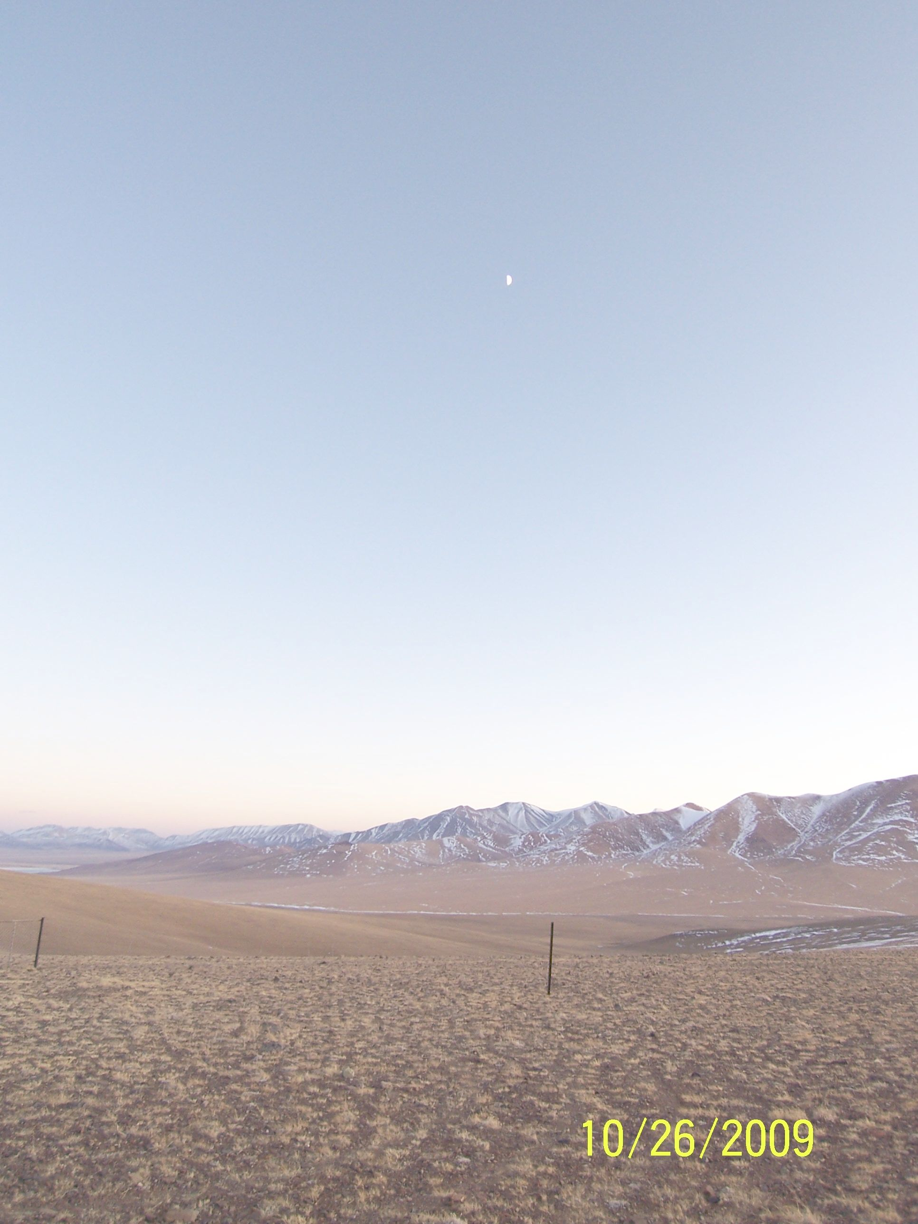
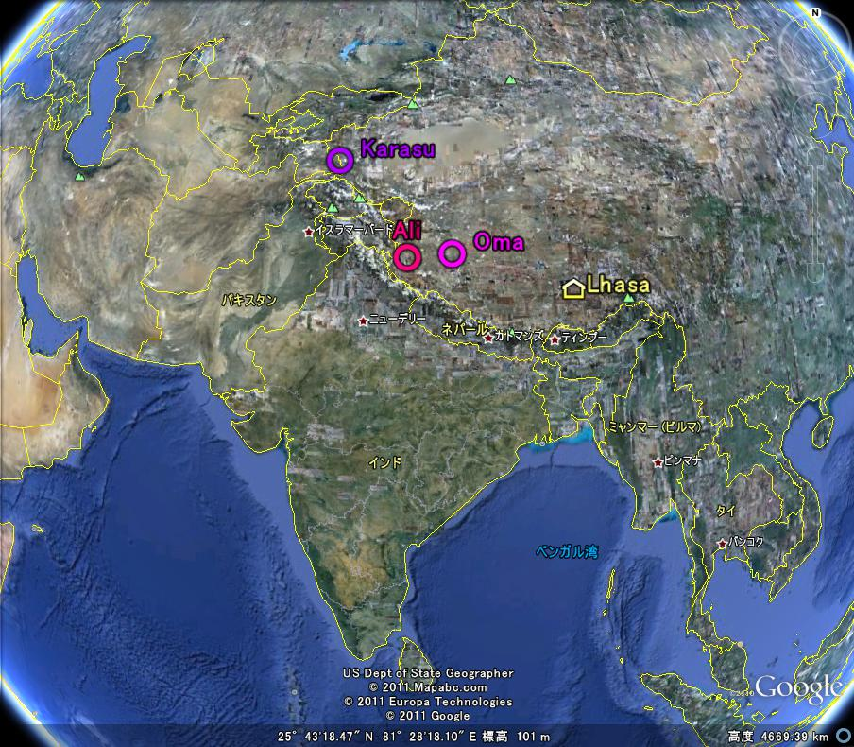
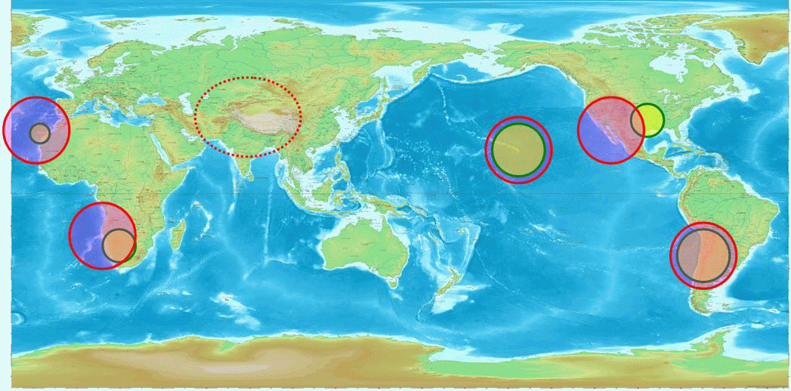
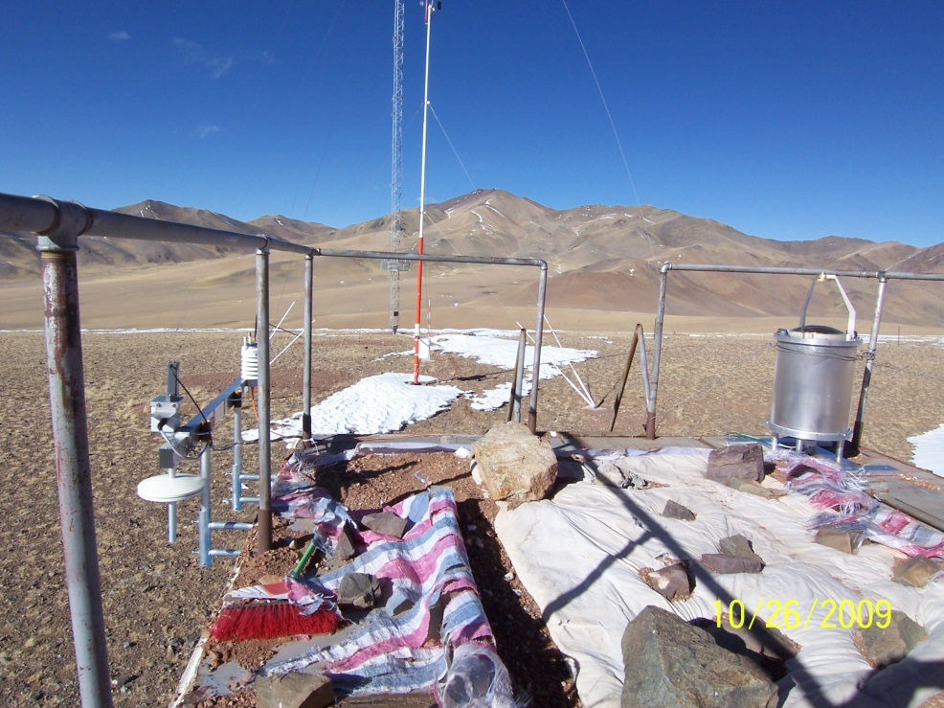
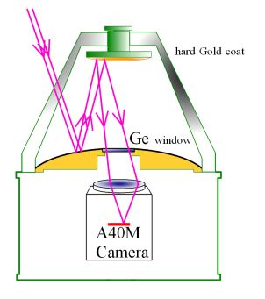
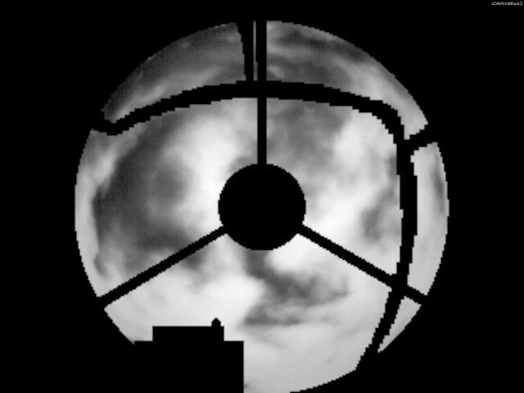
A China-Japan Collaborative Site Survey in west Tibet Sky clearness at Oma, Tibet
S7P10
(slide#1)
Toshiyuki Sasaki (NAOJ), Yongqiang Yao (NAOC), Michitoshi Yoshida (Hiroshima-U), Norio Ohshima, Yoshitaka Mikami, Norio Okada, Hisashi Koyanao, Kazuhiro Sekiguchi (NAOJ), Liyong Liu, Lin Li (NAOC)
A site in west Tibet is in an important location for global astronomical observation network
sites in west China; Karasu and Oma
CT2 sensor on 40m tower
N
Cloud Monitor camera
Weather station
and
Barometer
E
Instruments at Oma site
Sky image taken w/ Cloud Monitor

Slide 2
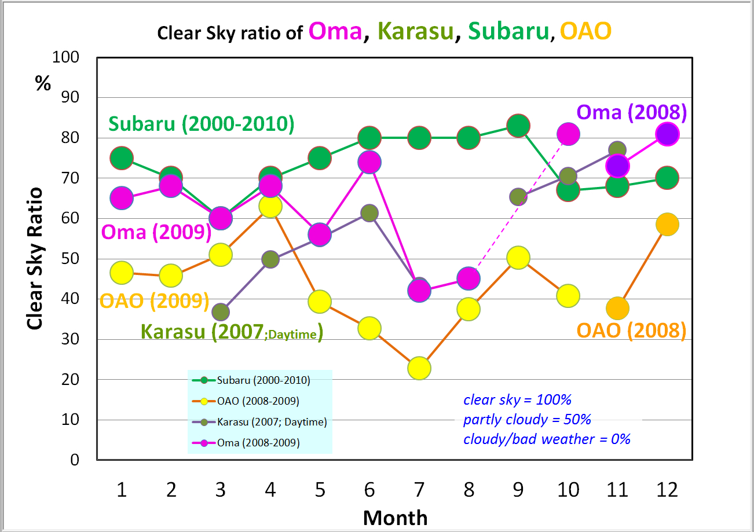
S7P10: A China-Japan Collaborative Site Survey in west Tibet: Sky clearness at Oma, Tibet (Sasaki et al.) (slide#2)
Clear sky ratios at Oma, except summer monsoon season, are around 70%, which are comparable to at Mauna Kea, Hawaii, and much bettre than at Okayama, Japan.

